Slide 1


PSI-theory working session
Duarte Gouveia
EEWC 2017 Antwerp
May 9, 2017

Slide 2
What is this session about?
PSI theory, version 4.2
What as changed?
What is still a problem?
Are there unhandled requirements?
How can it be improved?
What else?
Notes

Slide 3
Why are “you” presenting this?
Long emails in the review of this version of PSI theory

Slide 4
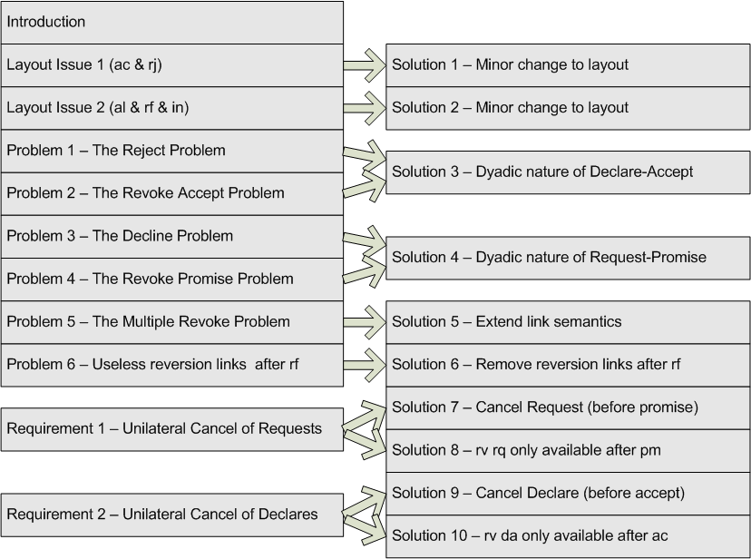
Map Page 1/2
Presentation Outline
We are
here
Notes

Slide 5
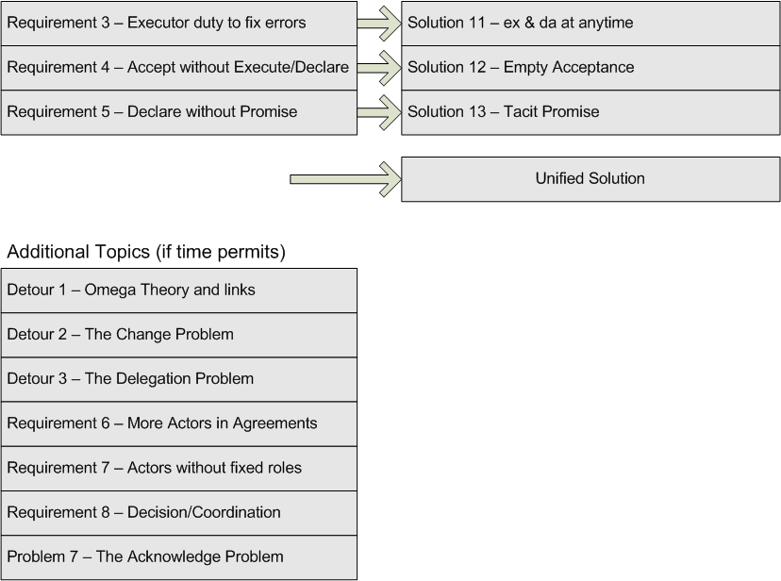
Map Page 2/2
Presentation Outline
Notes

Slide 6
Will the solution be too complex?
Diagram Elements | Current version (4.2) | Proposed version
Acts | 19 | 23
Facts | 28 | 15
Response links | 20 | 32
Causal links | 18 | 16
Wait links | 4 | 0
Reversion links | 7 | 4
Totals | 96 | 91
-5,2%Notes

Slide 7
Presentation Outline
2 layout issues
7 problems
8 requirements
3 detours
13 solutions
1 unified solution
90 minutes to present it and discuss it
Notes

Slide 8
What has changed?
(since 2015 version 2.0)
Text better explains the PSI theory in general
State (st) is now called Declare (da)
Quit and Stop acts/facts were eliminated
Reversiogenic Transactions are better defined
Conversations: Cogitatiogenic, Actagenic, Factagenic, Reversiogenic
“The PSI Theory – understanding human collaboration”, version 4.2

Slide 9
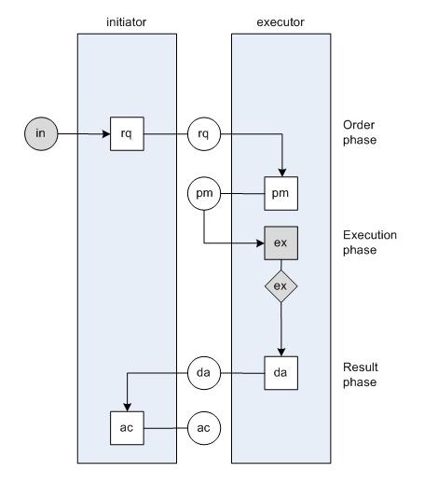
Notes
As shown in Figure 7 in “The PSI Theory – understanding human collaboration”, version 4.2

Slide 10
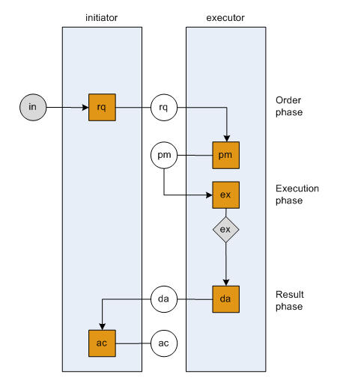
Seeing it as a Petri-Net
Acts (DEMO)
Transitions (Petri-Net)
Events (State Machine)
Edges (Graph Theory)
Notes

Slide 11
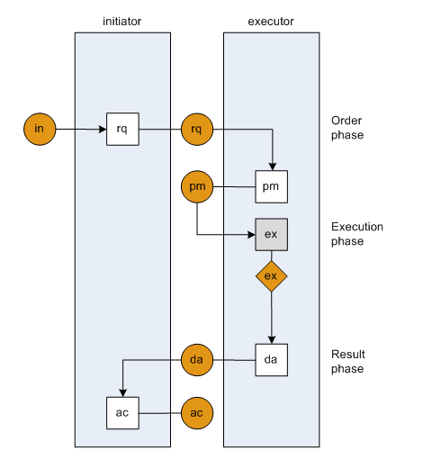
Seeing it as a Petri-Net
“usually external to the transaction”
Page 15, version 4.2
Combined “to save space”
Page 17, version 4.2
Facts (DEMO)
Places (Petri-Net)
States (State Machine)
Vertices (Graph Theory)
Notes

Slide 12
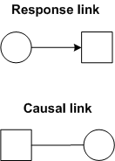
Seeing it as a Petri-Net
Notes

Slide 13
Seeing it as a Petri-Net
Notes

Slide 14
Seeing it as a Petri-Net
Notes

Slide 15
Seeing it as a Petri-Net
Notes

Slide 16
Seeing it as a Petri-Net
Notes

Slide 17
Seeing it as a Petri-Net
Notes

Slide 18
Seeing it as a Petri-Net
Notes

Slide 19
Seeing it as a Petri-Net
Notes

Slide 20
Seeing it as a Petri-Net
Getting back to the executed fact…
Notes

Slide 21
Seeing it as a Petri-Net
Mismatch between
Initiator and executor views
(Addressed at Solution 11)
Notes
Pending issues: 1

Slide 22
Map Page 1/2
Presentation Outline
We are
here
Notes

Slide 23
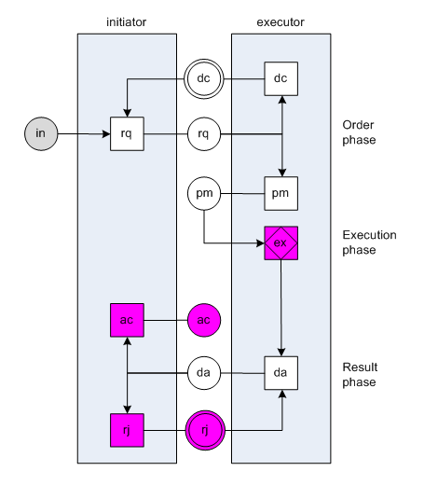
Layout Issue 1 – Minor change of layout
Notes
As shown in Figure 8 in “The PSI Theory – understanding human collaboration”, version 4.2

Slide 24
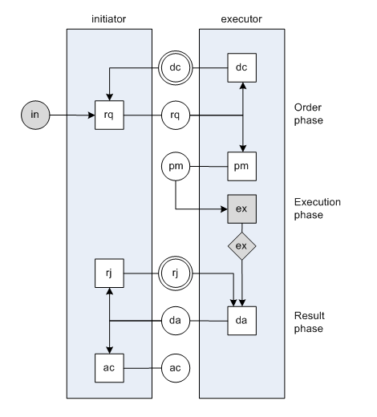
Solution 1 – Minor change of layout
Notes
Adapted from Figure 8 in “The PSI Theory – understanding human collaboration”, version 4.2

Slide 25
Map Page 1/2
Presentation Outline
We are
here
Notes

Slide 26
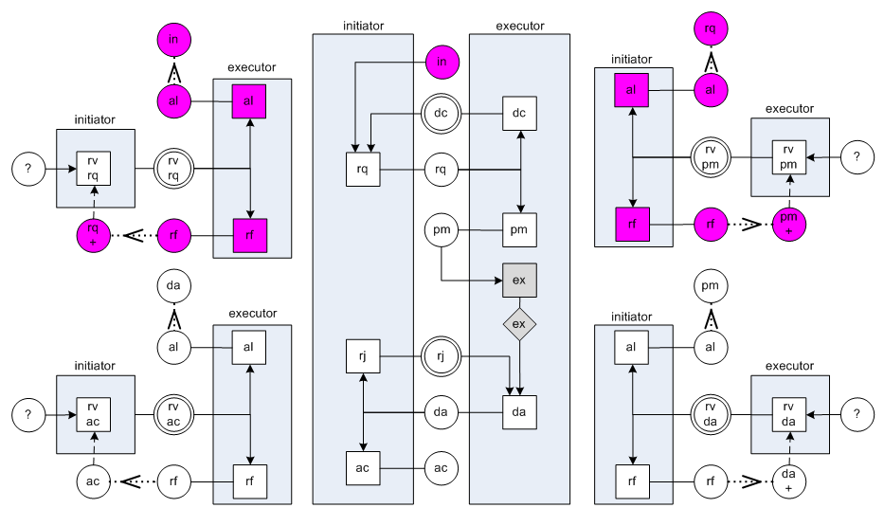
Layout Issue 2 – Minor change of layout
Notes
Adapted from Figure 10 in “The PSI Theory – understanding human collaboration”, version 4.2

Slide 27
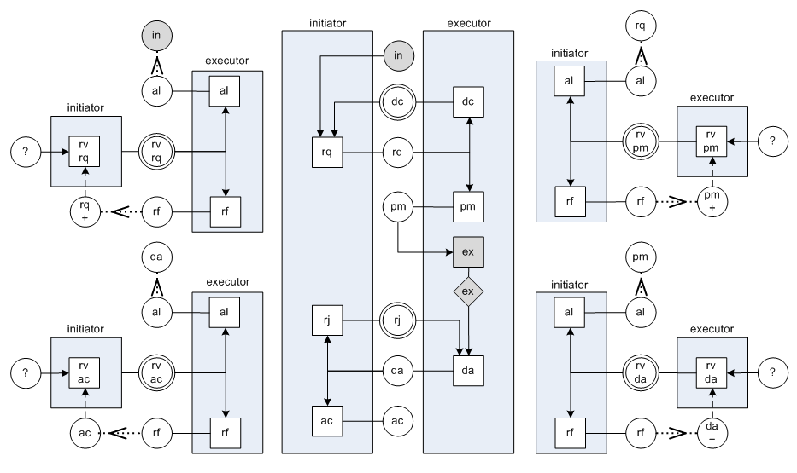
Solution 2 – Minor change of layout
Notes
Adapted from Figure 10 in “The PSI Theory – understanding human collaboration”, version 4.2

Slide 28
Map Page 1/2
Presentation Outline
We are
here
Notes

Slide 29
Problem 1 – The Reject Problem
Notes
Adapted from Figure 10 in “The PSI Theory – understanding human collaboration”, version 4.2

Slide 30
Problem 1 – The Reject Problem
Notes
Adapted from Figure 10 in “The PSI Theory – understanding human collaboration”, version 4.2

Slide 31
Problem 1 – The Reject Problem
Notes
Adapted from Figure 10 in “The PSI Theory – understanding human collaboration”, version 4.2

Slide 32
Problem 1 – The Reject Problem
Notes
Adapted from Figure 10 in “The PSI Theory – understanding human collaboration”, version 4.2

Slide 33
Problem 1 – The Reject Problem
Notes
Adapted from Figure 10 in “The PSI Theory – understanding human collaboration”, version 4.2

Slide 34
Problem 1 – The Reject Problem
Two options: either declare or revoke declare
Notes
Adapted from Figure 10 in “The PSI Theory – understanding human collaboration”, version 4.2

Slide 35
Problem 1 – The Reject Problem
Two options: either declare or revoke declare
Option 1: da (without rv previous da)
Notes
Adapted from Figure 10 in “The PSI Theory – understanding human collaboration”, version 4.2

Slide 36
Problem 1 – The Reject Problem
Two options: either declare or revoke declare
Option 2: rv da
Notes
Adapted from Figure 10 in “The PSI Theory – understanding human collaboration”, version 4.2

Slide 37
Problem 1 – The Reject Problem
Two options: either declare or revoke declare
Option 2: rv da
Notes
Adapted from Figure 10 in “The PSI Theory – understanding human collaboration”, version 4.2

Slide 38
Option 2: rv da
Two options: allow or refuse
Asking the same question twice?
Problem 1 – The Reject Problem
Notes
Adapted from Figure 10 in “The PSI Theory – understanding human collaboration”, version 4.2

Slide 39
Option 2: rv da
Two options: allow or refuse
Asking the same question twice?
Problem 1 – The Reject Problem
Notes
Response link?
Adapted from Figure 10 in “The PSI Theory – understanding human collaboration”, version 4.2

Slide 40
Map Page 1/2
Presentation Outline
We are
here
Notes

Slide 41
Problem 2 – The Revoke Accept Problem
Notes
Adapted from Figure 10 in “The PSI Theory – understanding human collaboration”, version 4.2

Slide 42
Problem 2 – The Revoke Accept Problem
Notes
Adapted from Figure 10 in “The PSI Theory – understanding human collaboration”, version 4.2

Slide 43
Problem 2 – The Revoke Accept Problem
Notes
The only possible status is da!
Response link?
Adapted from Figure 10 in “The PSI Theory – understanding human collaboration”, version 4.2

Slide 44
Problem 2 – The Revoke Accept Problem
Notes
Adapted from Figure 10 in “The PSI Theory – understanding human collaboration”, version 4.2

Slide 45
How to move from here?
Two Options: reject or revoke declare
Problem 2 – The Revoke Accept Problem
Notes
Adapted from Figure 10 in “The PSI Theory – understanding human collaboration”, version 4.2

Slide 46
How to move from here?
Two Options: reject or revoke declare
Option 1: rj doesn’t make sense (problem 1)
Problem 2 – The Revoke Accept Problem
Notes
Adapted from Figure 10 in “The PSI Theory – understanding human collaboration”, version 4.2

Slide 47
How to move from here?
Two Options: reject or revoke declare
Option 2: rv da is repeating the same question
Problem 2 – The Revoke Accept Problem
Notes
Adapted from Figure 10 in “The PSI Theory – understanding human collaboration”, version 4.2

Slide 48
Solution 3 – Dyadic Nature of declare-accept
Declare and Accept are dyadic by nature
You only have one to get to the other.
Revoking one is the same as revoking both.
Rejecting is the same as revoking both.
Notes

Slide 49
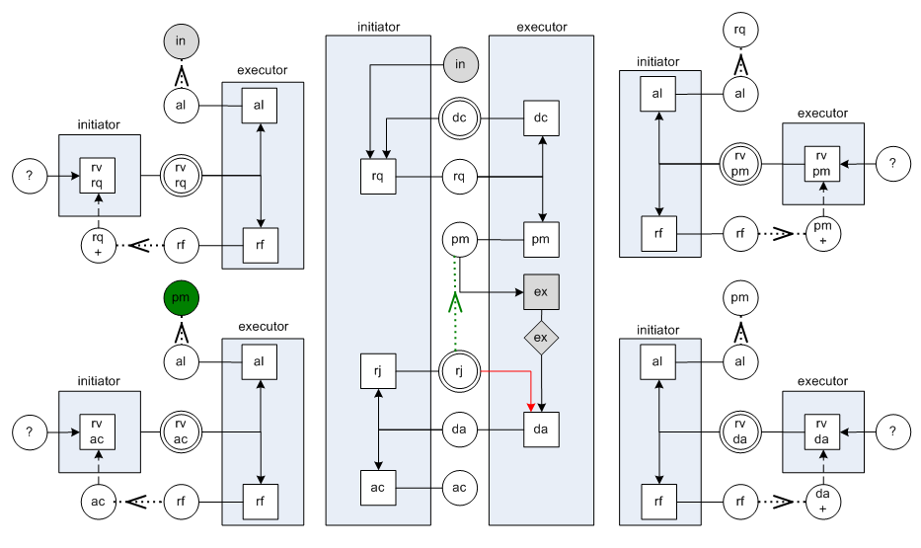
Solution 3 – Dyadic Nature of declare-accept
Notes
Adapted from Figure 10 in “The PSI Theory – understanding human collaboration”, version 4.2

Slide 50
New Pending Issue:
Do we need to always execute again?
(Addressed at Unified Solution)
Solution 3 – Dyadic Nature of declare-accept
Notes
Pending issues: 2

Slide 51
Map Page 1/2
Presentation Outline
We are
here
Notes

Slide 52
Problem 3 – The Decline Problem
Notes
Adapted from Figure 10 in “The PSI Theory – understanding human collaboration”, version 4.2

Slide 53
Problem 3 – The Decline Problem
Notes
Adapted from Figure 10 in “The PSI Theory – understanding human collaboration”, version 4.2

Slide 54
Problem 3 – The Decline Problem
Notes
Adapted from Figure 10 in “The PSI Theory – understanding human collaboration”, version 4.2

Slide 55
Two options, same result:
Option 1: request (without revoking previous request)
Option 2: revoke request (addressed as Solution 8)
Problem 3 – The Decline Problem
Notes
Adapted from Figure 10 in “The PSI Theory – understanding human collaboration”, version 4.2

Slide 56
Map Page 1/2
Presentation Outline
We are
here
Notes

Slide 57
Problem 4 – The Revoke Promise Problem (similar to the Revoke Accept problem)
Notes
Adapted from Figure 10 in “The PSI Theory – understanding human collaboration”, version 4.2

Slide 58
Problem 4 – The Revoke Promise Problem (similar to the Revoke Accept problem)
Notes
Adapted from Figure 10 in “The PSI Theory – understanding human collaboration”, version 4.2

Slide 59
Problem 4 – The Revoke Promise Problem (similar to the Revoke Accept problem)
Notes
Adapted from Figure 10 in “The PSI Theory – understanding human collaboration”, version 4.2

Slide 60
Problem 4 – The Revoke Promise Problem (similar to the Revoke Accept problem)
Response link?
Notes
Adapted from Figure 10 in “The PSI Theory – understanding human collaboration”, version 4.2

Slide 61
Problem 4 – The Revoke Promise Problem (similar to the Revoke Accept problem)
Notes
Adapted from Figure 10 in “The PSI Theory – understanding human collaboration”, version 4.2

Slide 62
Problem 4 – The Revoke Promise Problem (similar to the Revoke Accept problem)
Notes
Adapted from Figure 10 in “The PSI Theory – understanding human collaboration”, version 4.2

Slide 63
Problem 4 – The Revoke Promise Problem (similar to the Revoke Accept problem)
How to move from here?
Two Options: decline or revoke request
Notes
Adapted from Figure 10 in “The PSI Theory – understanding human collaboration”, version 4.2

Slide 64
Problem 4 – The Revoke Promise Problem (similar to the Revoke Accept problem)
How to move from here?
Option 1: decline (doesn’t make sense after an rv pm)
Notes
Adapted from Figure 10 in “The PSI Theory – understanding human collaboration”, version 4.2

Slide 65
Problem 4 – The Revoke Promise Problem (similar to the Revoke Accept problem)
How to move from here?
Option 2: rv rq also doesn’t make sense (repeating question)
Notes
Adapted from Figure 10 in “The PSI Theory – understanding human collaboration”, version 4.2

Slide 66
Solution 3 – Dyadic Nature of declare-accept
Request and Promise are dyadic by nature
You only have one to get to the other.
Revoking one is the same as revoking both.
Declining is the same as revoking both.
Notes

Slide 67
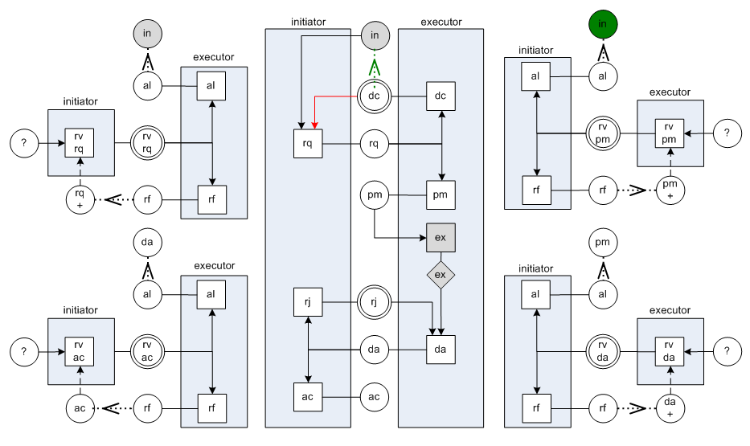
Solution 4 – Dyadic Nature of request-promise
Notes
Adapted from Figure 10 in “The PSI Theory – understanding human collaboration”, version 4.2

Slide 68
Map Page 1/2
Presentation Outline
We are
here
Notes

Slide 69
Problem 5 – The Multiple Revoke Problem
Notes
Adapted from Figure 10 in “The PSI Theory – understanding human collaboration”, version 4.2

Slide 70
Problem 5 – The Multiple Revoke Problem
Revoke Accept
Notes
Adapted from Figure 10 in “The PSI Theory – understanding human collaboration”, version 4.2

Slide 71
Problem 5 – The Multiple Revoke Problem
Revoke Declare
Notes
Adapted from Figure 10 in “The PSI Theory – understanding human collaboration”, version 4.2

Slide 72
Problem 5 – The Multiple Revoke Problem
Revoke Promise
Notes
Adapted from Figure 10 in “The PSI Theory – understanding human collaboration”, version 4.2

Slide 73
Problem 5 – The Multiple Revoke Problem
Revoke Request
Notes
Adapted from Figure 10 in “The PSI Theory – understanding human collaboration”, version 4.2

Slide 74
Problem 5 – The Multiple Revoke Problem
Revoke Accept x 2
Notes
Adapted from Figure 10 in “The PSI Theory – understanding human collaboration”, version 4.2

Slide 75
Problem 5 – The Multiple Revoke Problem
Allow Revoke Declare
Notes
Adapted from Figure 10 in “The PSI Theory – understanding human collaboration”, version 4.2

Slide 76
Problem 5 – The Multiple Revoke Problem
Allow Revoke Declare
Notes
Adapted from Figure 10 in “The PSI Theory – understanding human collaboration”, version 4.2

Slide 77
Problem 5 – The Multiple Revoke Problem
Notes
After Allow Revoke Declare
Revoke Accept must be terminated!
Adapted from Figure 10 in “The PSI Theory – understanding human collaboration”, version 4.2

Slide 78
Solution 5 – Extend link semantics
When a reversion link is followed to a destination fact,
all reversiogenic transations
regarding facts after that destination fact
must be terminated.
This is not written in the Theory, version 4.2

Slide 79
Map Page 1/2
Presentation Outline
We are
here
Notes

Slide 80
Problem 6 – Useless reversion links after Refuse
Notes
Adapted from Figure 10 in “The PSI Theory – understanding human collaboration”, version 4.2

Slide 81
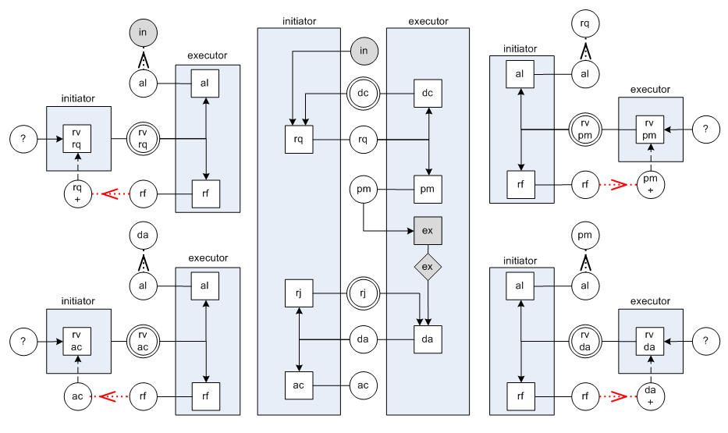
Solution 6 – Remove reversion links after Refuse (x4)
Notes
Adapted from Figure 10 in “The PSI Theory – understanding human collaboration”, version 4.2

Slide 82
Map Page 1/2
Presentation Outline
We are
here
Notes

Slide 83
Requirement 1 – Unilateral Cancel of Requests
If a Request was performed,
but not yet Promised or Declined,
the initiator should be able to
unilaterally revoke if (cancel request).

Slide 84
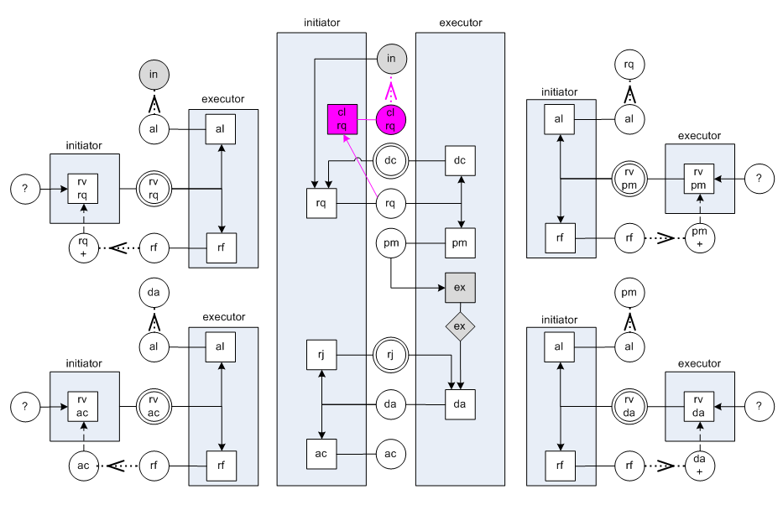
Solution 7 – Cancel Request before Promise (or Decline)

Slide 85
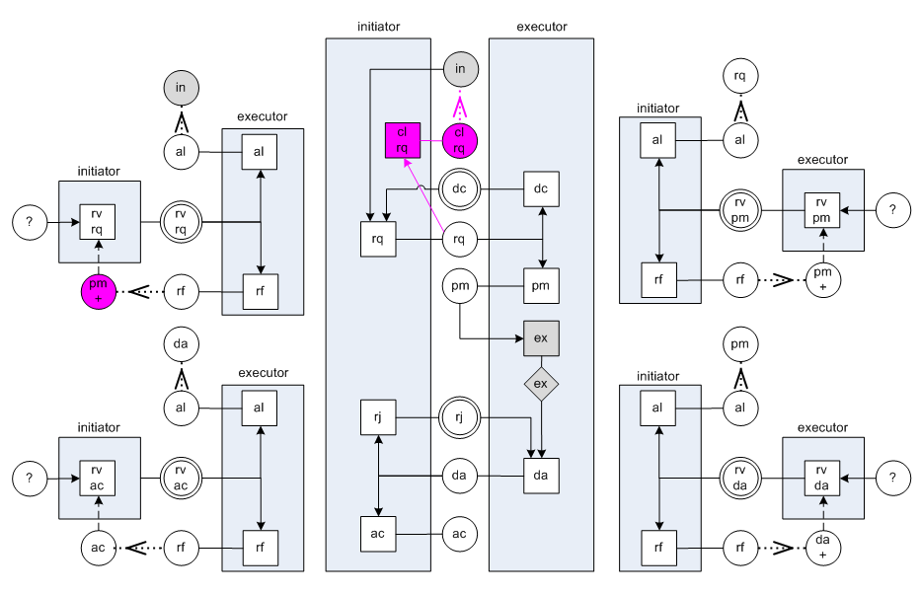
Solution 8 – Revoke Request only available after promise

Slide 86
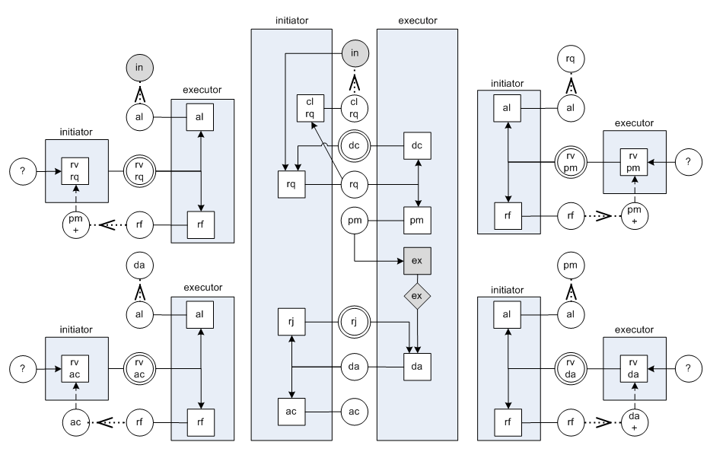
Solution 7 & 8 (combined)

Slide 87
Map Page 1/2
Presentation Outline
Notes
We are
here

Slide 88
Requirement 2 – Unilateral Cancel of Declares
If a Declare was performed,
but not yet Accepted or Rejected,
the executor should be able to
unilaterally revoke if (cancel declare).

Slide 89
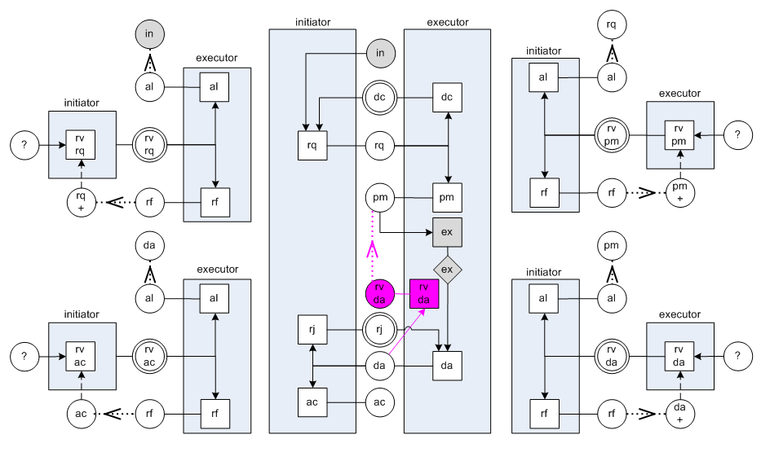
Solution 9 – Cancel Declare before Accept (or Reject)

Slide 90
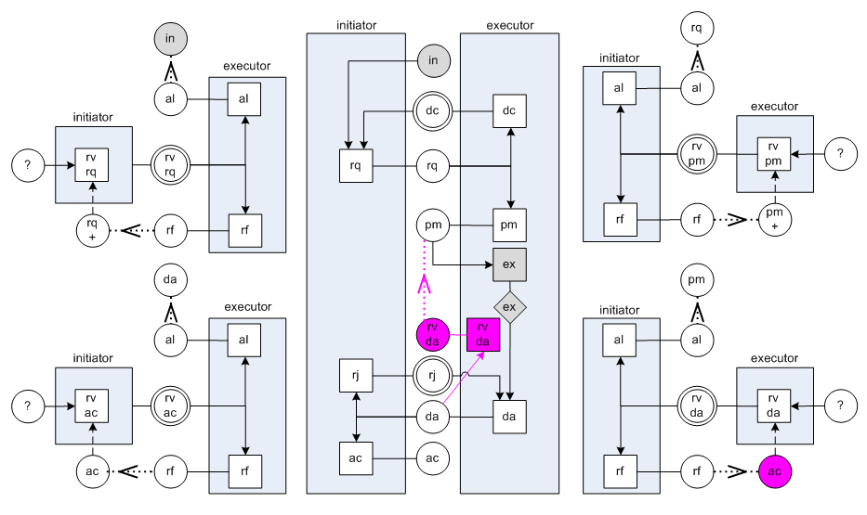
Solution 10 – Revoke Declare only available after Accept

Slide 91
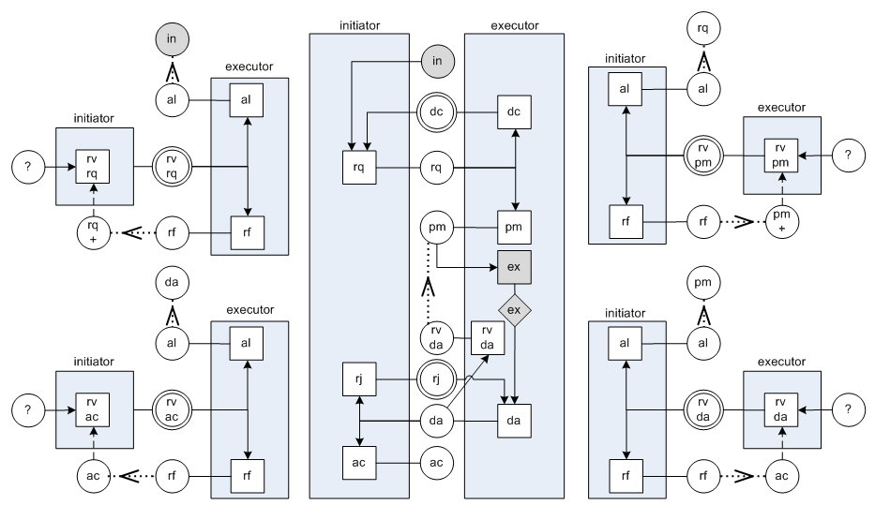
Solution 9 & 10 (combined)

Slide 92
Map Page 2/2
Presentation Outline
We are
here
Notes

Slide 93
Requirement 3 – Executor duty to fix error
The executor should be free to execute
The executor should be able to execute again,
namely to fix errors
or to provide a better result,
without requiring an allowed revoke declare
from the initiator
The initiator may not accept the new declared result and keep the old one.

Slide 94
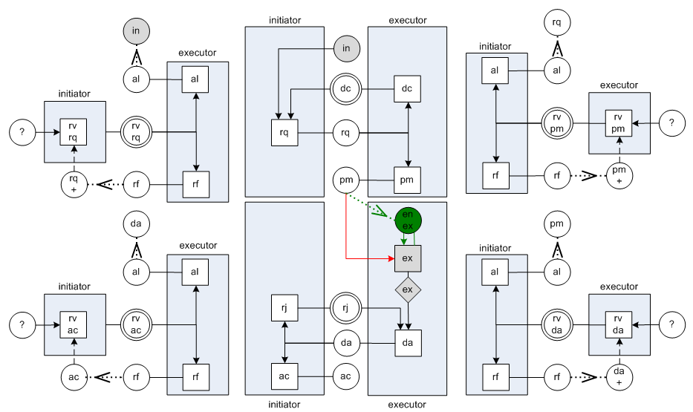
Solution 11 – Execute and Declare at anytime

Slide 95
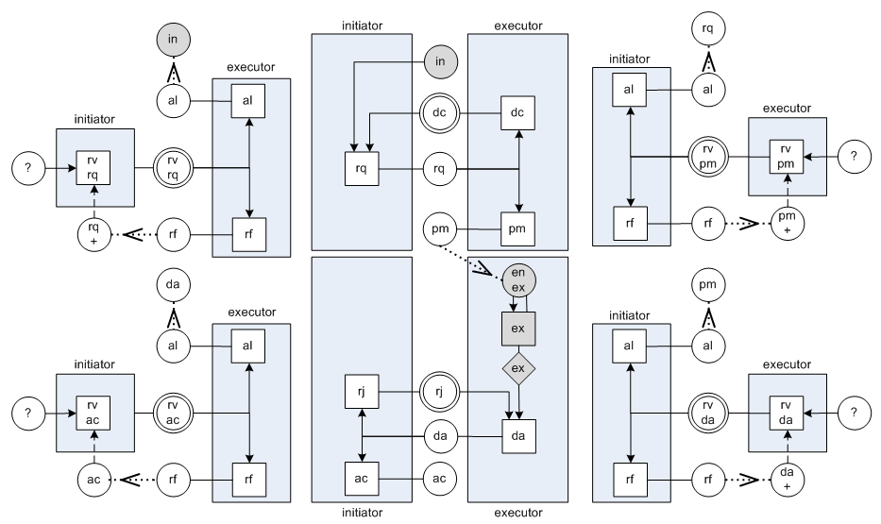
Solution 11 – Execute and Declare at anytime

Slide 96
Solution 11 – Execute and Declare at anytime

Slide 97
Solution 11 – Execute and Declare at anytime

Slide 98
Solution 11 – Execute and Declare at anytime

Slide 99
Solution 11 – Execute and Declare at anytime

Slide 100
Solution 11 – Execute and Declare at anytime

Slide 101
Seeing it as a Petri-Net
Remember…
Mismatch between
Initiator and executor views
(Addressed at Solution 11)
Notes

Slide 102
Solution 11 – Execute and Declare at anytime
Pending issues: 1

Slide 103
Map Page 2/2
Presentation Outline
We are
here
Notes

Slide 104
Requirement 4 – Accept without Execute/Declare
The initiator should be able to accept
an “empty” result, i.e,
Accept without
the executor Executing or Declaring
anything
“The initiator may accept a result that differs considerably from the requested product. (…) To top that, the client [initiator] may even accept the declaration if no coffee [result] has been brought to him/her at all!”
Page 16, Version 4.2

Slide 105
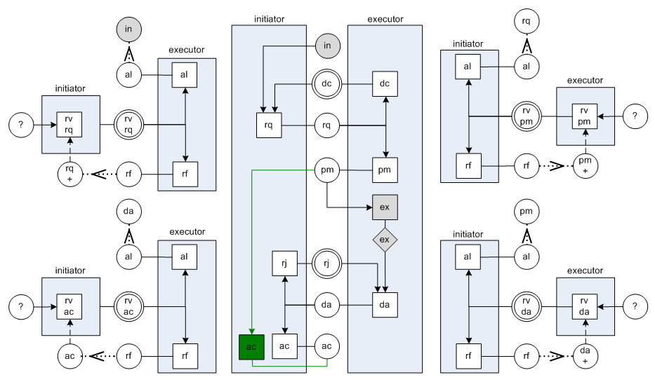
Solution 12 – Empty Acceptance

Slide 106
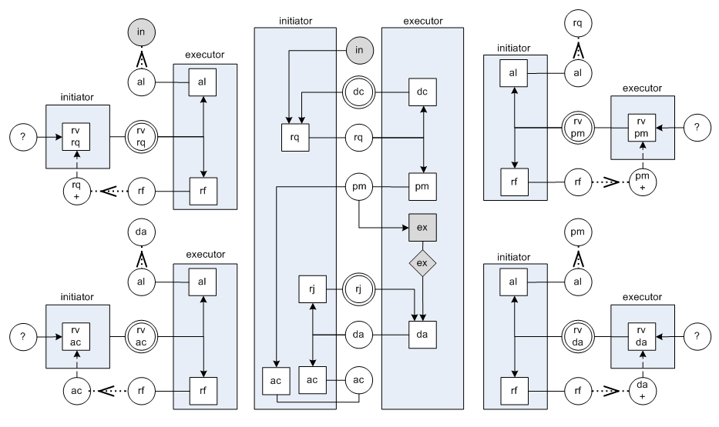
Solution 12 – Empty Acceptance

Slide 107
Map Page 2/2
Presentation Outline
We are
here
Notes

Slide 108
Requirement 5 – Declare without Promise
The executor may perform a tacit Promise
by Declaring after the Request.
“C-acts may also be performed tacitly, which means that there are no acts that could count as performing them. Still they are performed, but the evidence is implicit, either from the presence or from the absence of other acts.”
Page 16, Version 4.2
Only Promise can be implicit. All other C-acts must be explicit.

Slide 109
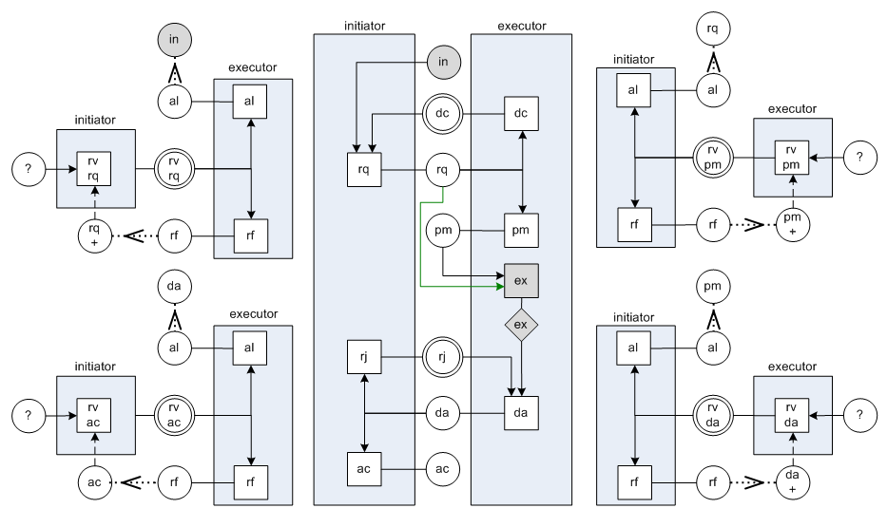
Solution 13 – Tacit Promise

Slide 110
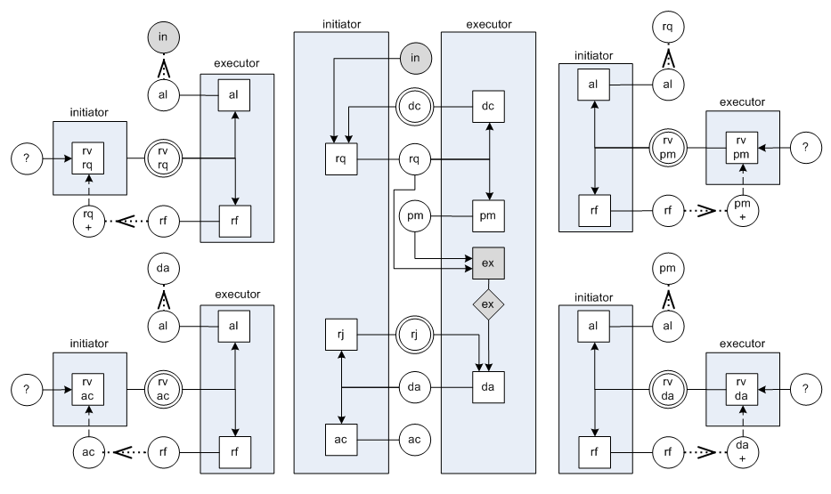
Solution 13 – Tacit Promise

Slide 111
Map Page 2/2
Presentation Outline
We are
here
Notes

Slide 112
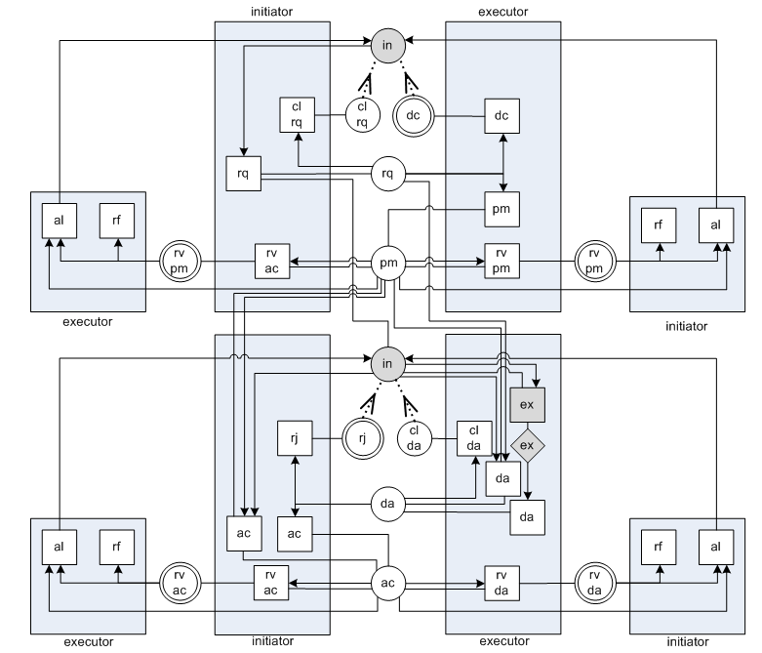
Unified Solution

Slide 113
Unified Solution
request

Slide 114
Unified Solution
cancel request
decline
promise
execute
declare

Slide 115
Unified Solution
revoke request
revoke promise
execute

Slide 116
Unified Solution
revoke request
revoke promise
execute
declare

Slide 117
Unified Solution
revoke request
revoke promise
reject
accept
execute
cancel declare

Slide 118
Unified Solution
revoke request
revoke promise
revoke accept
execute
revoke declare

Slide 119
Unified Solution
revoke request
revoke promise
revoke accept
execute
revoke declare
refuse
allow

Slide 120
Unified Solution
revoke request
revoke promise
execute

Slide 121
Unified Solution
revoke request
refuse
allow
revoke promise
execute

Slide 122
Unified Solution
request
execute

Slide 123
New Pending Issue:
Do we need to always execute again?
(Addressed at Unified Solution)
Solution 3 – Dyadic Nature of declare-accept
Remember…
Notes

Slide 124
Unified Solution
Pending issues: 0

Slide 125
Map Page 2/2
Presentation Outline
We are
here
Notes

Slide 126
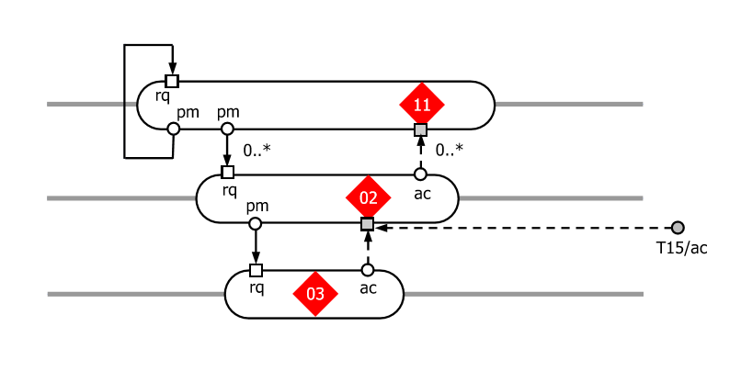
Detour 1 – Omega Theory and Links
From Figure 14, page 15, OMEGA theory, version 4.1
From which facts can initiator links originate?
Which facts can originate wait links?
Which acts can receive wait links?
Inductive Approach
Initiator links only originate from Request, Promise, Declare or Accept facts.
Wait links from Promise and Accept facts.
Wait links link to Promise, Execute and Accept acts.

Slide 127
Detour 1 – Omega Theory and Links
From Figure 14, page 15, OMEGA theory, version 4.1
From which facts can initiator links originate?
Which facts can originate wait links?
Which acts can receive wait links?
Deductive Approach (based on the dyadic nature of rq-pm, da-ac)
Initiator links only originate from any fact
Wait links from Promise, Accept , Decline, Reject, or Revoke facts
Wait links link to Promise, Execute or Accept acts.
Quality
Analysis
Reasons

Slide 128
Map Page 2/2
Presentation Outline
We are
here
Notes

Slide 129
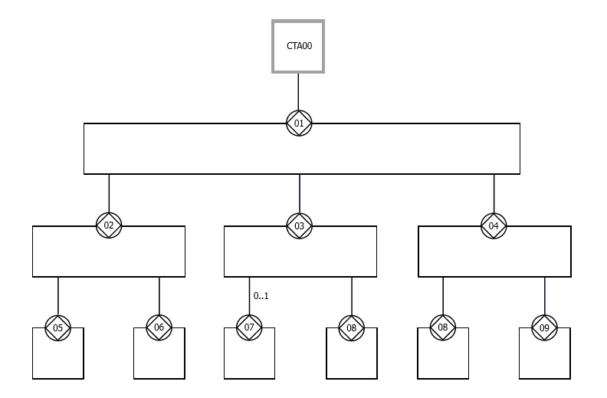
Detour 2 – The Change Problem
Interaction-based tree structure
From Figure 5, page 8, OMEGA theory, version 4.1

Slide 130

Detour 2 – The Change Problem
Interaction-based tree structure
From Figure 5, page 8, OMEGA theory, version 4.1

Slide 131
Map Page 2/2
Presentation Outline
We are
here
Notes

Slide 132


Detour 3 – The Delegation Problem
Cogitatiogenic Conversation
Create a Plan
Actagenic Conversation(s)
Aprove a Plan (and sub-plans)
Factagenic Conversation(s)
Execute a Plan

Slide 133
Map Page 2/2
Presentation Outline
We are
here
Notes

Slide 134
Map Page 2/2
Presentation Outline
We are
here
Notes

Slide 135
Map Page 2/2
Presentation Outline
Notes
We are
here

Slide 136
Map Page 2/2
Presentation Outline
Notes
We are
here

