Slide 1
Automatic Model Transformation for Enterprise Simulation
EEWC 2014
Authors: Yang Liu*, Junichi Iijima
Department of industrial engineering and management, Tokyo institute of technology, Japan

Slide 2
Contents
Background
Research Questions
Research Design
Case Study
Conclusion

Slide 3
1. Background (1)
--How can we analyze business process?
Real Business Process
Business process Model
(workflow )
Business process Simulation
Business Process Model (Enterprise ontology)
(construction)
(1)
(2)
(1) https://www.mfe.govt.nz/publications/rma/everyday/designations/images/process.gif
(2) http://www.isl.org/sites/default/files/projects/vito/Containerumschlag_Virtuel.png

Slide 4
1. Background (2)
--Modeling and Simulation
Model
Simulation Model
BPMN
UML
DEMO
IDEF
Agent Base
Petri-net
DEVS
System Dynamic
Modeling researches and simulation researches for business process are not closely related with each other.

Slide 5
1. Background (3)
--Limitations in Business Process Modeling
Most of business process models are not executable:
Existing problems are not easy to be discovered;
Possible solutions can not be well evaluated;
To address these limitations, business process model should be combined with simulation
In order to do this, either an additional mapping schema is developed or a transformation is required;
However, most of the mappings and transformation are manually addressed.

Slide 6
1. Background(4)
--Simulation Lifecycle
Conceptualization (C)
Abstraction of real world
UML
Text
DEMO
IDEF
FlowChart
BPMN
Specification
(S)
Formal Specification of simulation model
Process based Discrete event simulation model
Petri net model
DEVS
specification
System Dynamics
Implementation (I)
Executable simulation model in different simulation platform
Snoopy (petri net)
Arena
(DE)
DEVSDSOL
(DE)
DEVSJAVA
(DE)
AnyLogic
(DE)
Notes:
Conceptual Level (C), model that abstracts the real world into representations or notations. It is the highest level and independent from the simulation details;
Specification Level (S), the model in the specification level is a platform-independent simulation model that gives formal specification of simulation, for illustration, specification of DEVS notation;
Implementation Level (I), the model in this level is a platform-specific simulation model that is defined on a specific simulation platform, for illustration, JAVADEVS, AnyLogic or Arena.

Slide 7
1. Background (5)
--Issues in Business Process Simulation
Simulation does not have precise ontology at conceptual level.
  Conceptual Model (CM): “ontological representation of simulation that implements it¹” ;
  However, most of conceptual models are not ontological and they depends on implementation;
  Conceptual model without semantics meaning can not be re-implied, that such CM have low reusability in BPR.
Most of conceptual models are non-modularized, that none modularized conceptual model leads:
  Non-component based simulation model with uncontrollable change and low reusability;
1. Turnitsa, C., Padilla, J. J. & Tolk, A. (2010). Ontology for Modeling and Simulation. in Proc. Winter Simul. Conf. 643–651.
Notes:
63% simulation modelers use flowchart as CM, others use like BPMN, UML or text;

Slide 8
2. Research Questions
It is necessary to connect ontology with implementation so as to improve real business process
How can we semi-automatically derive component based simulation model from business process model to support BPR?
C
Q1: What type of ontology at conceptual level can support deriving component based simulation model ?
Q1
Q2
Q2: How can we translate this ontology into DEVS specification ?
S
Q4
DEVS
Q3: How can we translate this DEVS specification into executable simulation model ? (MMD4MS)
Q3
I
Q4: Is it possible to make this process automatically or semi-automatically carried out? How ?
DEVSDSOL

Slide 9
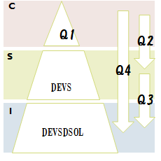
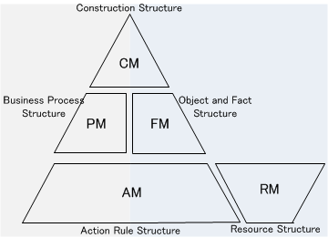
3. Research Design(1)
--DEMOpR
Q1: What type of ontology at conceptual level can support deriving component based simulation model ?
DEMOpR
DEMO:
Modularized model in high level abstraction;
Describing ontology not implementation of a social system;
Describing different structure in semantic;
Is DEMO enough for specifying simulation?
RM (resource structure) defines resource types required for completing a transaction.

Slide 10
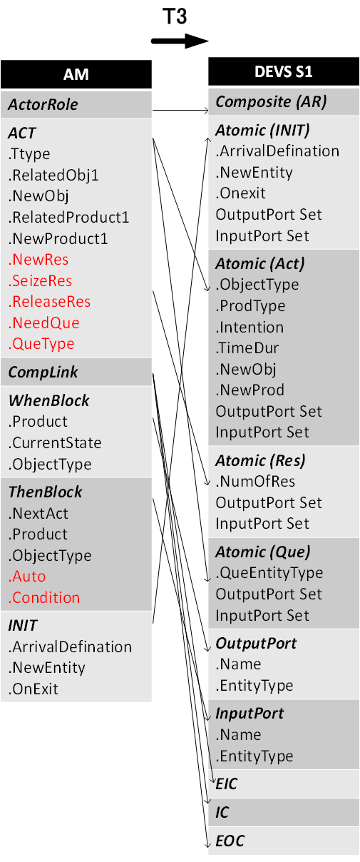
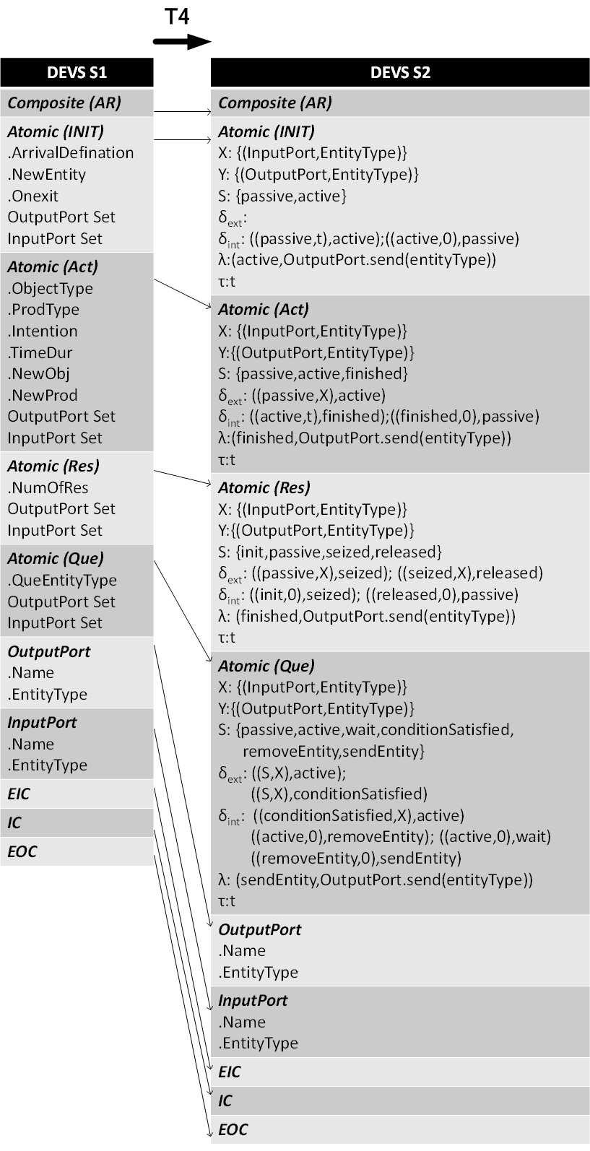
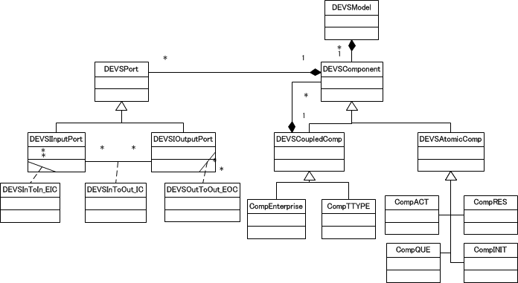
3. Research Design(2)
--DEMOpR based DEVS
Q2: How can we translate this ontology into DEVS specification ?

Slide 11
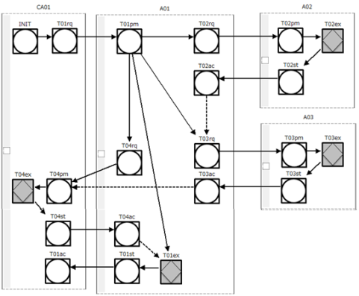
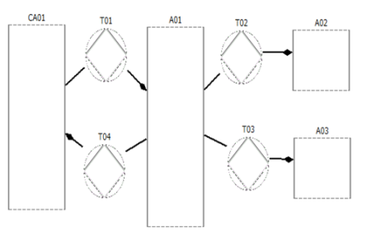
3. Research Design
(3) Model Transformation
Q4: Is it possible to make this process automatically or semi-automatically carried out? How ?
Eclipse Modeling Framework (EMF)
A model of A
(XMI)
A model of B
(XMI)
Meta-model A based
modelling platform for A
Meta-model B based
modelling platform for B
(GEMS)
Generic Eclipse Modeling System
Meta-model of A
(ATL)
ATLAS Transformation Language
Meta-model of B
Model Driven Framework

Slide 12
(4) Framework
Meta-model based Modeling Platforms
Meta-Models
Models
C
Meta-model of ATD
ATD modeling platform
ATD Model
T1
Meta-model of PSD
PSD modeling platform
PSD Model
T2
Meta-model of AM+RM
AM+RM modeling platform
AM+RM Model
DEMOpR
T3
S
Meta-model of DEVSs1
DEVSs1 modeling platform
DEVSs1 Model
T4
DEVS
Meta-model of DEVSs2
DEVSs2 Model
I
Meta-model of DEVSDSOL
DEVSDSOL Code
DEVSDSOL
MDD4MS

Slide 13
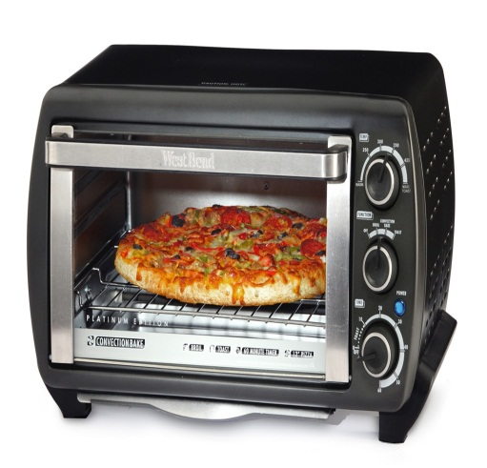




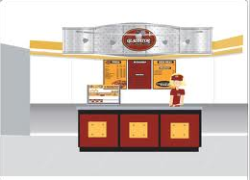




4. Case Study
---(1) Pizza Store
StuffA01: 2
Stuff A02:2
Oven: 3
8 min
Oven
10 min
StuffA03
StuffA01
3 min
Exponential distribution mean =8
1 min

Slide 14
(2) Parameters
Transa ction | Act | Time Duration | Seize Resource | Release Resource
T01 | rq | 0’
 | pm | 3’ | Stuff_A01,1 | Stuff_A01,1
 | ex | 0’
 | st | 0’
 | ac | 0’
T02 | rq | 0’
 | pm | 0’ | Oven,1
 | ex | 8’
 | st | 0’ |  | Oven,1
 | ac | 0’
Transa ction | Act | Time Duration | Seize Resource | Release Resource
T03 | rq | 0’
 | pm | 0’ | Stuff_A03,1
 | ex | 10’
 | st | 0’
 | ac | 0’
T04 | rq | 0’
 | pm | 0’
 | ex | 1’
 | st | 0’
 | ac | 0’ |  | Stuff_A03,1

Slide 15
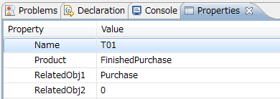
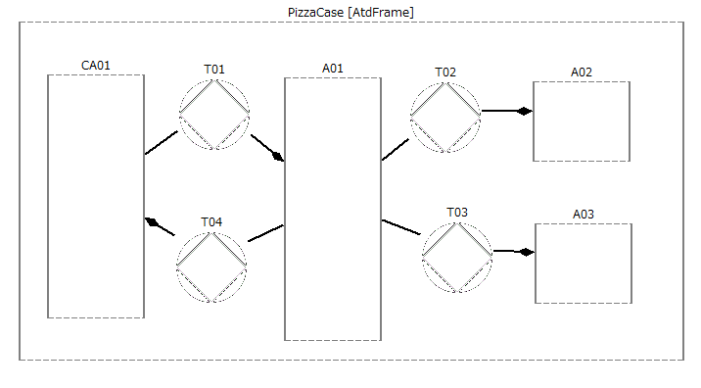
(3) ATD Modeling Platform and ATD Model
Finished Purchase
Prepared Purchase
Delivered Purchase
Paid Purchase
T1

Slide 16
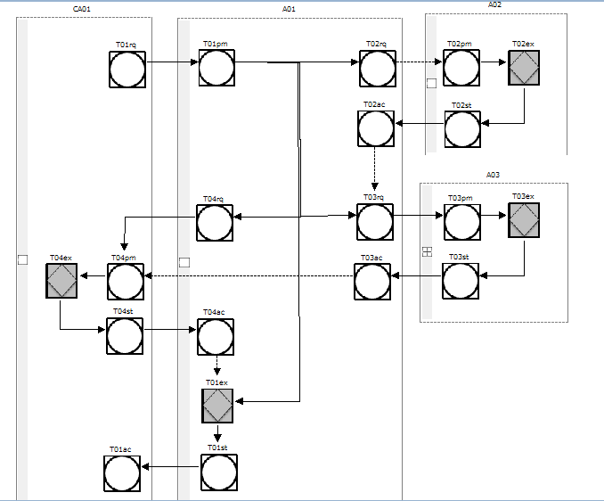
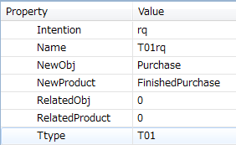
(4) PSD Modeling Platform and PSD Model
Conditional Link need to be manually added
T2

Slide 17


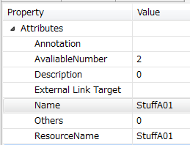
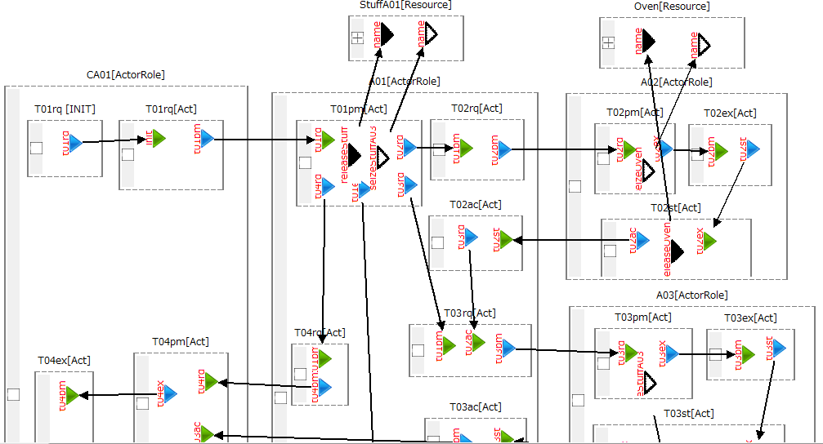
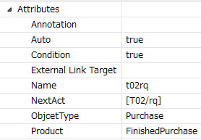
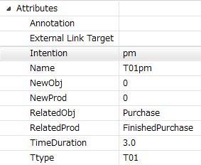
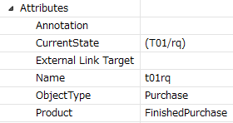
4. AM
releaseResBlock
seizeResBlock
Need to be added
Resource
Need to be added
Need to be added
Then Block
Need to be added
ACT
When Block
T3
Need to be added

Slide 18
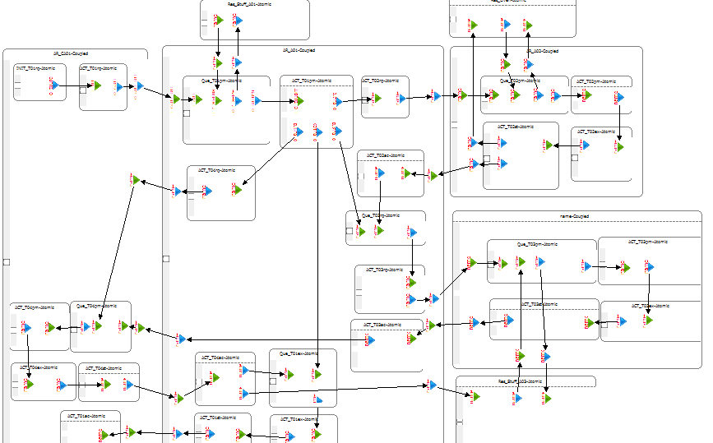
(4) DEVSs1 Modeling Platform and DEVSs1 Model
Explained in Next Page

Slide 19
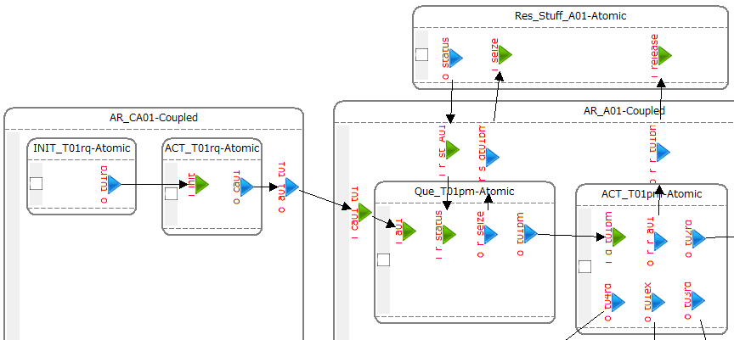
(5) DEVSs1 Modeling Platform and Detailed DEVSs1 Model
Initiation Point(INIT_)
Action (ACT_)
Actor Role (AR_)
Queue(Que_)
Resource(Res_)
Output Port
Input Port
T4
Notes:
There are five types of components defined in AM-DEVS: INIT, AR, ACT, Que and Res
INIT represent for initiation point, where entity arrival rate is assigned;
AR represent for Actor Role in DEMO;
ACT represent for Act, including both c-act and p-act in DEMO, where execution time is defined
Que represent for waiting queue. Queue could wait for:
resource(e.g Que_t02pm wait for resource stuff)
facts(e.g Que_t01ex wait for fact “T04(purchase) been accepted”)
Or both
Res represent for resource, it will be seized by que and released by act.
INIT, AR, ACT could be automatically generated from AM but Que and Res need to be manually added.
Input port and output port are derived from when block and then block in AM.
DEVS_S1 define components, input port, output port and links in DEVS, not detailed DEVS specifications. Thus it is easy to modify and confirm the correctness of the model before going into DEVS details.

Slide 20
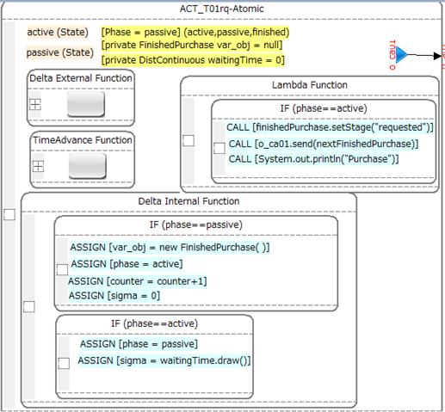
(6). DEVS_S2 for Pizza Case
AR, ACT, INIT, Que and Res have different specifications.
DEVSs2
2DEVSDSOL

Slide 21
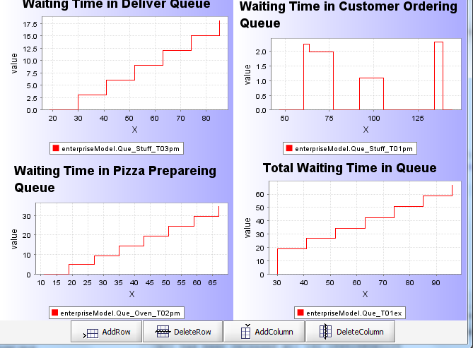
(3) Statistic Result of Simulation

Slide 22
5. Conclusion
Outcomes:
  DEMO expanded with Resource Structure;
  Meta-models: DEMO(CM, PM, FM, AM, RM), DEVSs1;
  Modeling Platforms: DEMO(CM, PM, FM, AM, RM), DEVSs1;
  Transformations : ATD2PSD, PSD2AMRM, AM2DEVSs1, DEVSs12s2
Contributions:
  Assist DEMO modeling;
  DEMO expanded with resource structure can be applied as conceptual model to derive executable simulation model;
  DEMO oriented simulation is component based that it can help analyzing complex enterprise problems with higher reusability.
  Semi-automatically generated DEVS simulation model reduces complexity and time for simulation.
Future Research:
  Apply this method into different simulation platforms, such as Arena or AnyLogic;
  Combine DEMO with BPMN in act definition level;
  DEMO based DEVS simulation with Agent based and system dynamic for provide full view of enterprise in both macro level and micro level.

Slide 23


Slide 24
A1. Research Questions (2) DEVS Simulation
DEVS (Discrete Event Simulation)
  Tool for analyzing and designing complex systems.
  Mathematical formalism based on system theoretic principles.
DEVSDSOL
  A DEVS simulation tool developed by TU Delft.
  JAVA based platform
C
?
?
S
DEVS
I
DEVSDSOL

Slide 25
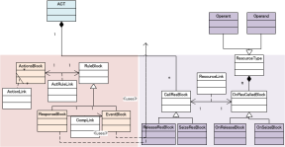
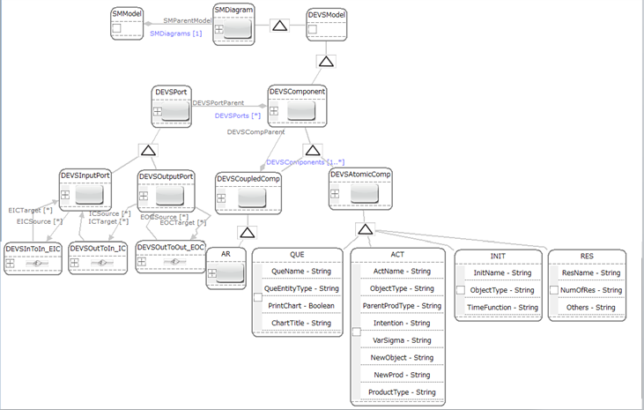



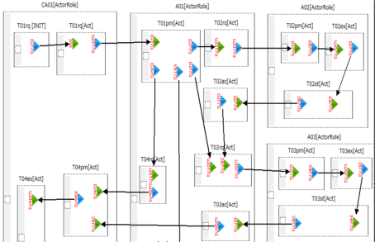
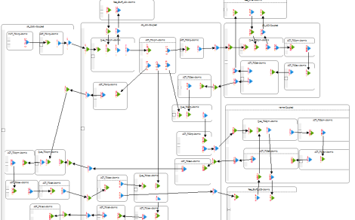
A2. Framework
Q2: How can we translate ontology into simulation specification?
Q3: How can we translate specification into executable simulation model?
T1
T2
T3
T4
MM-CM
MM-PM
MM-AM+RM
MM-DEVSs1
MM-DEVSs2
CM
PM
AM+RM
DEVSs1
DEVSs2

Slide 26
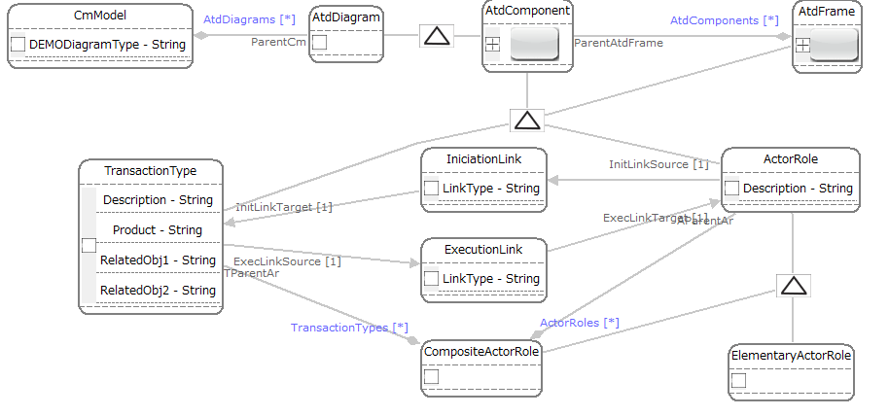
A3. Meta-model of CM

Slide 27
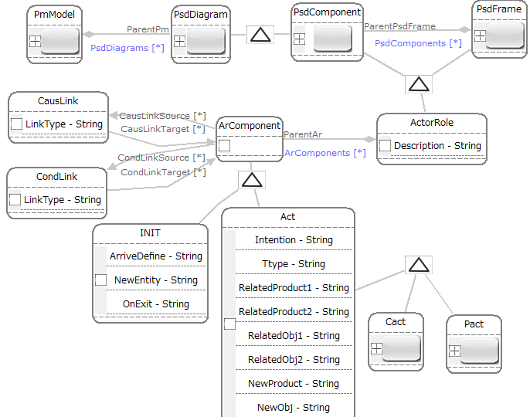
A4. Meta-model of PM

Slide 28
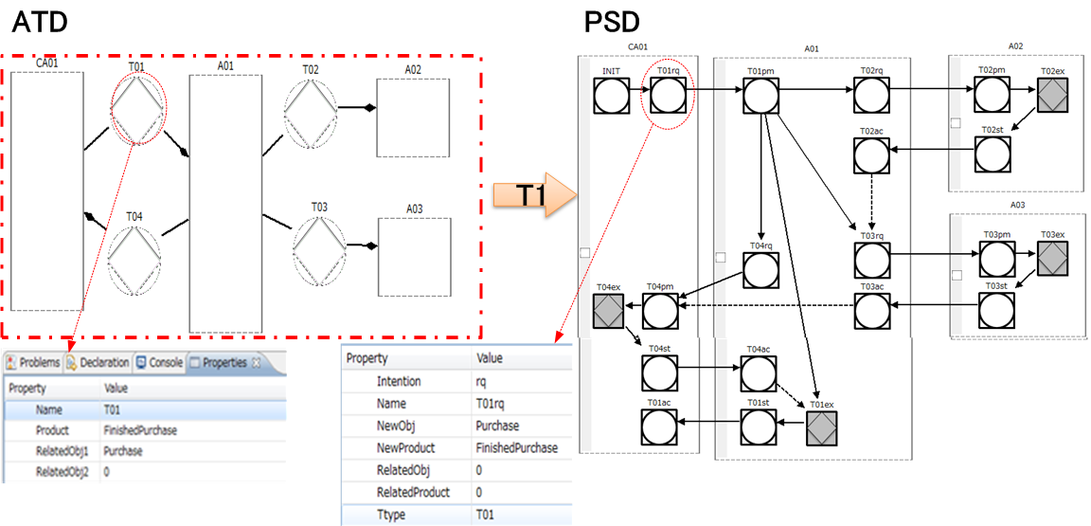
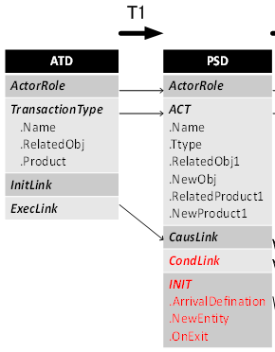
A5. T1--ATD2PSD
T1

Slide 29
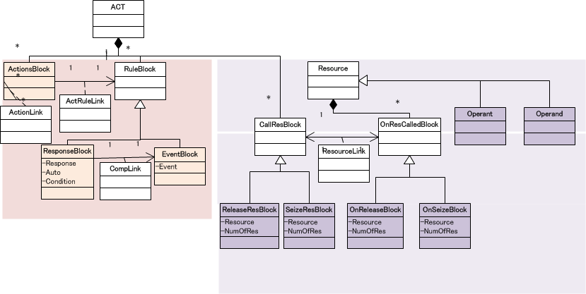
A6. Meta-model of AM+RM
AM
RM

Slide 30
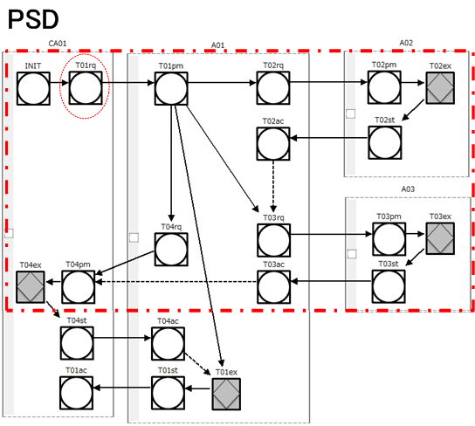
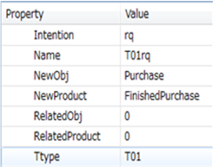
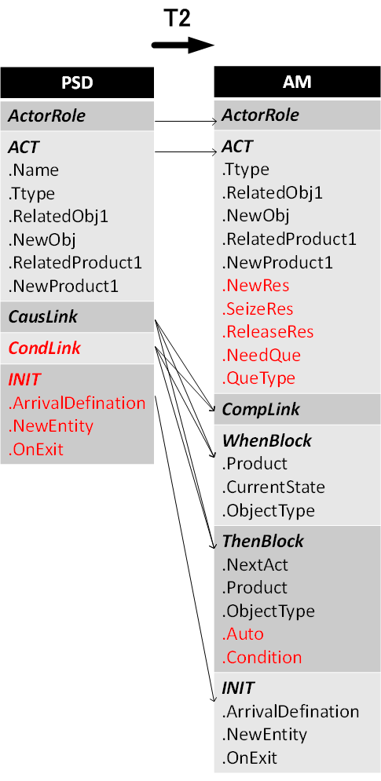
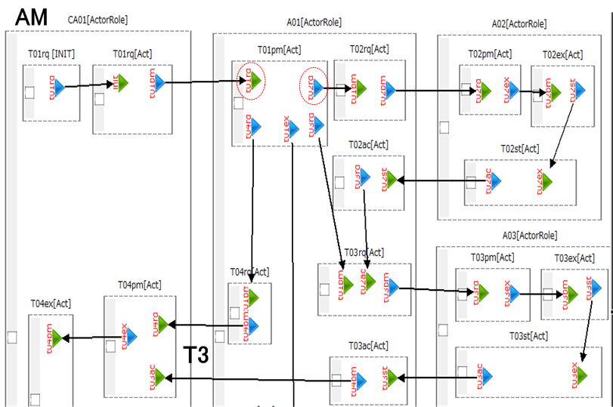
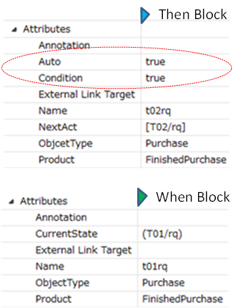
A7. T2—PSD2AM
T2

Slide 31
A8. Meta-model of DEVSs1

Slide 32
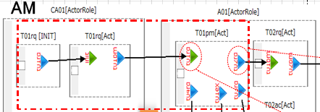
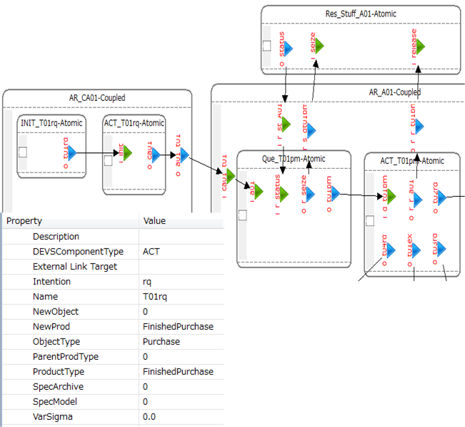
A9. T3--DEMO2DEVSs1
T3

Slide 33
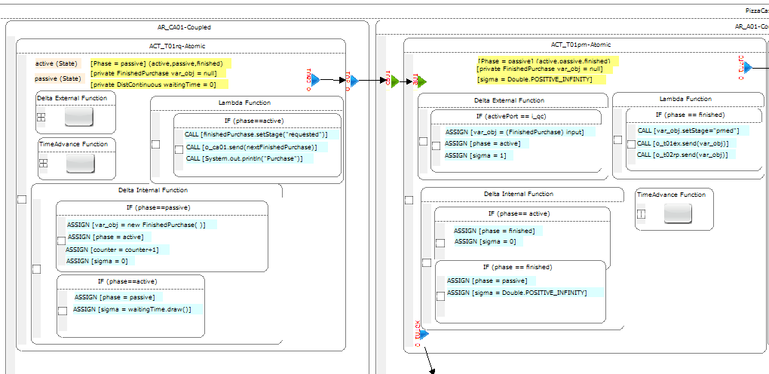
A10 DEVS s2
DEVS_S2 will be generated from DEVS_S1 model, where Component AR, ACT, INIT, Que and Res have different specifications.

Slide 34
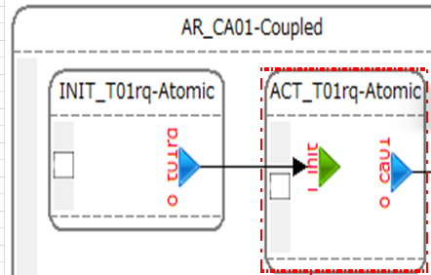
A11. T4--
DEVSs1 2 DEVSs2
T4

Slide 35

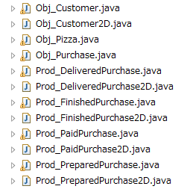
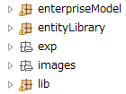
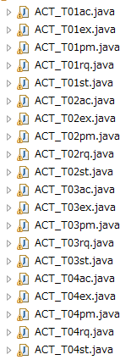
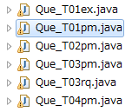
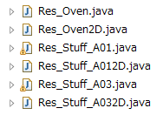
A12. DEVSDSOL Java Code generated from MDD4MS framework
DEVS Components
Entities
Manually created according to OFD
Generated from DEVS

Slide 36
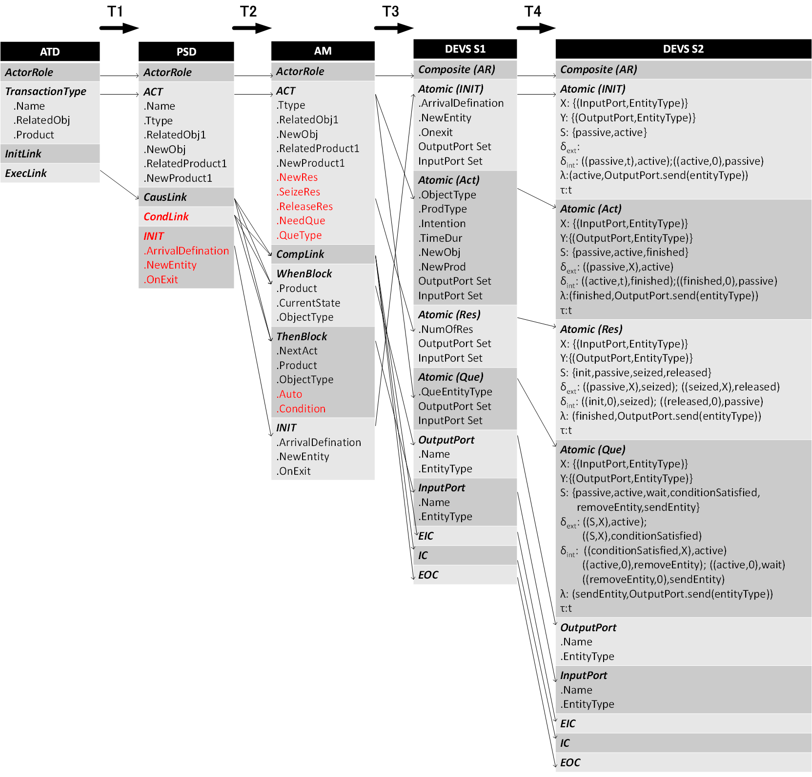
A13. Transformation

Slide 37
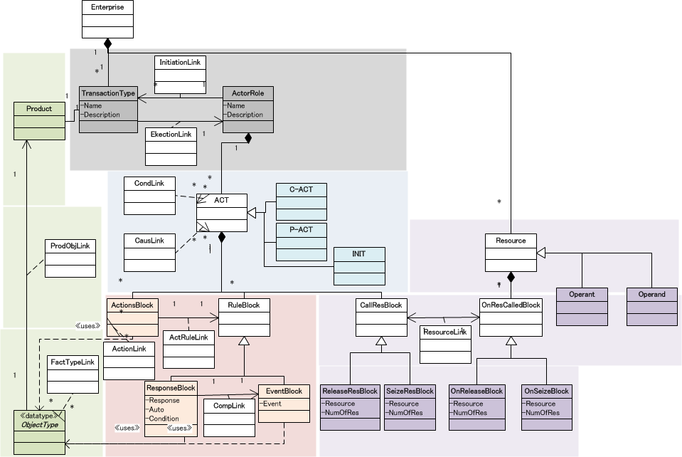
A14. Meta-model of AM+RM
CM
FM
PM
RM
AM

