Slide 1

e-CO FOOTPRINT
An Innovation in
Enterprise System Customization Processing
Vishnupriya Kalidindi and Yun Wan
e-CO Matrix, LLC
University of Houston - Victoria

Slide 2
Agenda
Background
The Challenge
Study
System
Results
Conclusion

Slide 3
Background
Enterprises build software components such as integrations, interfaces, services and reports to enable and augment e-business (EBS) collaboration; these are software objects are called customization.
We called them “e-Collaboration components” or in short, e-CO Components.

Slide 4
Background
When choosing or implementing e-Business systems, enterprises spend considerable amount of effort to conduct cost benefit analysis because of the large amounts of resources spent, namely human, time and monitory.
However, not much emphasis is placed to conduct similar analysis on the e-CO Components because they are considered necessary for operational efficiency of the Organization.
Nonetheless, e-CO components are complex and costly to build and maintain and add a layer of risk to the EBS system.

Slide 5
Background
Over time, IT department keeps implementing any e-Components that are demanded by the users. Mainly because there is no objective method to determine effectiveness of the e-CO Component request.
Even though the cost for each e-CO component may not be significant, overall cost of implementation and maintenance of these components over a period of time can add up to be a significant amount of resources.
In order to utilize the resources of the enterprise efficiently, it is crucial to adapt a strategic process that is more proactive when developing the e-CO Components.

Slide 6
The Challenge
There are three important issues that affect e-CO Component Management in enterprises.
Firstly, there is lack of information in terms of e-CO Component implementation costs and benefits, to determine Return on Investment (ROI) of the component at the time of request.
Secondly, users are unable to objectively prioritize the e-CO Component Requests due to little to no knowledge of component ROI information.
Thirdly, there is no regulation for the number of e-CO components implemented in a specific period of time, due to lack of internal or external restrictions.

Slide 7
Potential Solutions
The Study
To solve the problem stated, the following concepts are studied.
Understand how to calculate ROI of an e-Co Component.
Understand how to set up flexible regulation for
e-CO Component Management.

Slide 8
ROI Measurement
The Study
Measuring ROI of e-business investments is not so straightforward.
Study of existing Cost- Benefit Analysis (CBA) frameworks can help develop a method to measure the ROI of e-CO Components.
Knowing the ROI can help identify the most important e-CO Components for company's business process.

Slide 9
Software Cost Estimation Techniques
The Study
Heuristic rule of thumb
Expert judgment/Delphi Technique
Analogy
Parkinson
Price to win
Top-down/Bottom-up
Case studies
Algorithmic models
Constructive Cost Model (COCOMO)

Slide 10
Cost Estimation in EBS Context
The Study
In the context of the above techniques, Boehm states that “None of the alternatives is better than the others from all aspects.”[Boehm, 1981].
Extensive research conducted by [Kemerer, 1987] concluded that the key differentiator is, coming up with the relevant factors that are suited for the domain and the software for which the cost estimation has to be conducted.
Hence one can determine the cost drivers and identify the attributes that are best suitable for the EBS environment as well as the context of the enterprise.
In the EBS context, e-CO Component solutions that are developed in various tools result in not just lines of code but also other components such as GUI screens, workflows, Report layouts etc.

Slide 11
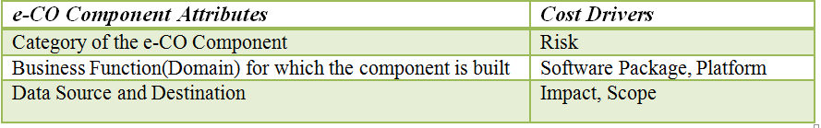
e-CO Component Cost Drivers
The Study
Above attributes drive the cost estimation of an e-CO Component.
The cost drivers dictate and determine the complexity of the component and their factors add up to the cost.
Historic data can help determine the factors for the cost drivers.

Slide 12
Benefit Categories
The Study
Along with the Cost information, it is crucial to understand the Benefits an e-CO Component is going to bring to the organization so as to justify the cost of developing and implementing the e-CO Component.
Benefits are often difficult to measure; value can be in terms of savings, opportunity, new revenue, or soft benefits, such as improved customer satisfaction or better decision making.
When an organization starts to determine the ROI for a technology project, they may have some grip on the cost of the project, but the answers for the return value, are easily subject to manipulation. [Radding, 1999]

Slide 13
Quantify Benefits ?
The Study
Actually the benefit of an e-Co component request may not be quantified in absolute terms, all we need to know is its relative terms when compared with other requests.
If the reviewers can be provided with the knowledge of the type of benefit an e-CO component can bring, and the user base it effects, reviewers can make a decision to prioritize the most cost effective e-CO Components to be built.

Slide 14
Prioritize
The Study
By introducing priority as a mandatory aspect of processing the e-CO Component request, one can be assured that that the most effective Components are being built.
By prioritizing the requests, unnecessary or least important request fall to the bottom of the list.
Even if the requests are prioritized, many organizations do not have an effective methodology to manage large number of e-CO components requests by the users.
To make the prioritization of e-CO Components effective, regulation is considered as a mechanism.
This process can be further improved by using distributed method – allow users to self-regulate their requests.

Slide 15
Regulate
The Study
Carbon Emission Trading principles are referenced to understand how to set up flexible regulation, here is why –
e-CO Components are necessary for enterprises to fit the EBS system according to their needs and operational processes; at the same time e-CO Components implementation involves risks and cost that impact the EBS system and the enterprise.
So one can say e-CO Components are inevitable, but can be harmful to the enterprise when implemented unnecessarily and in excess; similar to Carbon Emission.

Slide 16
Self-Regulation
The Study
Organizations can set up a limit or regulation on the amount of e-business collaboration cost that can be spent in a specific time period such as a quarter.
By having a set allowance on amount of collaboration to be implemented in a period of time, the e-collaboration requests that are most needed will get the priority to be implemented.
By allowing users to borrow and loan allowance, users can self-regulate their request and encourage conservative request initiatives, thus increase overall savings for the organization.

Slide 17
From Theory to Practice
The Study
Design and develop prototype software that can evaluate ROI of e-CO Components.
Incorporate the e-CO Component regulation methodology in the software.
Provide access to users from an EBS environment to test the process.
Conduct a survey to find out if the methodology defined is effective.

Slide 18
Design of the System
The System
The first problem to solve is, set up a method to evaluate the ROI of e-CO Components
The cost drivers for e-CO Components are narrowed down as following:
e-CO Component Domain or Business Function (drives Software, Platform)
e-CO Component Category (drives Risk)
e-CO Component Data Source and Destination (drives scope, impact).
One of the important aspects of making these attributes work for any e-Business environment is to provide an ability for the enterprises to set up the values for each of the above attributes as per the needs and context of their organization.

Slide 19
e-CO Footprint
The System
A new Unit of Measure (UOM) is invented to capture the essence of all of these aspects.
Since the goal of this process is to bring efficiency to the e-CO Component process, drawing the inspiration from the Carbon Footprint, it is called
e-Collaboration Footprint or e-CO Footprint.
e-CO Footprint is derived by adding up the factors of the Cost Drives of an
e-CO Component.
This UOM as a whole denotes the complexity of the e-CO Component; more complex the component higher the cost.

Slide 20
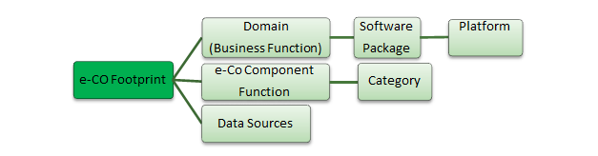
e-CO Footprint Calculation
The System
This study suggests that, instead of knowing an accurate cost late in the process, it is more useful for the user to know the e-CO Footprint of a component earlier in the process to understand the complexity and cost of the component being requested.

Slide 21
System Terminology
The System
Terminology | Explanation
e-CO Proposals | Requests to create e-Collaboration Components.
e-CO Footprint | A Unit of Measure (UOM) assigned to each e-CO Proposal; this is derived by the Category of the components, domain and data sources of the component, software and Platform on which they are developed .
e-CO Period | A time period setup in the e-CO Footprint Tracker that is similar to a software build period
e-CO Allowance | Number of e-CO Footprints assigned to each Business Area for an e-CO Period.
e-Xchange Center | This is an interface setup in the e-CO Footprint Tracker for the various users to exchange e-CO Allowance as credits and debits.

Slide 22
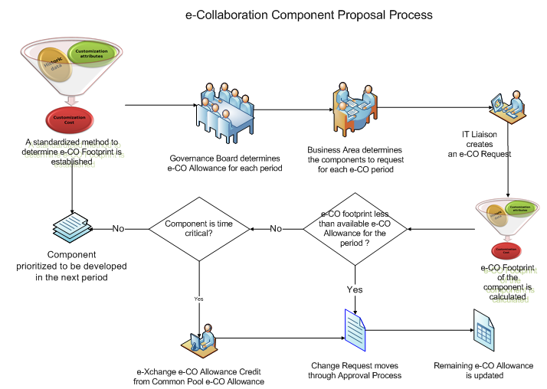
The System
Process Flow

Slide 23
Data Model
The System
To create a flexible data model for the tool, especially to set up the attributes and the related factors of the e-CO Component as per the Organization’s needs, the following entities and relationships are designed.
A set of generic data entities called Element Categories and Elements is designed.
Element Categories can hold the main data elements such as Business Units, Business Functions, Element Type, Element Source, Allowance Type, Approval Type, User Role, Benefit Type etc.
Elements entity holds the data values for each category. All of the attributes related to e-CO Components can be captured in this model.
These two data elements together give flexibility to set up the main cost attributes and their corresponding values as per the context of organizations.

Slide 24
The System
Roles and Responsibilities
This role is assigned to a resource that is responsible to configure the e-CO footprint Tracker setups that are specific to the organization. These resources typically can be IT Business analysts.
Super User
This role is assigned to resources that are responsible to enter e-CO Proposals that can help the Organization utilize the e-Business tools efficiently. Business users such as SMEs can be assigned this role.
Requester
Reviewer
This role is assigned to resources that are responsible to review and prioritize e-CO Proposals. These resources can set the priority and status of e-CO Proposals. They also have privilege to borrow e-CO Budget. Business users such as Business process leads can be assigned this role.
This role is assigned to resources that are responsible to review and ‘Approve’ e-CO Proposals to be moved to operational mode. These resources can review the over all proposals that are in the system and decide on what to approve for the budget period. Business users such as Governance Board member can be assigned this role.
Approver

Slide 25

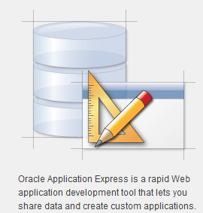
System Software
The System
APEX
The prototype system is designed.
The Tool is also envisioned to be used as a service; hence it is build it in the cloud.
Upon research, the tool Oracle APEX is picked to build the tool, and it resides in the Oracle cloud.

Slide 26
System Details
The System
The database objects namely, tables, sequences, functions and procedures etc. reside in the database schema set up in the Oracle Cloud.
Oracle’s native PL/SQL scripting language and SQL are used to develop the database objects.
User Interfaces are designed by using the development platform and framework provided by APEX; HTML and XML are used as part of the coding necessary for developing the screen.

Slide 27
Interface Design
The System
The interface design is based on the information that, the main issues surrounding this process are due to the lack of knowledge regarding the e-CO Component costs and benefits.
This hinders the reviewers from making a strategic decision on implementing the e-CO Components that are most effective for the enterprise.
Keeping knowledge distribution as the key aspect, this tool helps in creation, development, and reuse of knowledge as a formal organizational resource. [Dennis & Vessey, 2005].

Slide 28
Interface Design
The System
Information is presented in the form of reports for each Role in a manner that is relevant to their function.
Users also have access to e-CO Component information in the form of dash boards to get accurate information at a glance.
Creating this knowledge hierarchy and helping the users make strategic decisions is one of the key aspects of this system.

Slide 29
The Experiment
Powell Industries, Inc. participated in the pilot study testing. This company designs, manufactures and packages equipment and systems for the distribution, control, generation, and management of electrical energy and other dynamic processes.
Eighteen users were involved in this study; they include two super users served by IT director and Business Process Lead for HR, one approver by IT director, five reviewers from different business departments.
Requester role is assigned to a mixed group of people, some are the subject matter experts in the business and some of them are technical and functional experts in the EBS system.

Slide 30
Survey Results
The Results
The data from the survey is tested for internal consistency and it is found that the Cronbach's Alpha for usefulness is 0.927, an indication of high consistency, which means the system is useful from user perspective.
However, the same test for ease of use resulted in a score of 0.362, which means there were inconsistent perspectives on how easy this system is to use.
This could be due to the fact that the users did not get training on the system and they have been using it for only a few times. When proper training is provided and the user interface is further improved, we expect the ease of use will increase.

Slide 31
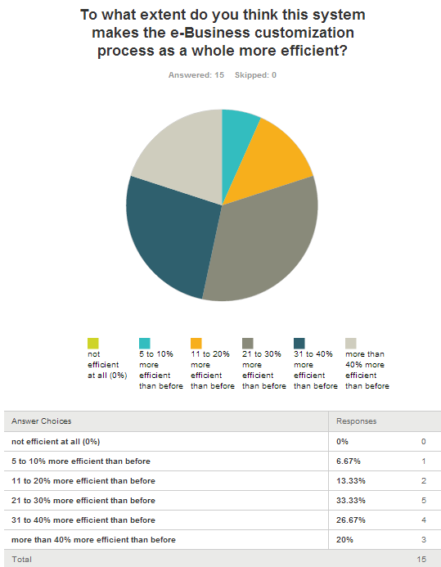
Survey Results
The Results

Slide 32
Participant Feedbacks
The Results
Overall it was actually a very interesting concept. Today I think we have several ways we’re trying to manage the pieces of information that you had in there and it doesn't even capture everything like the e-CO footprint part of it. Today it's all the changes to the system lumped in together.
I really like the idea of having a budget.
I really like the idea of being held accountable to true value added changes and not getting buried in lots of changes. Important changes seem to get lost in the mix so I really like being able to prioritize based on the e-CO priority, the e-CO footprint and my available budget. - Commodities Manager, Purchasing, Powell Industries

Slide 33
Participant Feedbacks
The Results
Participating in the study has really opened my mind to a possibility of using a structured to approach to streamlining the process of determining which enhancements would better the company. I've always felt this required a significant amount of subjective input that would be difficult to program, but by combining the concept of carbon footprint with a cost-benefit analysis it provides the necessary information to effectively assign the resources to the highest priority efforts.
The primary issue that we would face, as would any company with a tool like this, is determining upfront what your priorities are and what factors to consider in order to rank and weight the requests. This would be a project in itself to identify what those priorities should be and how to weight them to come up with something meaningful at a glance.
Applications Director , ERP Systems, Powell Industries

Slide 34
Conclusion
e-CO Footprint is innovative Software as Service (SaaS) tool; it has ability to determine the complexity of e-CO components in the form of a new Unit of Measure called e-CO Footprint, and provide visibility to the benefits of the component.
This enables the organization to choose the most cost effective components to be built in a self-regulated manner. The tool also has features that assist enterprises flexibly manage and regulate e-Collaboration component requests.

Slide 35
Conclusion
By objectively looking at ROI of e-CO Components, mandating prioritization as part of the process and setting up flexible regulation, enterprises can save valuable resources and bring the much needed efficiency to the process.
Such process can help develop system solutions that are effective and sustainable. This can translate in to business value and eventually to customer value thus enabling the organization attain Green IT.

Slide 36
Questions and Comments
Questions?
Welcome your comments to us:
Vishnupriya Kalidindi – kvpriyas@gmail.com
Yun Wan - yunwan@gmail.com

Slide 37
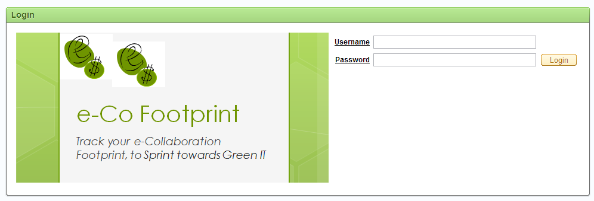
The Tool
http://apex.oracle.com/pls/apex/f?p=19546:LOGIN_DESKTOP:5496139680660:::::

Slide 38
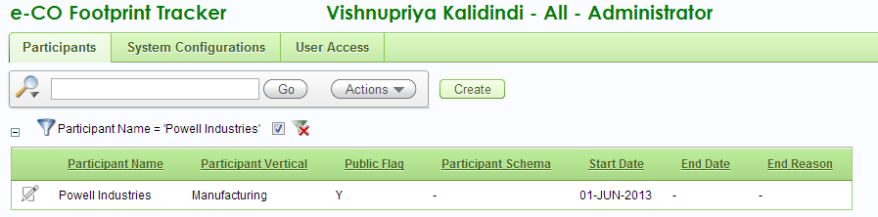
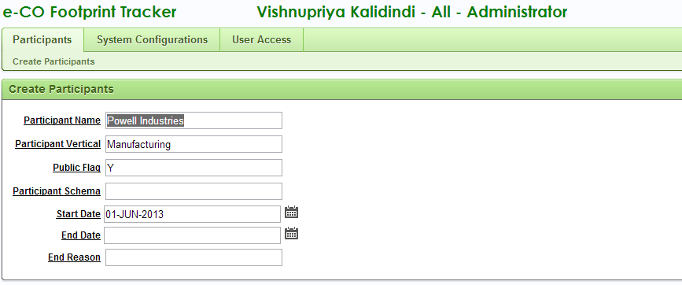
Participants Set up

Slide 39
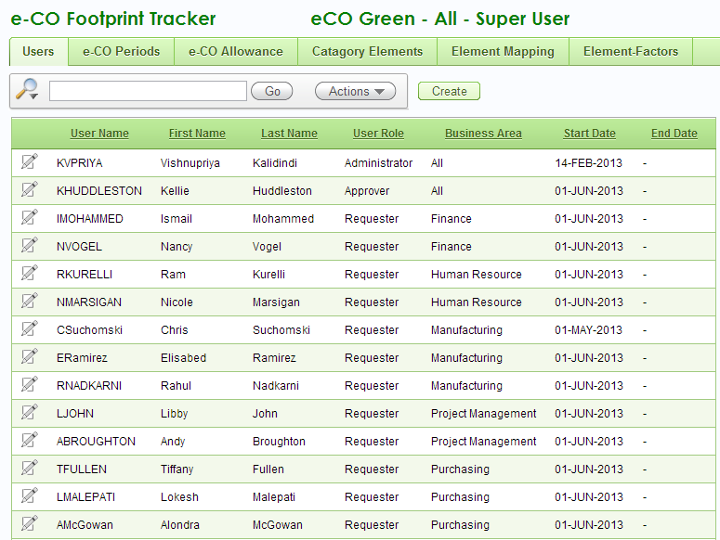
User Setup

Slide 40
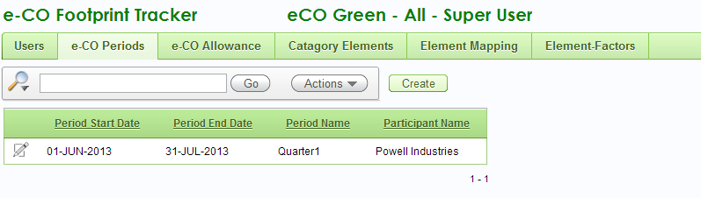
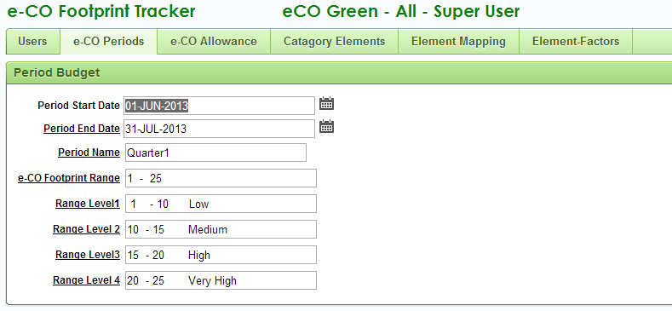
e-CO Period Set up

Slide 41
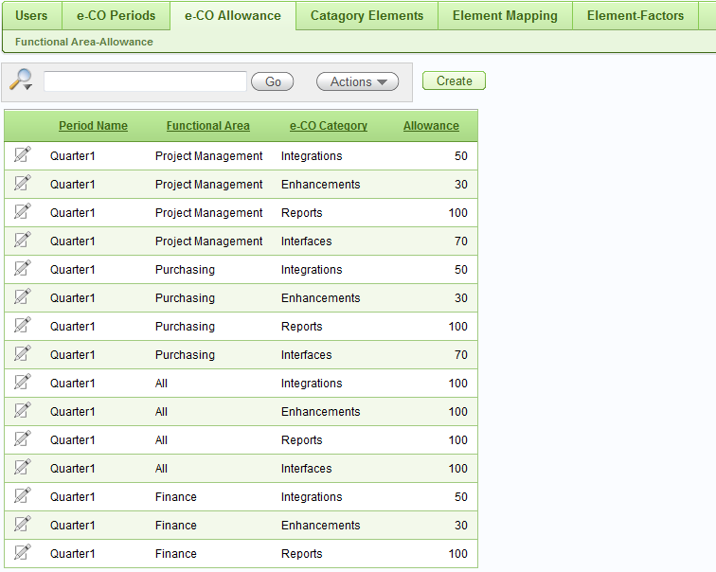
e-CO Allowances Set up

Slide 42
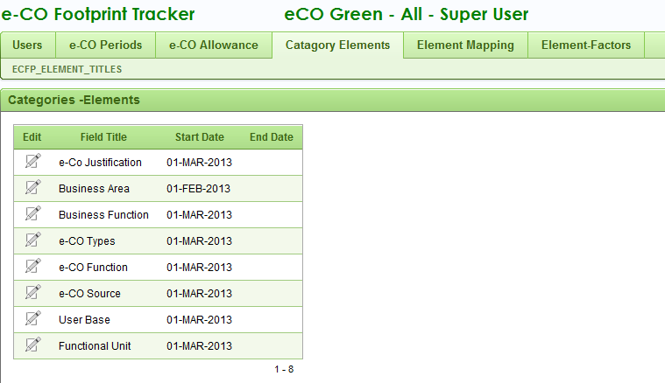
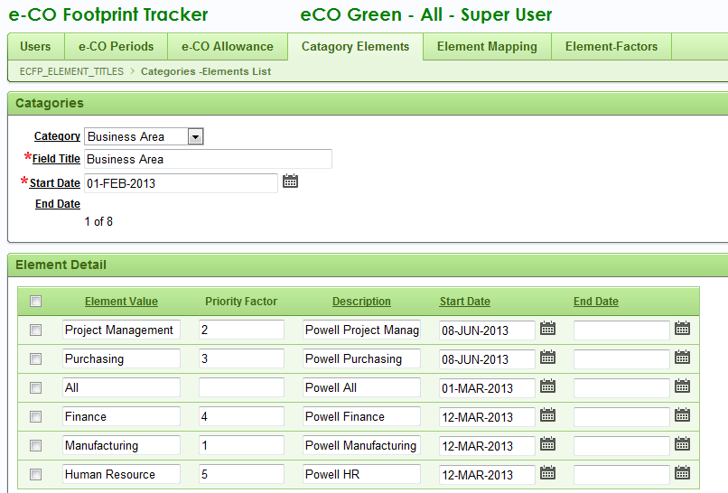
Category Element Set up

Slide 43
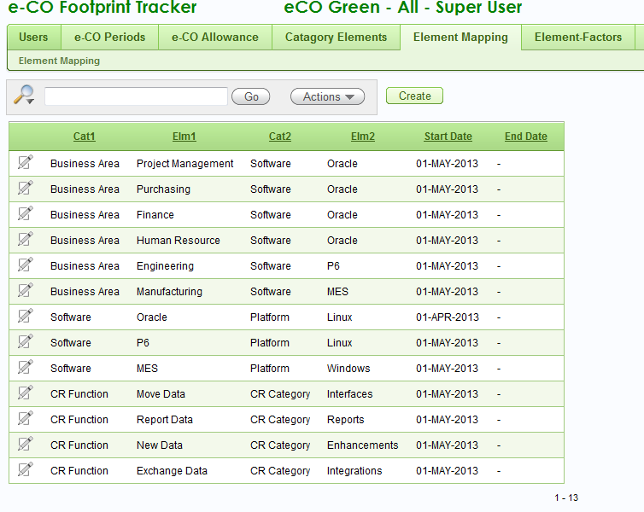
Element Mapping Set up

Slide 44
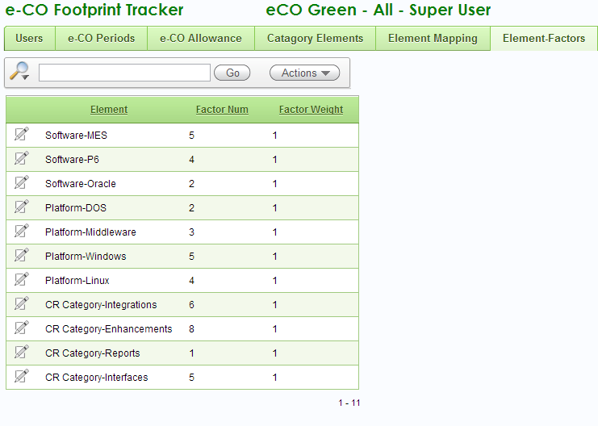
Element Factors Set up

Slide 45
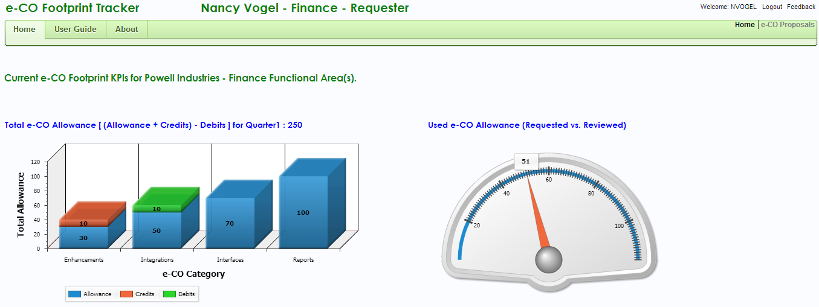
Requester Home Page

Slide 46
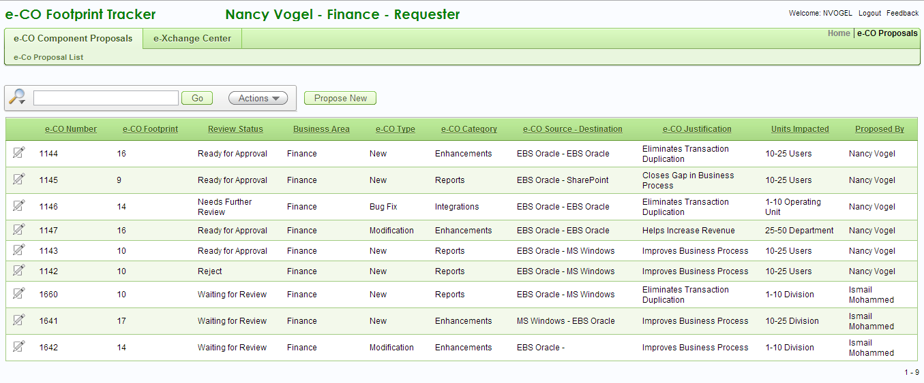
e-CO Component Proposal Interface

Slide 47
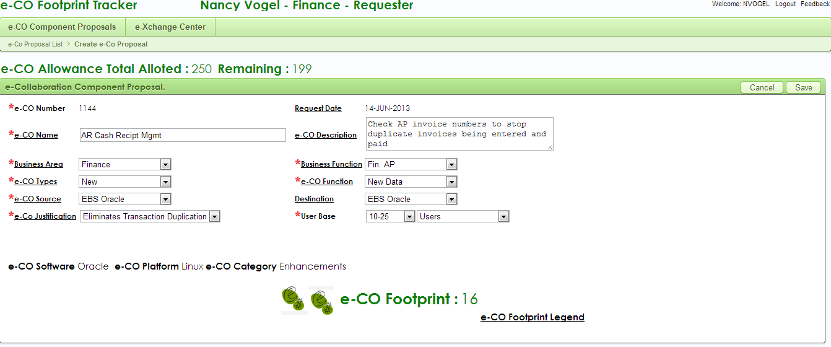
e-CO Component Proposal

Slide 48
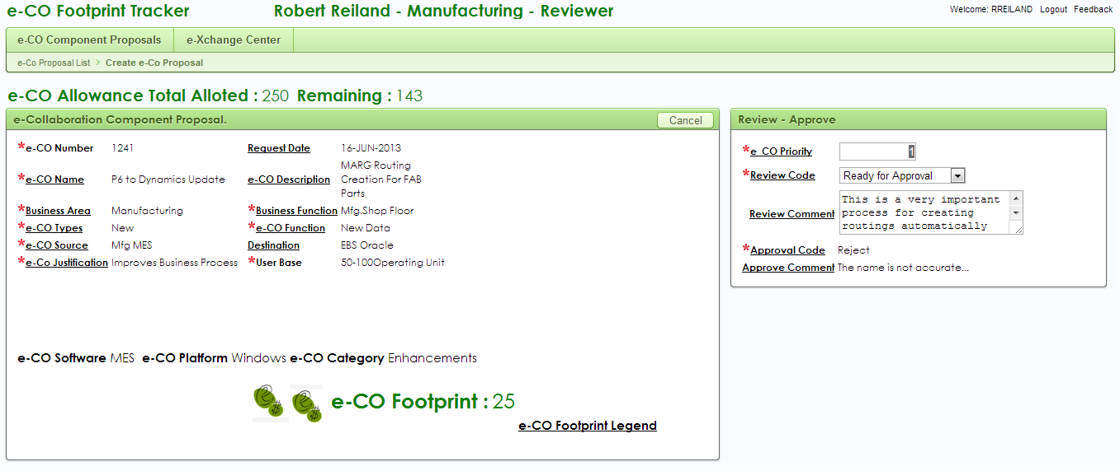
Review e-CO Proposal
The review code can be set to Ready for Approval only if the Category Allowance is more than the e-CO Footprint. If the Allowance is not sufficient the system will stop the transcation. Reviewers can buy more Allowance at the e-Xchange Center

Slide 49
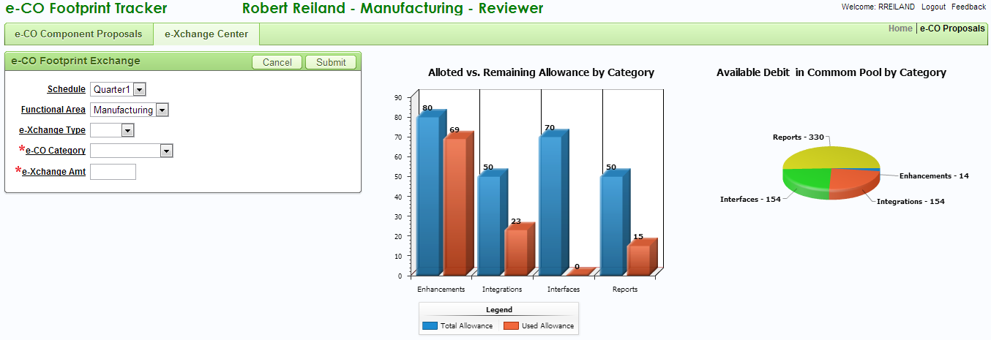
e-Xchange Center

Slide 50
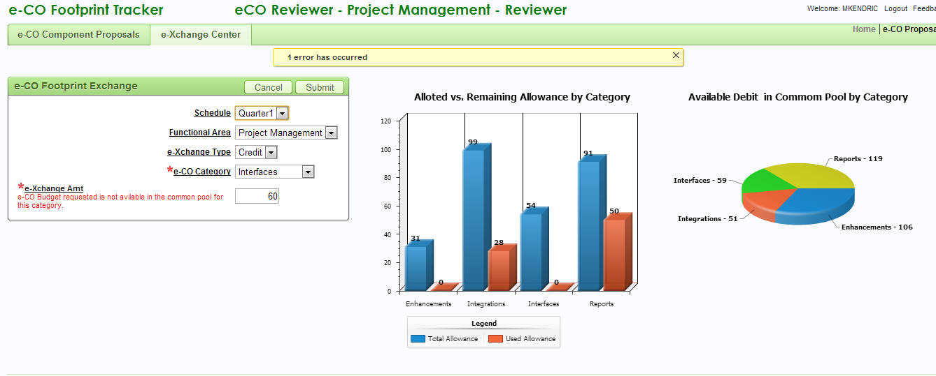
e-Xchange Center

Slide 51
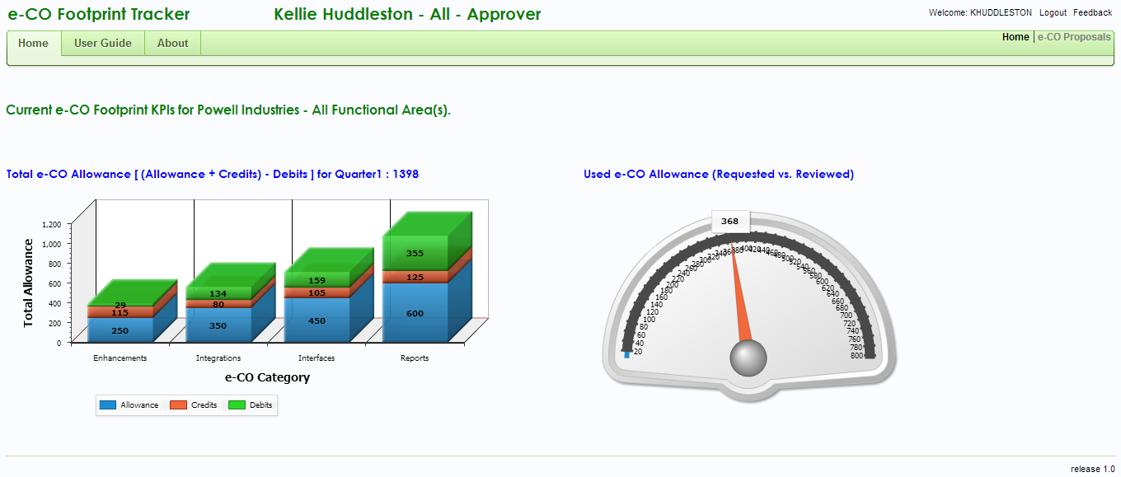
Approver Home Page

Slide 52
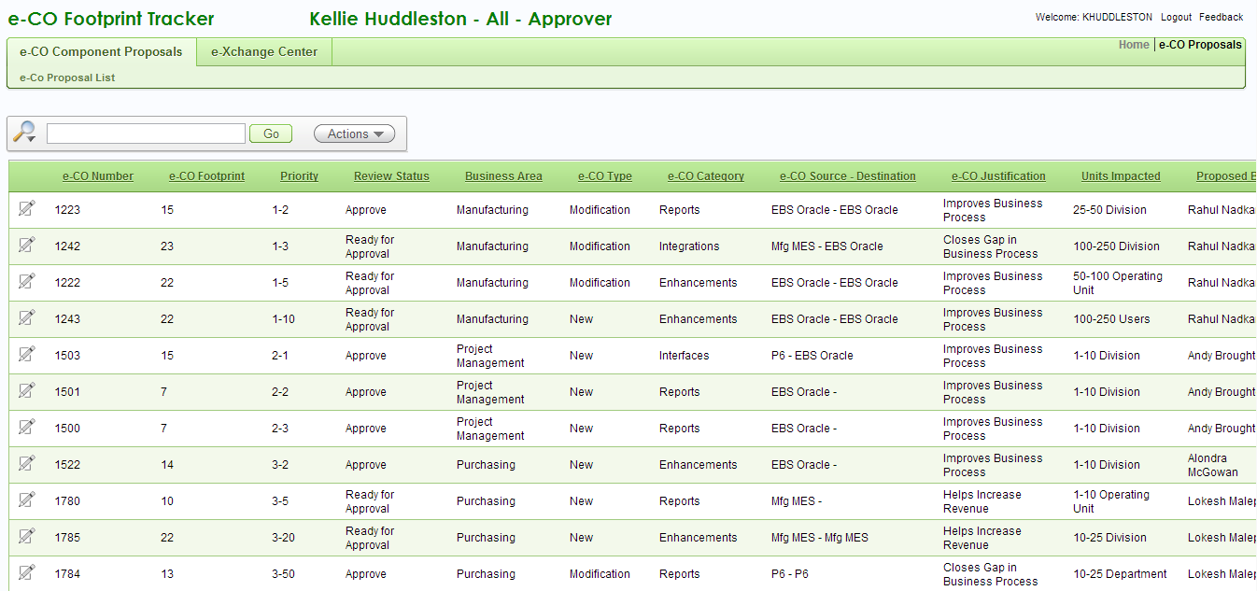
Approve e-CO Proposals

Slide 53
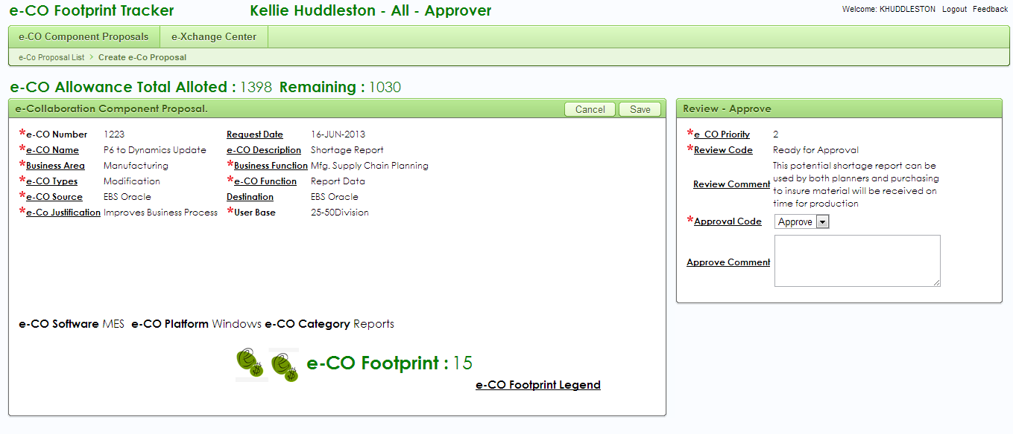
Approve e-CO Proposals

Slide 54
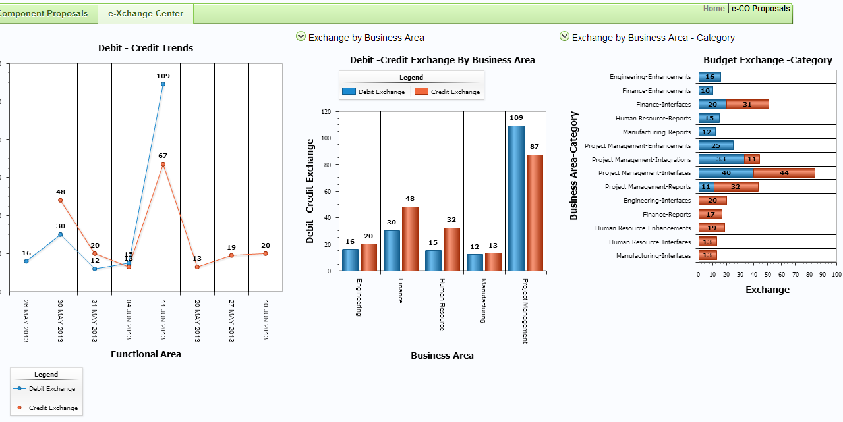
e-Xchange Center

Slide 55
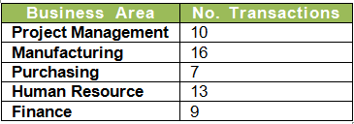
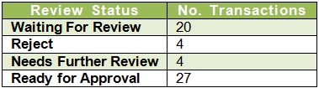
Transaction Summary

Slide 56
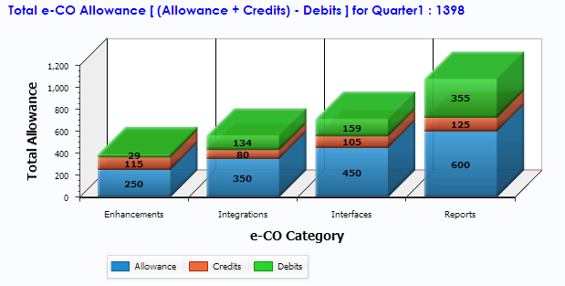
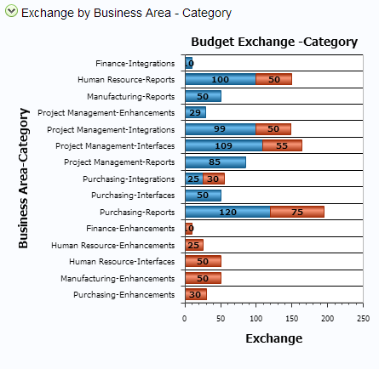
e-Xchange Transactions

