Slide 1
Approach for Semi-Automatic Extraction of Business Vocabularies and Rules from Use Case Diagrams
Authors:
Tomas Skersys, Paulius Danėnas, Rimantas Butleris
Center of Information Systems Design Technologies,
Kaunas University of Technology, Lithuania
Presenter:
Paulius Danėnas

Slide 2
Outline of the presentation
Research problem
Very short introduction of techniques used in research
Description of proposed approach
Experimental results
Conclusions

Slide 3
VEPSEM PROJECT
Stands for „Integration of Business Processes and Business Rules on the Base of Business Semantics“
Is run at Kaunas University of Technology, Center of Information Systems Design Technologies
The main goal is to integrate OMG standards BPMN, SBVR and UML into one visual modeling approach
Extraction of SBVR specifications is one of the goals of this project

Slide 4
Problem of the research
Use Case diagrams are key tools for requirement elicitation
Extraction of business vocabulary and business rules enables reuse of the knowledge represented in these diagrams
Synchronization with graphical requirement models, enhanced efficiency and quality of corresponding UML UC diagrams, reduced ambiguity and eliminated duplicates, etc.

Slide 5
Relevant research
Currently, most of related work deals with transformation of UML class diagrams to SBVR specifications and vice versa:
SBVR BV & BR→ UML Class Diagram (SBVR specification, Nemuraite et al., 2010, Bonais et al., 2012, Afreen et al)
UML Class Diagram → SBVR BV & BR (Cabot et al., 2010)
SBVR BV & BR→ UML Use Case Diagram (Thakore, Upadhyay, 2012):
Core concepts only – actors, associations and use cases;
Does not cover full UCD specification
NLP pattern based approaches to transform textual specifications to UML diagrams

Slide 6
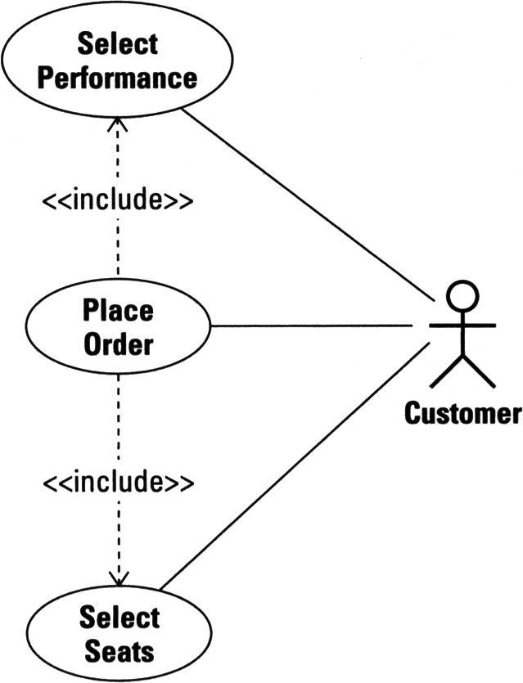
UML Use Case diagrams
Main tool for modeling requirements
Actors, use cases, relationships
More advanced concepts:
include, extend relationships
boundaries
generalizations

Slide 7
SBVR main concepts
SBVR stands for Semantics of Business Vocabulary and Business Rules
a novel standard enabling one to express business knowledge using controlled natural language, which would be unambiguous and understandable to business and IT people and also interpretable by computers
Version 1.0 released in 2008, current version is 1.2
Main concepts :
General concept, a specialization of noun concept which classifies things on the basis of their common properties ;
Verb concept denotes some type of relationship between two or more noun concepts or a characteristic of the noun concept. Following the definition, verb concepts are defined using the existing noun concepts, which have been already defined in BV;
Business rule, a rule that is under business jurisdiction

Slide 8
SBVR formating guidelines
‘term’ formatting is used to represent general concepts (object types) and roles, e.g. ‘sales clerk’. Best practices require that general concepts and roles are defined in singular form using lower case letters.
‘Name’ formatting represents individual concepts that usually are proper nouns and represents names, towns, countries, companies, etc. (e.g. ‘EURIS’, ‘Lithuania’). The first letter is usually capitalized.
‘verb’ formatting designates a verb, a preposition, or a combination of these two. Verbs are used in singular active or passive forms as synonymous forms (e.g., customer makes car booking, synonymously car booking is made by customer);
‘keyword’ font represents linguistic symbols that are used to construct statements and definitions, such as if, It is obligatory that, greater than, that and etc.

Slide 9
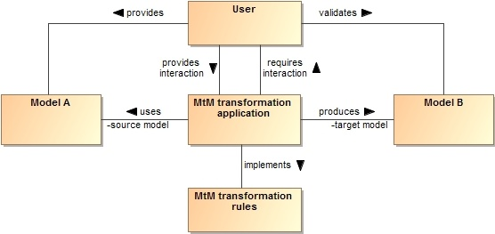
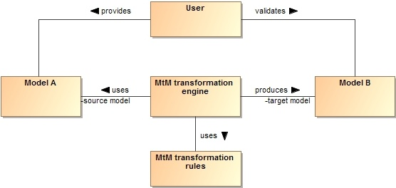
Level of automation
manual M2M transformation – performed exclusively by the user;
semi-automatic M2M transformation – partial user interaction, specific parts transformed automatically
automatic - without any user involvement; implemented as hard-coded applications or by using dedicated transformation languages

Slide 10
Mapping matrix notation
“A­_{{i}}” implies that a corresponding SBVR general concept, verb concept or rule can be automatically identified and extracted from one or more UCD elements;
“M­_{{i}}” implies manual (semi-automatic) identification and extraction of a corresponding SBVR general concept, verb concept or rule from one or more UCD elements;
Each UCD concept is supplied with unique index “i” (see the first column in the matrix). Then, a set of indexes next to the particular mapping A­_{{i}} or M­_{{i}} specify, which UCD concepts are used to form a corresponding SBVR concept or rule.
E.g., A­_{1,2,3} means that in our UCD → BV&R approach each association (: Association) in a given UCD will be a subject for automatic extraction of a SBVR verb concept
additional indexes i = 1 and i = 2 indicate that each instance of this extraction also involves certain UCD actor (Actor) and use case (UseCase) connected to each other via that particular association.

Slide 11
M2M mapping matrix
UML UCD (source) |  | SBVR BV&R (target)
Index | UCD concept | General Concept | Verb Concept | Business Rule
1 | Actor | A­₁ | - | -
2 | Use Case | M­₂ | - | -
3 | Association | - | A­_{1,2,3} | -
4 | Association Condition | M­₄ | M­₄ | M­_{1,2,3,4,10}
5 | Include | - | - | A­_{1,2,3,5,10}
6 | Extend | - | - | A­_{1,2,3,6,10}
7 | Extension Point | M­₇ | M­₇ | M­_{1,2,3,7,10}
8 | Generalization (between actors) | - | A­_{1,8} | -
9 | Generalization (between use cases) | - | - | -
10 | Boundary | A­₁₀ | - | -
11 | Comment | M­₁₁ | M­₁₁ | M­₁₁

Slide 12
Best practices for modeling UCD
Actors are represented as noun phreases
Only associations between Actor and UseCase are allowed – associations between two UseCase elements and two Actor elements are also possible, but discouraged to use;
UseCase names start with a verb and are followed by noun. It is possible that this noun has adjectives or is related to other nouns using composition (“of a”) or other relationships, although best practices advocate short use case names conforming to pattern <verb><subject> (e.g., Create Rental Contract);
Extension point is considered and defined as a boolean condition which defines destination point where functionality of an extending use case can be inserted into the base use case
Association cardinality in UCD is generally not considered as a best practice; it is not considered in this work.

Slide 13
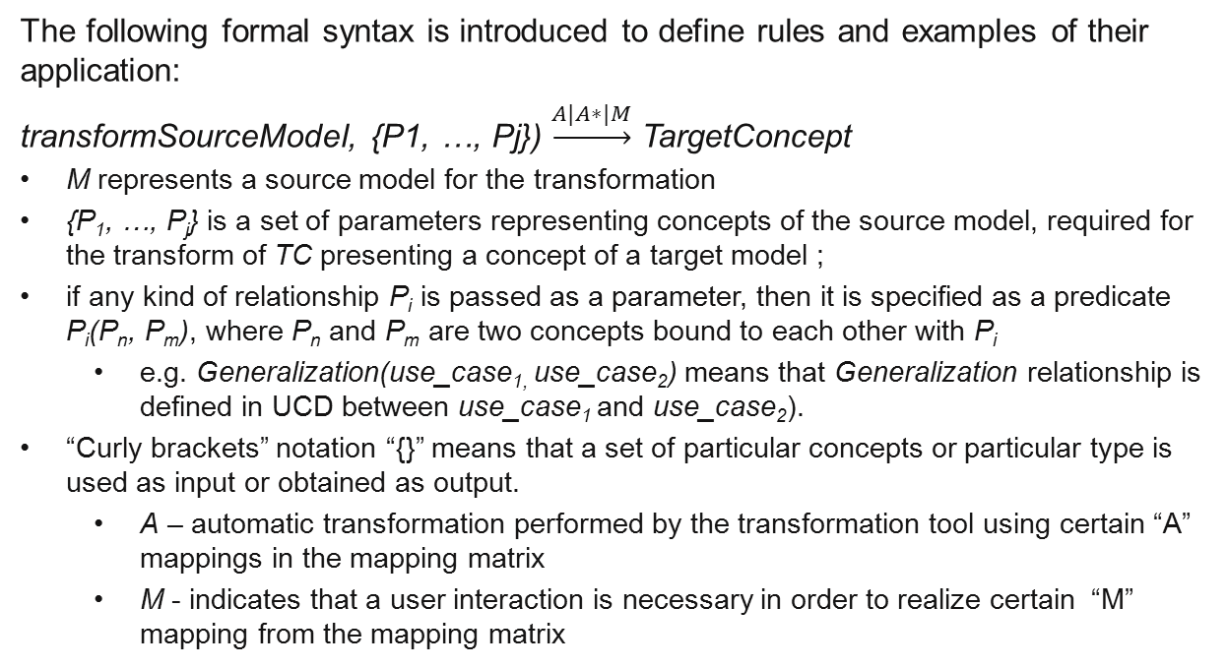
Transformation rules
The following formal syntax is introduced to define rules and examples of their application:
transformSourceModel, {P1, …, Pj}) $\underset{→}{A|A∗|M}$ TargetConcept
M represents a source model for the transformation
{P₁, …, P_{j}} is a set of parameters representing concepts of the source model, required for the transform of TC presenting a concept of a target model ;
if any kind of relationship P_{i} is passed as a parameter, then it is specified as a predicate P_{i}(P_{n}, P_{m}), where P_{n} and P_{m} are two concepts bound to each other with P_{i}
e.g. Generalization(use_case_{1,} use_case₂) means that Generalization relationship is defined in UCD between use_case₁ and use_case₂).
“Curly brackets” notation “{}” means that a set of particular concepts or particular type is used as input or obtained as output.
A – automatic transformation performed by the transformation tool using certain “A” mappings in the mapping matrix
M - indicates that a user interaction is necessary in order to realize certain “M” mapping from the mapping matrix

Slide 14
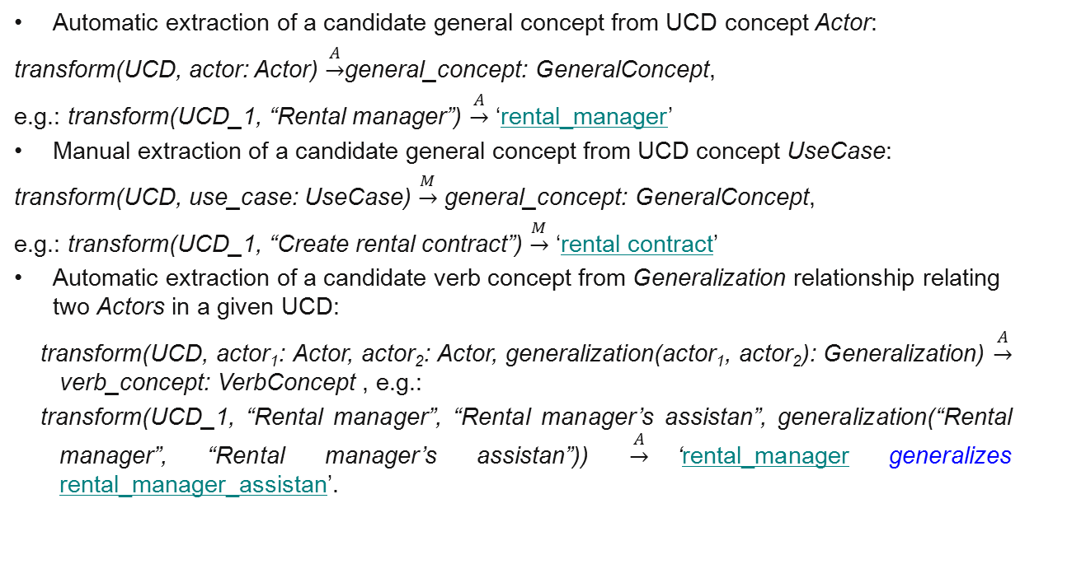
examples of transformation rules and their applications
Automatic extraction of a candidate general concept from UCD concept Actor:
transform(UCD, actor: Actor) $\underset{→}{A}$general_concept: GeneralConcept,
e.g.: transform(UCD_1, “Rental manager”) $\underset{→}{A}$ ‘rental_manager’
Manual extraction of a candidate general concept from UCD concept UseCase:
transform(UCD, use_case: UseCase) $\underset{→}{M}$ general_concept: GeneralConcept,
e.g.: transform(UCD_1, “Create rental contract”) $\underset{→}{M}$ ‘rental contract’
Automatic extraction of a candidate verb concept from Generalization relationship relating two Actors in a given UCD:
transform(UCD, actor₁: Actor, actor₂: Actor, generalization(actor₁, actor₂): Generalization) $\underset{→}{A}$ verb_concept: VerbConcept , e.g.:
transform(UCD_1, “Rental manager”, “Rental manager’s assistan”, generalization(“Rental manager”, “Rental manager’s assistan”)) $\underset{→}{A}$‘rental_manager generalizes rental_manager_assistan’.

Slide 15
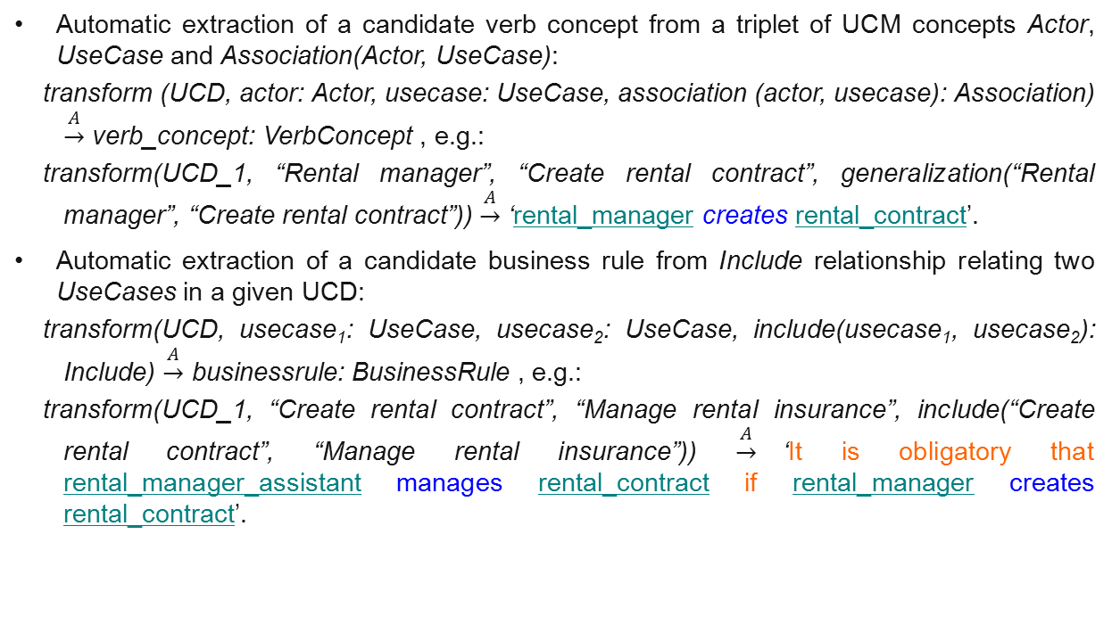
examples of transformation rules and their applications
Automatic extraction of a candidate verb concept from a triplet of UCM concepts Actor, UseCase and Association(Actor, UseCase):
transform (UCD, actor: Actor, usecase: UseCase, association (actor, usecase): Association) $\underset{→}{A}$ verb_concept: VerbConcept , e.g.:
transform(UCD_1, “Rental manager”, “Create rental contract”, generalization(“Rental manager”, “Create rental contract”)) $\underset{→}{A}$ ‘rental_manager creates rental_contract’.
Automatic extraction of a candidate business rule from Include relationship relating two UseCases in a given UCD:
transform(UCD, usecase₁: UseCase, usecase₂: UseCase, include(usecase₁, usecase₂): Include) $\underset{→}{A}$ businessrule: BusinessRule , e.g.:
transform(UCD_1, “Create rental contract”, “Manage rental insurance”, include(“Create rental contract”, “Manage rental insurance”)) $\underset{→}{A}$‘It is obligatory that rental_manager_assistant manages rental_contract if rental_manager creates rental_contract’.

Slide 16
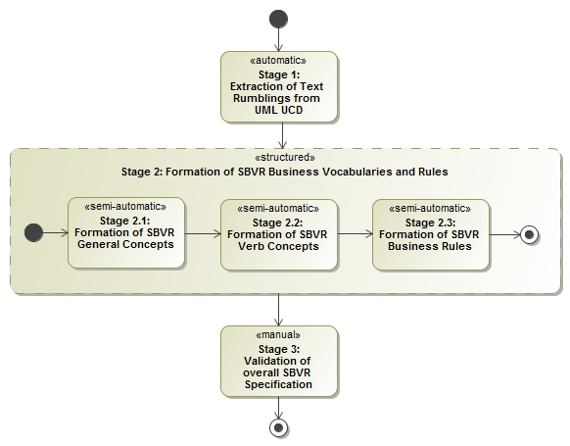
Basic algorithm of the semi-automated UCD → BV&BR Extraction approach

Slide 17
Prototype implementation
CASE tool MagicDraw UML :
full support for the newest official versions of UML, BPMN and other modeling standards; SBVR support is under development.
DSL technology and profile development capabilities;
Open Java API enables development of extensions (plug-ins) for MagicDraw UML.
BV&BR extraction tool working as a plug-in of the MagicDraw UML
SBVR editor VeTIS
a tool developed by the Department of Information Systems, Kaunas University of Technology, Lithuania.
supports the development and syntactic validation of SBVR BV&BR.

Slide 18
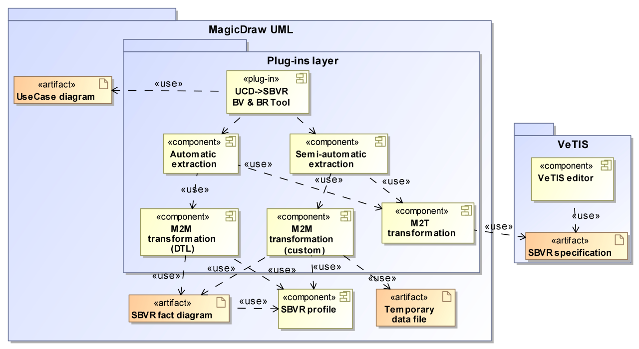
Implementation (including planned features)

Slide 19
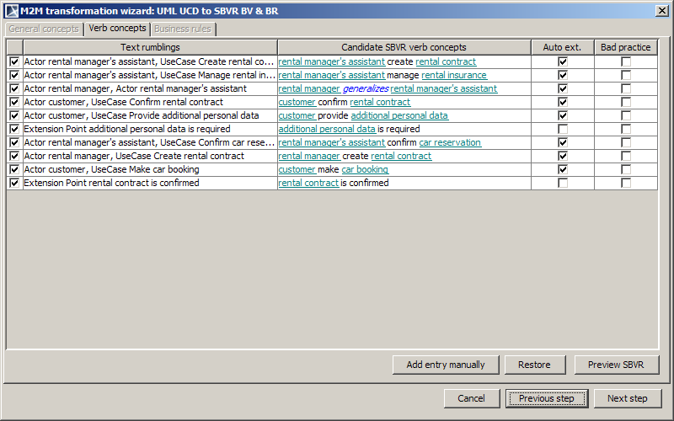
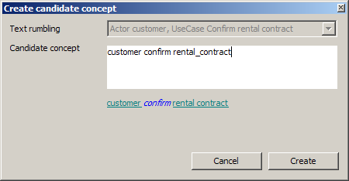
Prototype implementation dialog

Slide 20
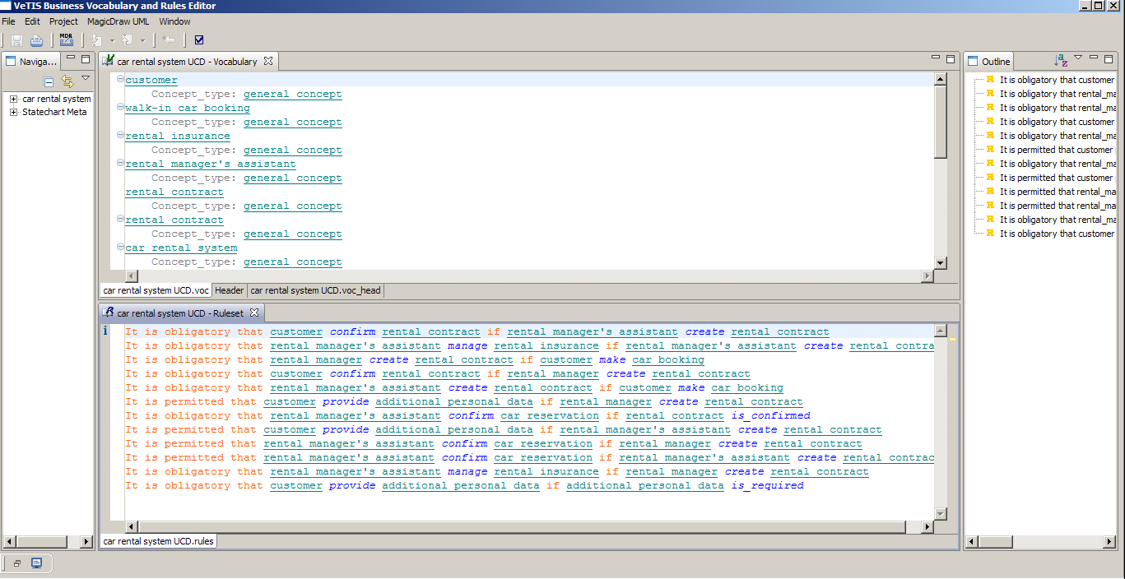
SBVR model (VeTIS OUTPUT)

Slide 21
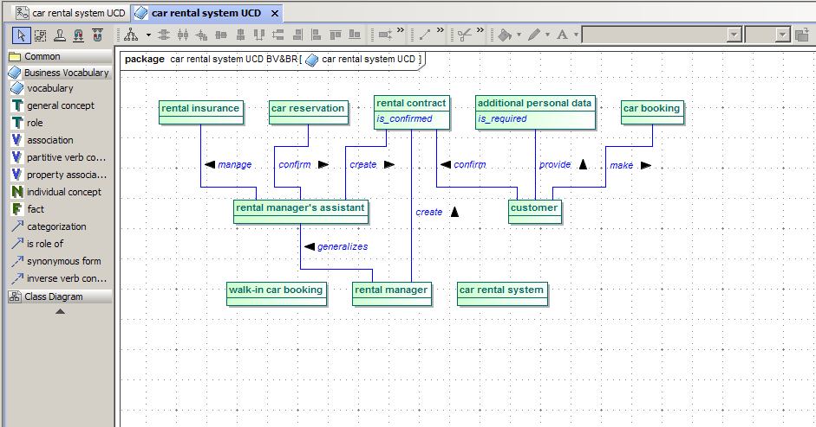
SBVR model (MagicDraw UML fact diagram)

Slide 22
Future prototype enhancements
Extensions to support other UML diagrams and BPMN BPD
UML class diagrams and statechart diagrams are of particular interest to VEPSEM
BPMN BPD diagrams are also researched
Advanced NLP-based processing
Further improvements

Slide 23
Experimental evaluation results
Extraction from properly formed UCD resulted in uncomplicated extraction process
UCD with inconsistent naming schemes provided higher rate of errors in the results of low-experienced SBVR users; experienced SBVR users dealt with naming inconsistencies fluently.
Low-experienced SBVR users struggled while extracting valid candidate business rules from text rumblings.
During the BV&R extraction process users detected invalid uses of UML syntax and bad practices in the given diagrams. This proved our presumptions that the quality of use case diagrams can also be improved during the extraction process or after it.
Comparison of task execution times showed that it could take almost twice as much time to complete the task with unsound source diagrams compared to the time needed to extract BV&R from the sound ones.

Slide 24
Conclusions
Diagrams might be might be complemented with natural language-like specifications, which can be either semantically identical to graphical models or convey additional information.
BV& BR specifications should not be necessarily developed from scratch – automated extraction tools may help to extract them from existing specifications
Our research confirmed that SBVR BV&BR can indeed be extracted from UML use case diagrams
We propose formal description ansd mappings and rules for extraction as well as prototype implementation
The experiments concluded that it enabled faster development of well-structured, formalized business vocabularies and rules
The proposed approach can be the basis for similar processing of other UML diagrams as well; it is still under research

Slide 25
Thank you for listening
Questions???

