Slide 1
Modeling Financial Statement Preparation of a SME Enterprise by an Accountancy Firm
Joop de Jong

Slide 2
Financial Statement
A formal record of the financial activities of the business of the organization. It includes relevant financial information in a structured way and in a standardized format.
The financial statement has to be prepared according to legal rules and according to professional guidelines of independent accountants.
The financial statement is usually required for calculating the tax amount, getting bank loans, etc.

Slide 3
Initial question:
After setting up, the financial statement is presented (the ‘state’) and they ask me to give my signature below the next statement:
Finally, we acknowledge our responsibility for the financial statement. We confirm that we agree this financial statement for the concerning financial year.
What does the underlined part mean?

Slide 4
Further questions arise:
Is the financial statement only the result of an infological process or are original facts also created by them?
Is an infological process defined for something that happens once a year?
What is the construction model for deriving (?) the financial statement?

Slide 5
Some ontological P-acts performed by the accountant
Assessing the current value of the tangible assets. Estimating the durability and the residual value.
Identification and assessment of obsolete inventories.
Estimating the amount of doubtful accounts
Estimating the progress of ongoing projects, estimating any provision for loss-making projects
Determining the level of provisions
Estimating payables whose amount is currently unknown
Determining correctness of mutual fees
Determining whether non-balance sheet liabilities in the financial statements are disclosed
Checking whether relevant events are reported after the balance sheet date

Slide 6
Inquiry:
It appears that the accountant not only performs infological, but also ontological transactions.
He is doing that without consulting his customer.
He wants to prevent accountability by asking a signature

Slide 7
Sourcing:
What about sourcing:
Do the accountants fulfill actor roles from the organization or do they only fulfill actor roles in their own organization.
The process can be isolated from the other processes in the organization. It is based on a relevant set of original facts.
The process of deriving a financial statement is similar for all enterprise. Therefore, it can be performed by specialist firms (e.g. an accountancy firm)

Slide 8
Theoretical Foundation (Hevner)
Enterprise Engineering Paradigm
PhD Thesis – De Jong (2013) “A Method for Enterprise Ontology based Design of Enterprise Information Systems”
Way of modeling: Infological system
Implementation independent model is the basis for determining EIS scenarios.

Slide 9
Some ontological P-acts performed by the accountant
Assessing the current value of the tangible assets. Estimating the durability and the residual value.
Identification and assessment of obsolete inventories.
Estimating the amount of doubtful accounts
Estimating the progress of ongoing projects, estimating any provision for loss-making projects
Determining the level of provisions
Estimating payables whose amount is currently unknown
Determining correctness of mutual fees
Determining whether non-balance sheet liabilities in the financial statements are disclosed
Checking whether relevant events are reported after the balance sheet date

Slide 10
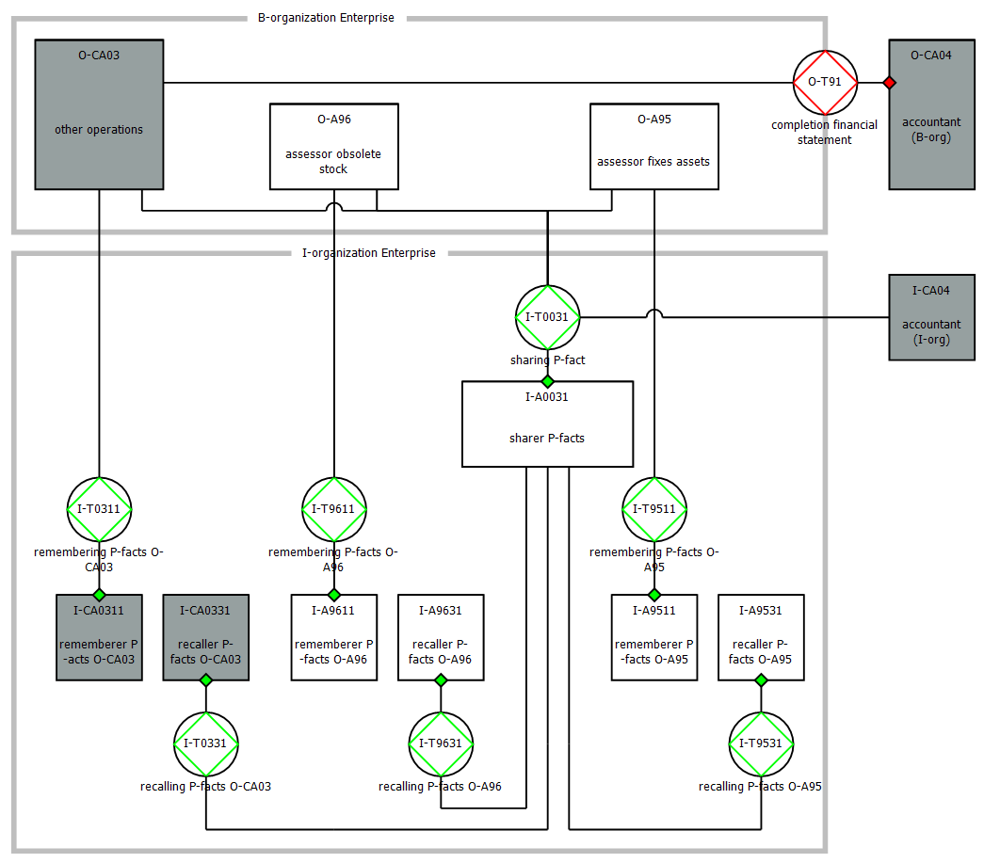

Slide 11
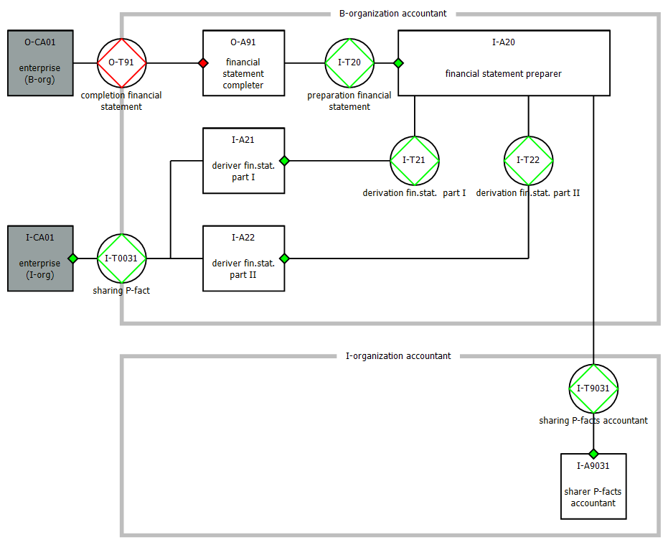

Slide 12
Initial question:
After setting up, the financial statement is presented (the ‘state’) and they ask me to give my signature below the next statement:
Finally, we acknowledge our responsibility for the financial statement. We confirm that we agree this financial statement for the concerning financial year.
What does the underlined part mean?

Slide 13
Conclusion
Accountant performs both ontological and infological transactions
Reponsibilities:
Ontological – enterprise
Infological – accountancy firm
Letter of confirmation gives rise to ambiguities.
The accountant should only ask the management to sign only for taking over the responsibility for the ontological production acts they execute.

Slide 14
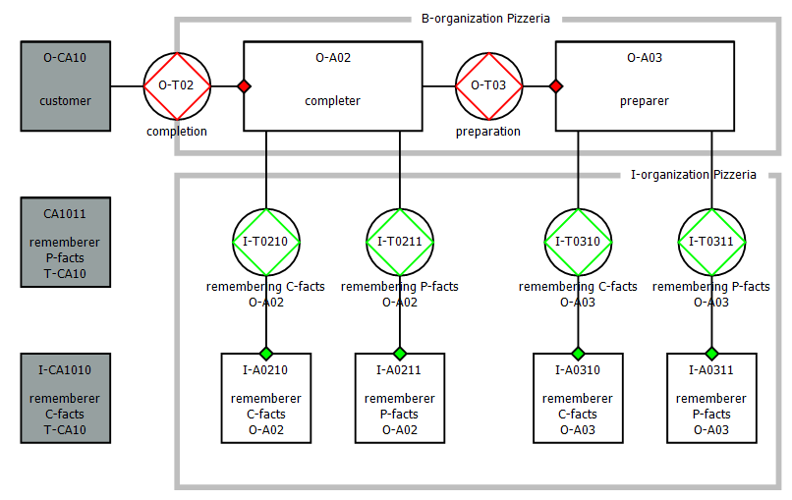

Slide 15
