Slide 1
Cross Channel Communication Architecture
ir. Mark Mulder

Slide 2
Content
Current Situation and Definitions
Cross Channel Perspectives
Research Questions & Method
Cross Channel Communication Architecture
Theories
Processor and Protocol Construction
Protocol Architecture
Design Example
Conclusion & Future steps

Slide 3
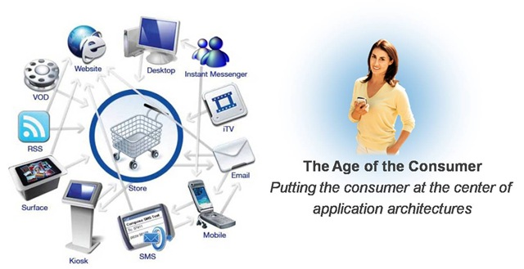
Current Situation

Slide 4
Existing Definitions
Cross Channel Marketing (Business dictionary)
Use of one marketing channel (such as direct mail or internet) to support or promote another channel (such as retailing).
Cross Channel Marketing (Marketing facts)
Cross-channel marketing is using multiple supporting channels to send the same message from a customer centric point of view to support the customer journey.
Cross Channel Marketing (Smarter Commerce)
The creation and promulgation of campaigns that take into account customer preferences and engage recipients on their chosen platform and via their preferred medium.

Slide 5
Definitions
Cross Channel Communication
The communication over bi-directional digital channels that take into account customer preferences and engage recipients via their preferred channel.
Architecture
The normative restriction of design freedom.

Slide 6
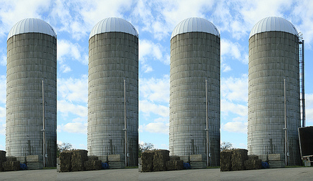
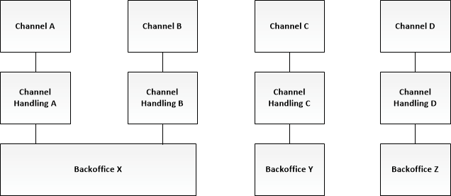
Current solution
Multiple communication channels (silos)
Frequent organizational changes
Multiple IT changes
Overlapping changes

Slide 7
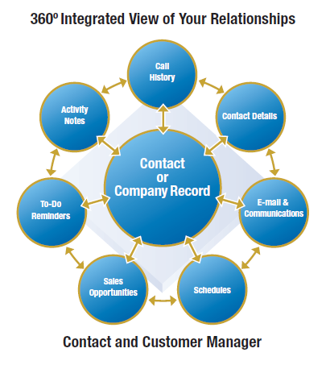
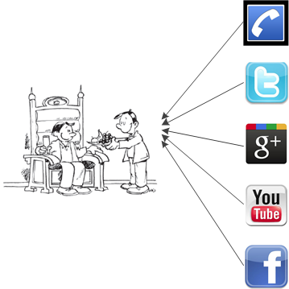
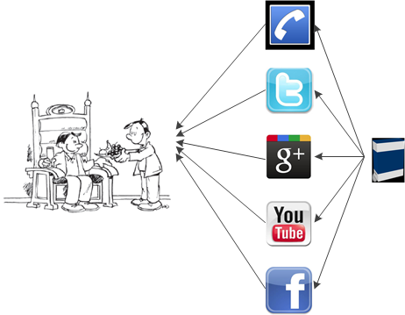
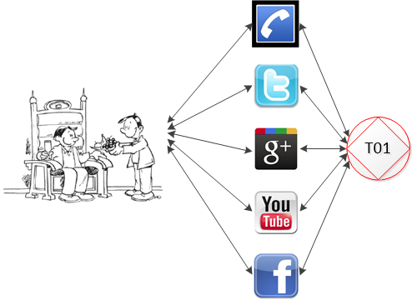



Cross Channel Perspectives
Marketing
Information
Communication
Uniform User Experience
Uniform information
Uniform transactions
Research

Slide 8
Research Questions
How can C³A be defined in such a way it is an extension to existing single and multi-channel architecture?
How can a social transaction in the B-organisation as described in the Ψ-theory be implemented and supported by a computer program based on the π-theory and δ-theory in such a way a cross channel communication protocol can be based on Ψ-transactions?
How can the communication context be preserved between channels during a transaction within C³A?

Slide 9
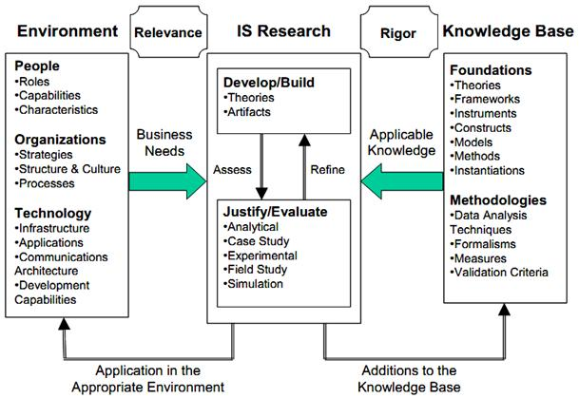
Design Science Research
Hevner? van Aken? Design/Develop Artefacts & Justify

Slide 10
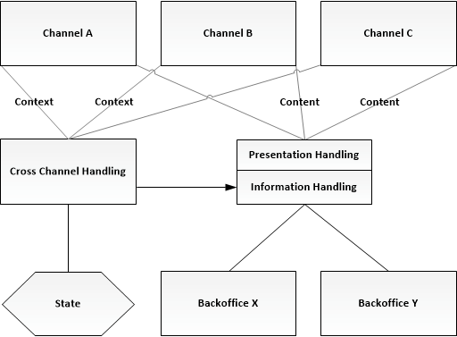
Cross Channel Communication Architecture - C³A
Marketing
Pres. Handling
Information
Inf. Handling
Communication
CC Handling
Silos only customer facing.

Slide 11
Theories
Ψ-theory
π-theory
NS-theory
DES
…

Slide 12
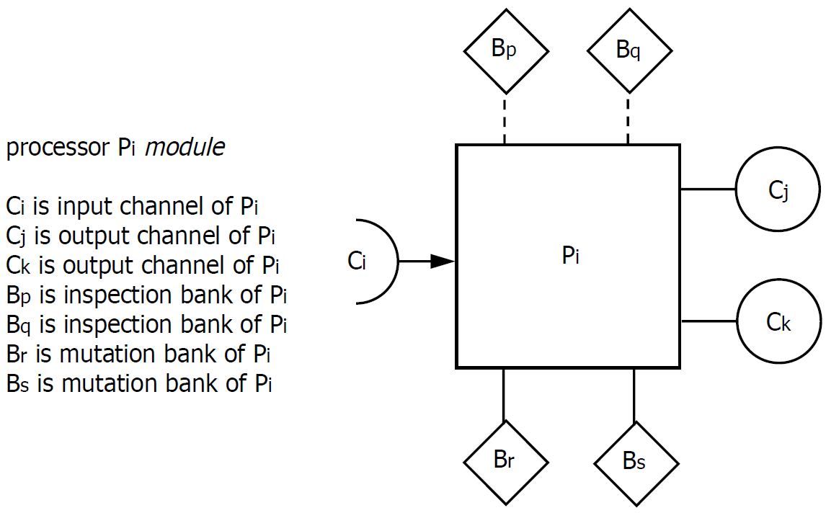
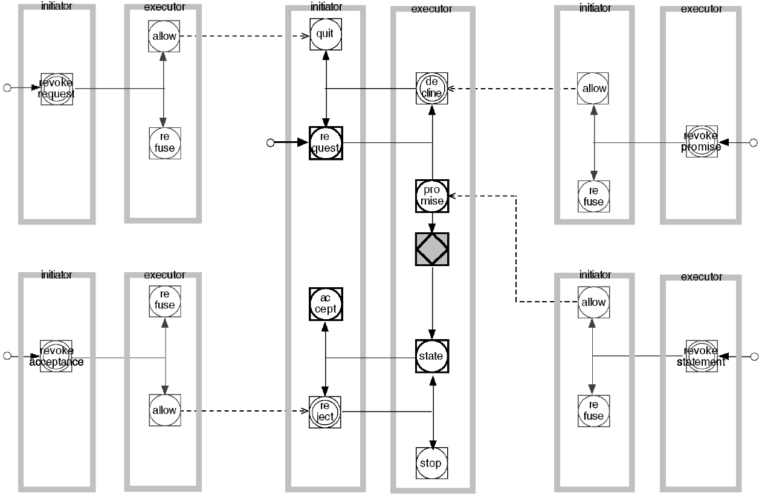
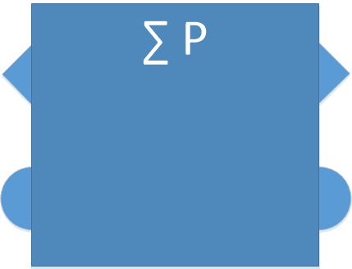
Transaction processor construction

Slide 13
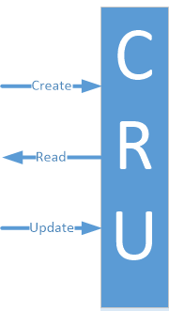
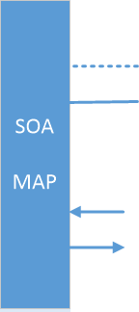
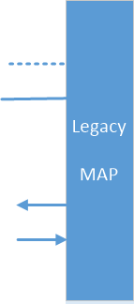
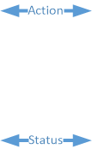

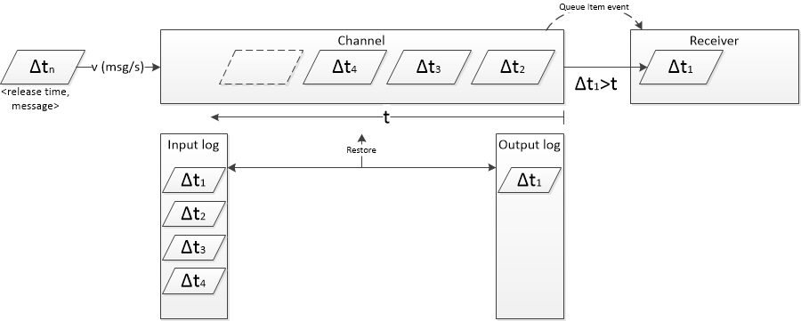
Protocol construction

Slide 14
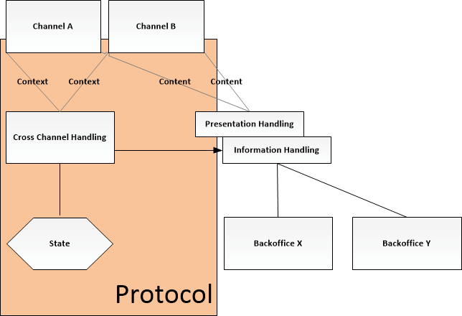
Protocol Architecture

Slide 15
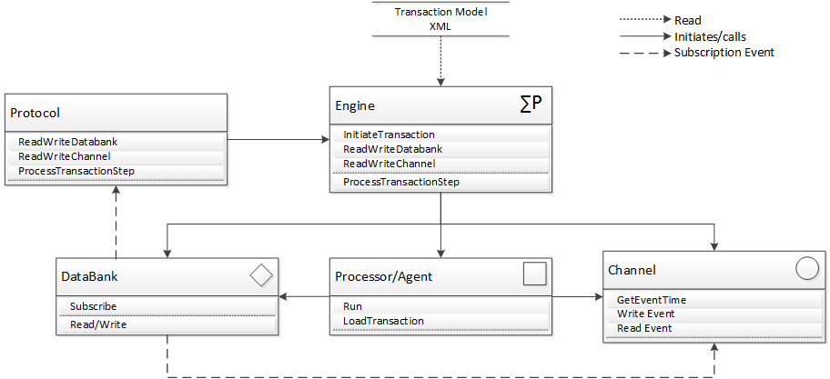
Design Example

Slide 16
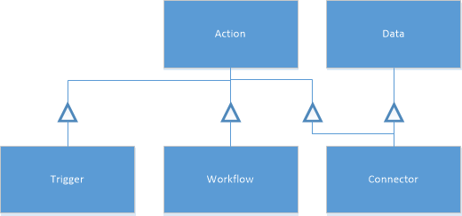
Normalized Systems
separation of concerns (1)
version transparency (2, 3)
separation of states (4)

Slide 17
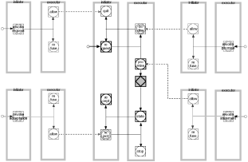
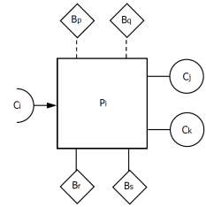
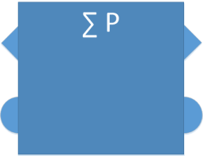

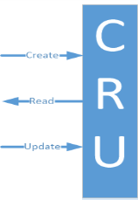

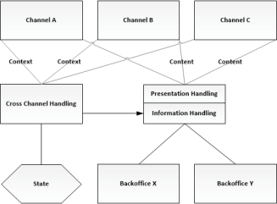
Artefacts
DES
π-channel
Processor
Engine
SOA Mapping
Legacy Mapping
Protocol
Architecture

Slide 18
Future Steps
Defining and verifying the (need of) artefacts
Designing and building the artefact
Justify the artefacts in case studies

Slide 19
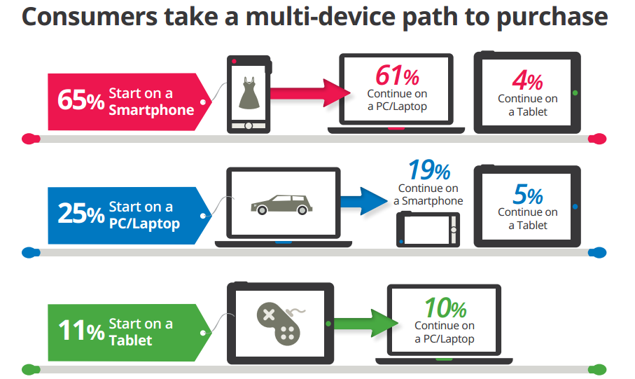

Slide 20






































