Slide 1

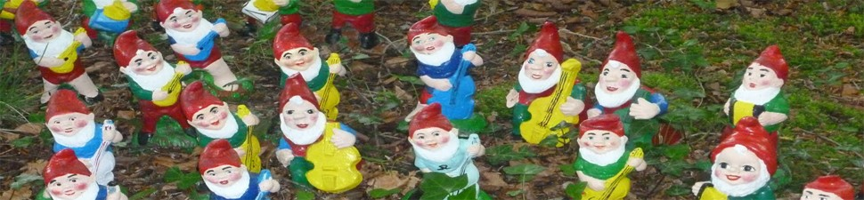
Federal University of Minas Gerais
School of Information Science
Research group: RECOL
Ontological Principles of Documents Acts in DEMO Method: A case study in the context of Public Health Institution
Kátia Coelho Maurício Almeida (Supervisor) David Aveiro (Co-Supervisor)
14th CIAO! Doctoral Consortium
Funchal, Madeira, Portugal

Slide 2
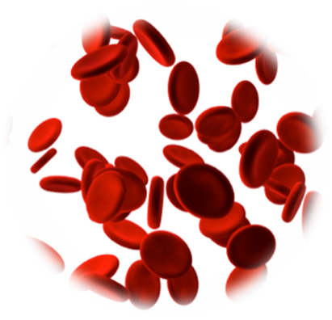
About me
Kátia C. Coelho
PhD Candidate in Information Science at School of Information Science - Federal University of Minas Gerais, Brazil
Job and research: at Foundation Center of Hematology and Blood Transfusion of Minas Gerais, Brazil - Hemominas Foundation - where our research will be developed
Hemominas provides services in areas of hematology and transfusion medicine, which develops healthcare, education, production, quality control, health education activities, and develop research in different areas, contributing to the scientific knowledge in different science fields

Slide 3
Acknowledgment
References
Authors, their work and lessons
Almeida M.B,
Aveiro, D.S
Brochhausen
Dietz, J.L.G
Slaughter L,
Smith, B
and others not mentioned here

Slide 4
Agenda
Current stage
Introduction
Motivation
Objectives
Background
Methodology
Final remarks and future work

Slide 5
Current stage
This paper presents our research proposal
Doctoral thesis in early stage - Beginning: 2013, August
This paper was not improved as desired
there was no enough time to include such improvements
there is need of collecting additional data of the Hemominas processes
there is need to study Joop de Jong thesis to properly address it here

Slide 6
Introduction
Scope: Enterprise Ontology
The context: DEMO
it aims to develop models of the construction and operation of organizations
it independent of the actual implementation, by focusing on the communication patterns between human actors
communication between human actors is a necessary and sufficient basis for a theory of organizations
Although theoretical approach of the Enterprise Ontology and DEMO Method are relevant and will be discussed in depth in our PhD thesis, both of them are not discussed specifically in this paper

Slide 7
Introduction
Problems in representing organizations
Processes increases in complexity
Challenge: Given this complexity, organizational processes undergo constant restructuring in order to suit the goals of the organization.

Slide 8
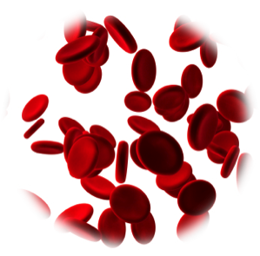
Motivation
The context
What is missing is a good representation about processes
connection between organizational processes and organization's documents?
Documents are disseminated troughout social life and they are crucial entities for any organization

Slide 9

Motivation
The context: the domain of hematology and blood transfusion
Hemominas: it has chosen to take its management model and its practices evaluated by an outside agency, specializing in the evaluation of hematology and transfusion medicine, legitimacy attested by the Ministry of Health service, to ensure its quality condition of finalistic processes.
Difficulty the majority of methods are not be able to produce models that represent organizations, either because organizational processes are only in people's minds or because they are not formally recorded in documents.

Slide 10
Objectives
Main goal
to check improvements in the process modeling activity using DEMO through a connection between organizational processes and documents.
Secondary goals
to add improvements to DEMO via d-acts
to test results of DEMO in real processes of a public health institution, in the field of hematology and transfusion medicine
Next pages: We will present our main subject, namely Document acts (d-acts), which we will connect our research to such approaches already established

Slide 11

Background
Document Acts Theory
Ontological principles proposed by Barry Smith
about the author
Smith studied Mathematics and Philosophy at the University of Oxford, and he obtained his PhD from the University of Manchester for a dissertation on the Ontology of Reference
Since 1994 - Professor of Philosophy and Adjunct Professor of Biomedical Informatics, Computer Science, and Neurology in University at Buffalo (New York, USA)
Author of some 500 scientific publications, including 15 authored or edited books. He is also editor of The Monist: An International Quarterly Journal of General Philosophical Inquiry.

Slide 12
Background
Document Act Theory
it is an extension of the speech acts theory due to Austin and also to Searle
it does justice to how documents can be used to cause a variety of effects. Speech is evanescent, documents endure through time
documents can be more than just reports, they can add something to reality
they also have social and institutional powers (legal, ethical), named deontic powers
documents can be preserved so that they can be inspected and modified in successive points in time and grouped into complexes lasting documents
Notes:
Deontic power value that expresses an obligation or permission
on the Greek dé on - which is mandatory

Slide 13
Background
Speech Acts Theory
provides an explanation of how entities begin to exist
but... it also can serve as the physical basis for the temporally extended existence of such entities and for their enduring power to serve coordination.
small societies and in simple social interactions:
we might reasonably identify this physical basis with the memories of those involved.
but... how this works in large societies?
highly complex social interactions, involving who may enjoy little or no prior personal acquaintance
interactions which may evolve through time, and here individual memories will rarely.

Slide 14
Background
Growth in size and reach of civilization: have been extended through documents in ways which give rise to essential new types of social reality
a document can remain the same over time, it can be:
signed and initialed
stored,
registered,
inspected,
transmitted,
copied,
ratified,
canceled,
stamped,
forged,
hidden,
lost or destroyed

Slide 15
Background
it sets can be chained and combined to form new complexes documents whose structures reflect the underlying human relationships
it enable new kinds of lasting social relationships
It enable new forms of social entities, allowing the evolution of new dimensions of economic reality

Slide 16
Background
Documents plays an essential role in many social interactions and can unite people, groups or nations in a lasting way
Different sorts of things we can do to a document...
fill it in
sign it
stamp it
inspect it
copy it
file it
... and of the different ways in which one document can be transformed into a document of another type: example, when a license is annulled.
Notes:
preenchê-lo assiná-lo carimbá-lo inspecioná-lo copiá-lo registrá-la

Slide 17
Background
Different sorts of things we can do (achieve, effect, realize) with a document
create an organization
record the deliberations of a committee
initiate a legal action
release funds
confirm flight readiness
Institutional systems to which documents belong in areas
marriage
law
government
commerce
credentialing
identification
as well as real estate property titling systems
credit reporting systems
credit card payment systems
taxation systems
and so on

Slide 18
Background
the provenance of documents: ways in which documents are created as products of document acts
when documents with deontic powers are created through an official act of printing in a parliamentary digest
provenance of documents
ways in which documents are created as products of document acts of special sorts as when documents with deontic powers:
are created through an official act of printing in a parliamentary digest
ways in which documents are anchored to extra-documental reality
through the inclusion of photographs, fingerprints, and so forth
ways in which documents are authenticated and protected through security devices
signatures and passwords.
Notes:
proveniência dos documentos

Slide 19
Background
Documents and their Generative Powers
contract creates obligation | stock and share certificate creates capital
statute of incorporation creates company | examination document and diploma create qualification
deed creates privilege | declaration of war creates (initiates) state of war
title deed creates property right and property owner | bankruptcy certificate creates bankrupt
cadastral map creates real state parcel | rulebook creates rules
statute of incorporation creates corporation | insurance certificate creates insurance coverage
birth certificate creates evidence of birth | receipt creates evidence of payment
patent creates exclusive rights (granted to an inventor) | license creates official permission to perform certain acts
statement of accounts creates audit trail | lease creates landlord/tenant relationship
marriage license creates bond of matrimony | IOU note creates obligation to pay
warning label creates immunity | proxy form creates medical proxy
Smith, 2012

Slide 20
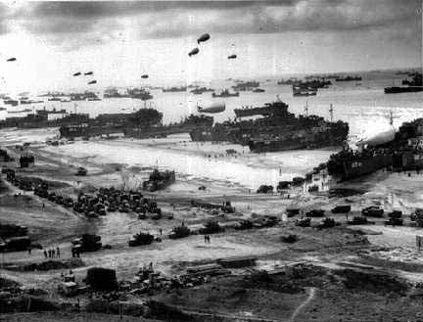
Smith, 2012
Notes:
http://www.google.com/imgres?um=1&hl=en&tbo=d&biw=1366&bih=610&tbm=isch&tbnid=xvBuU3znJmnzLM:&imgrefurl=http://www.rjgeib.com/heroes/draper/german-point-of-view.html&docid=__bCJ0XzNrdPlM&imgurl=http://www.rjgeib.com/heroes/draper/d-day-beach.jpg&w=432&h=329&ei=fjfDUL-1O5HssgbSmoDYAg&zoom=1&iact=rc&dur=578&sig=112516764352206821928&page=1&tbnh=136&tbnw=198&start=0&ndsp=18&ved=1t:429,r:2,s:0,i:156&tx=54&ty=87

Slide 21
Background
These new practices bring documentary changes in social relations, the also bring new social artifacts
receipts
money
identity documents
criminal records
signatures
templates of documents
checks
official seals
bank accounts
liens
insurance policies
credit cards
contracts
shares
mortgages
… and so on

Slide 22
Background
How to do things with words (speech act theory)
How to do things with documents (document act theory)
We represent how things are:
record, report, description, assertion …
We try to get people to do things: request, order, command …
We commit ourselves to doing things:
promise, agreement, …
We bring about changes in the world through utterances
declaring, baptizing, marrying, promoting, hiring, testifying …
We represent how things are:
map, chemical diagram, x-ray image, …
We try to get people to do things:
blueprint, wiring diagram, training manual…
We commit ourselves to doing things
contract, planning agreement, flow chart…
We bring about changes in the world through document acts
official stamp, serial number, seal, signature, …
Smith, 2012
Notes:
Searle 1996, p. 9.

Slide 23
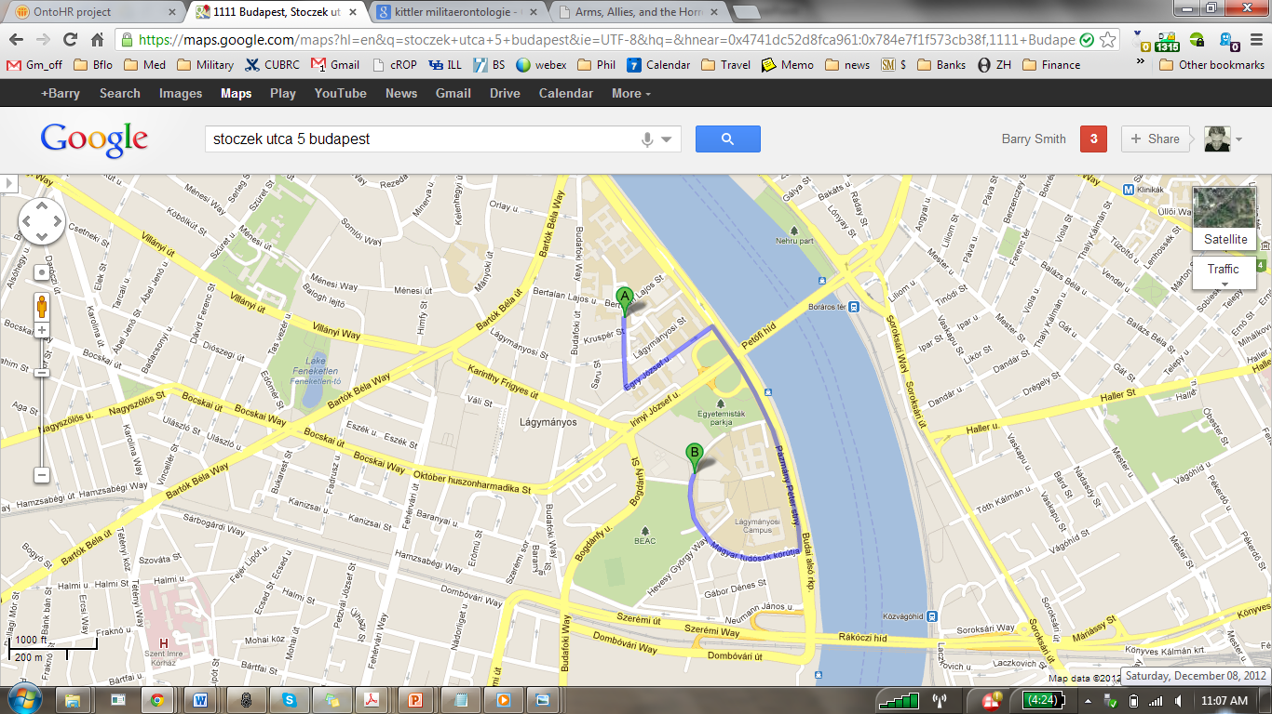
what begins as a plan, ends as a record
what makes the record true is:
the journey you took
what begins as a forecast, ends as a hindcast
Smith, 2012

Slide 24
what begins as a plan, ends as a record
Smith, 2012

Slide 25
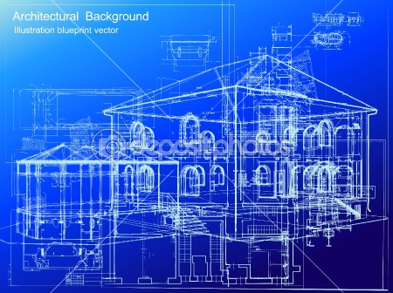
Background
Blueprint
what begins as a plan
ends as a record
of process
of product
Smith, 2012

Slide 26
Background
Blueprint associated with multiple series of documents with deontic powers
chain of commitments
from order
to blueprint creation
to acceptance of blueprint
to process of building in accordance with blueprint
to acceptance of finished building
Smith, 2012

Slide 27
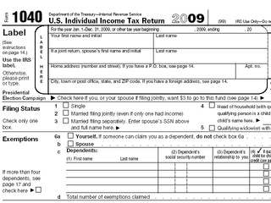
Background
Plans will be modified along the way
physical changes to the building
changes in materials/suppliers
changes in allowed physical processes
changes in administrative (approval) processes
Smith, 2012

Slide 28

Documents enable complex processes extending over ever larger regions of space and time
Smith, 2012
Notes:
http://www.aetherapparel.com/journal/wp-content/themes/aether/images/btn-share-hov.png, Great City by Adrian Smith + Gordon Gill Architecture

Slide 29
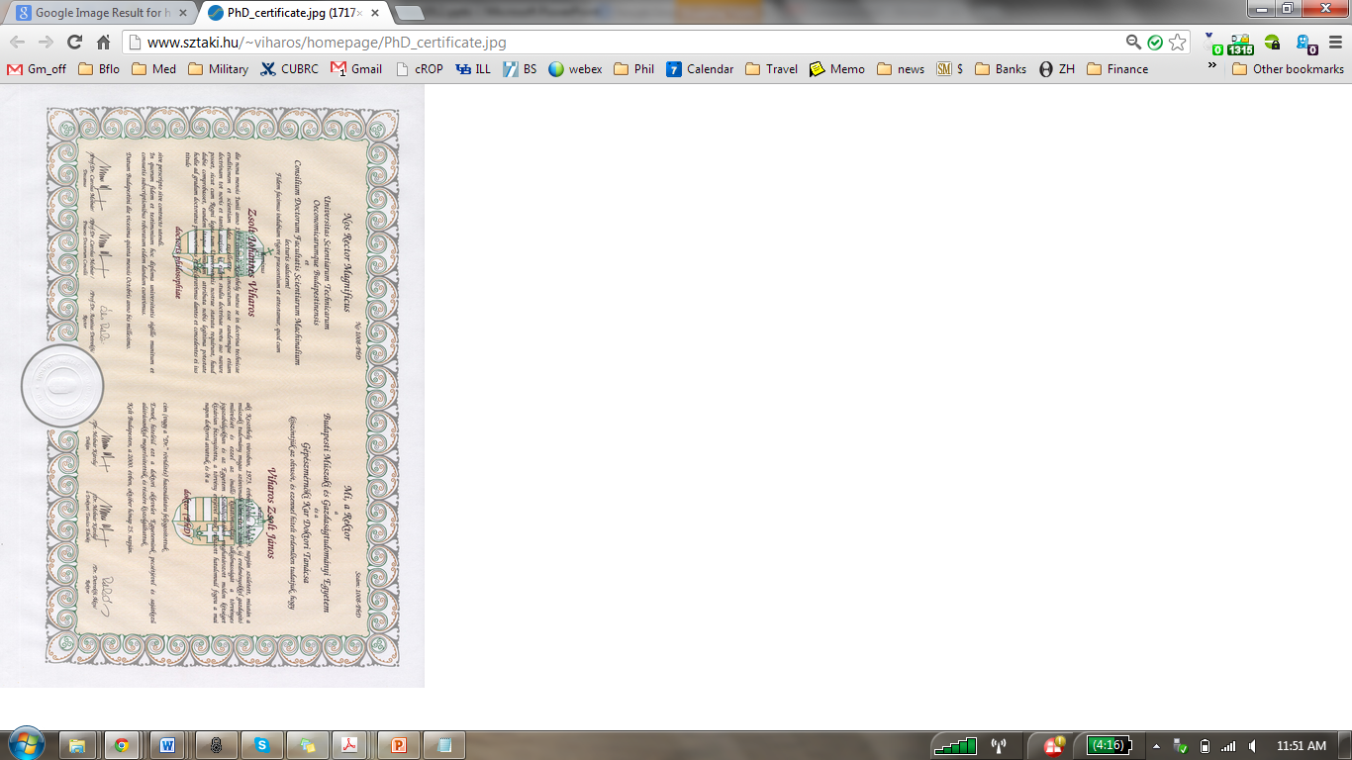
How to do things with diagrams
Smith, 2012

Slide 30
Background
Document Acts – it is based on Searle’s theory of social action
Context: conditions in the world in which a document act is manifested
Content: proposition underlying the document act, that is, the common element that characterizes the effect of that document
Force: organizational relationships established and the way in which the content is related to the institutions’ environment

Slide 31
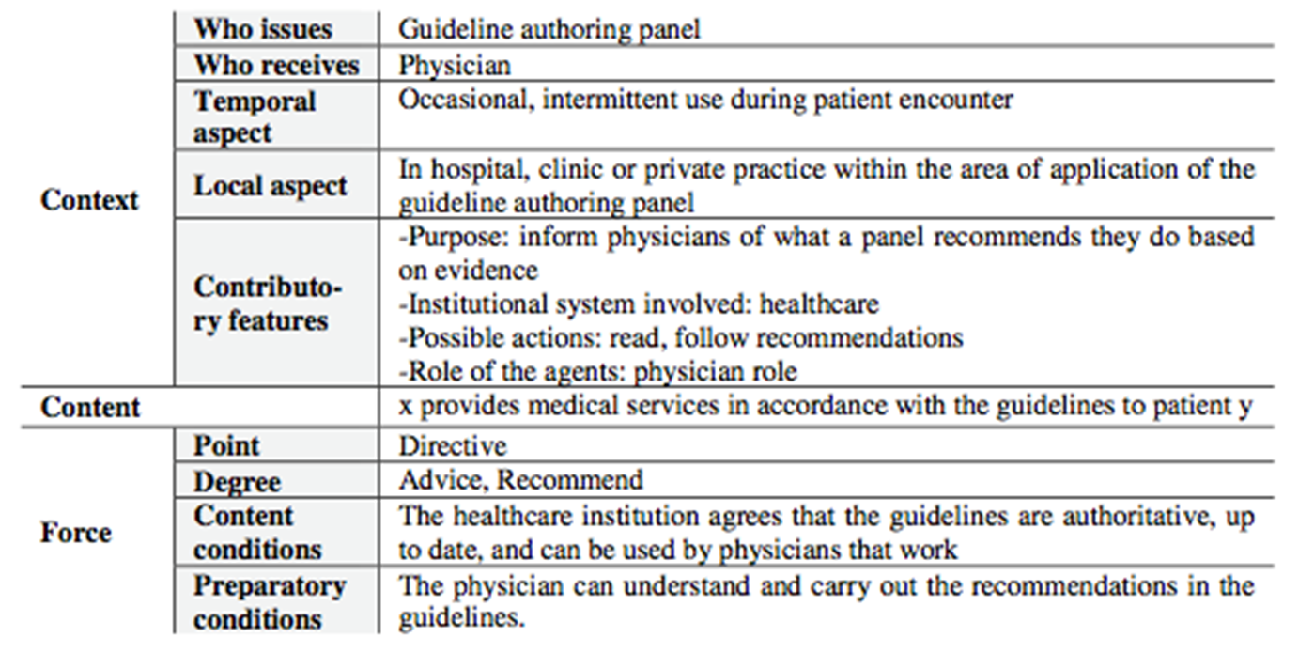
Background
Documents Acts – template - example
Almeida, Slaughter and Brochhausen, 2012

Slide 32
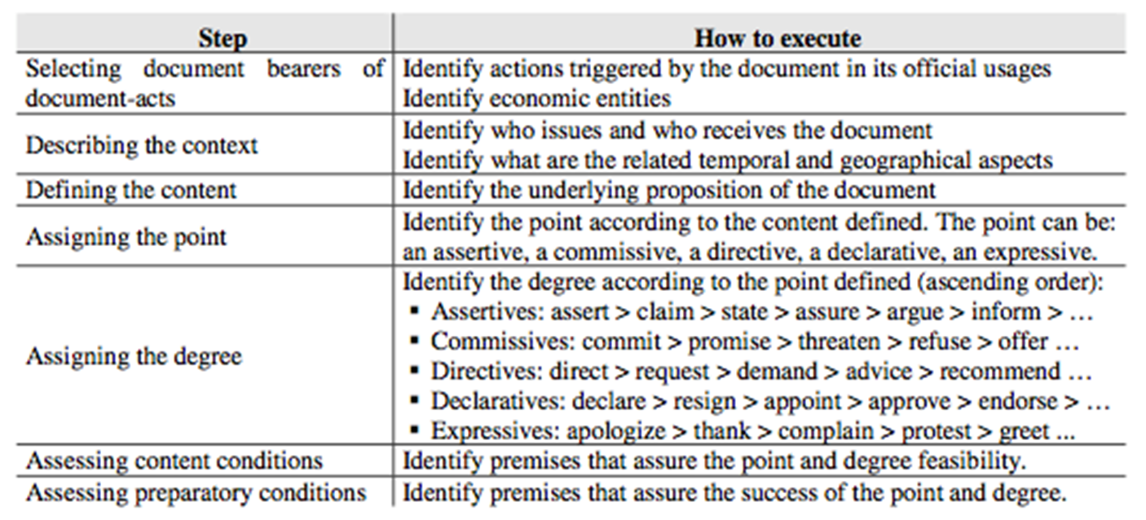
Background
Documents Acts – template
Almeida, Slaughter and Brochhausen, 2012

Slide 33
Background
Where the d-acts could be used
data integration in information systems
different organizations and its processes
clinical management guideline
in our case… blood transfusion services processes
and so forth

Slide 34
Background
In the context of blood transfusion services, there are many documents acts
One is the signing of the letter of donation consent: legally authorizes the process of blood donation.
Its effect within a blood transfusion service can be annotated using d-acts.
A letter of consent is specified within the act of the donor consent for the donation procedure document.
The clerk responsible for the blood donation process is the bearer of the creative role model of the document act. The candidate for blood donation is the bearer of the performer role of the statement.
A nurse is responsible for the medical procedures that allow the donor to donate blood, for example, the withdrawal of blood from the donor's arm. She is the target statement since it is endowed with the right to perform the above procedures.
… so, speech acts are events that exist during its execution
documents are objects that endure over time and keeps a history of changes.
Documents acts, as well as speech acts serve to create new kinds of social and organizational orders, but the acts of the document turns lastingly.

Slide 35
Background
It is important: document acts do not work in isolation from speech acts.
the success of a document act will depend of conditions in that it is involved in the speech acts of the traditional sort
the person who fills in the document has to have the authority to do so; she has to do so with appropriate intentions, in the appropriate sorts of contexts, and so forth
the goal of d-acts is to provide an ontology representation of the documents acts

Slide 36
Background
Another difference between speech acts and document acts
Documents can be algorithmically executable

Slide 37
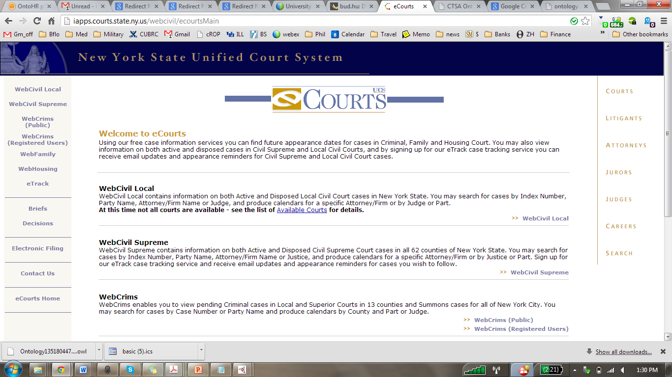
Smith, 2012
Notes:
http://iapps.courts.state.ny.us/webcivil/ecourtsMain

Slide 38
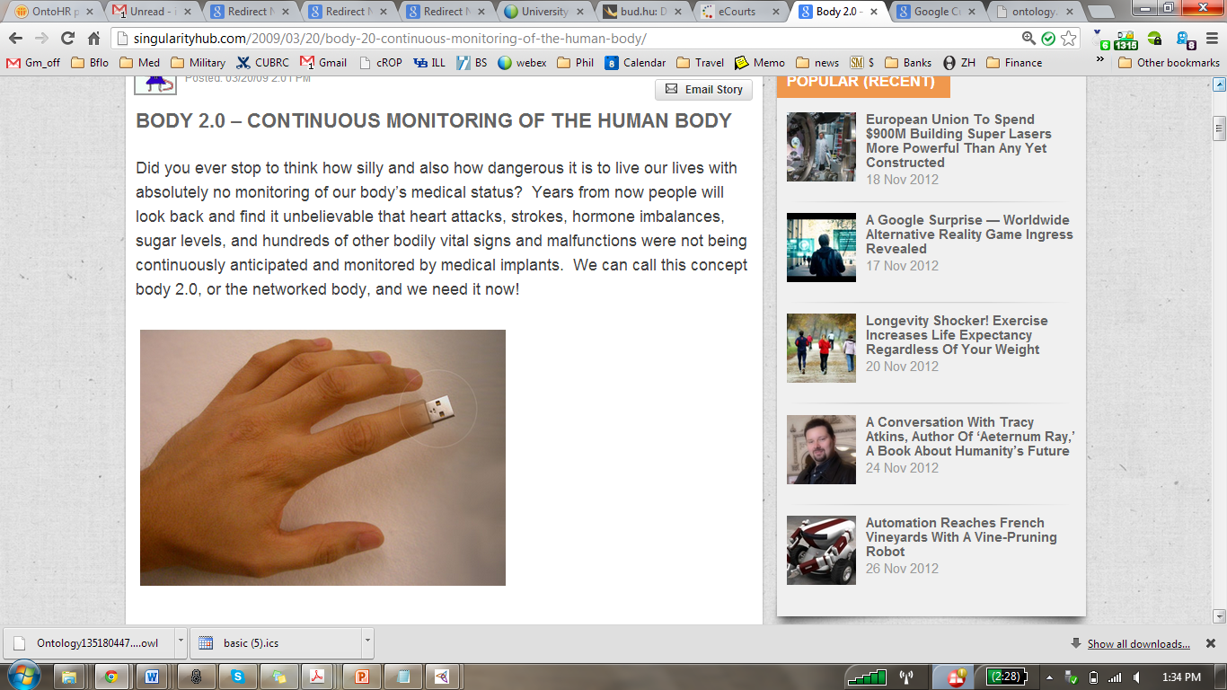
Smith, 2012
Notes:
http://singularityhub.com/2009/03/20/body-20-continuous-monitoring-of-the-human-body/

Slide 39
Motivation
We expect,
improvements from the theoretical point of view, providing DEMO Method the possibility to deal with documents via Document-acts (D-acts)
a new set of best practices for the DEMO way of working
improvements in Hemominas Foundation processes from Enterprise Ontology and DEMO point of view
document-acts included

Slide 40
Methodology
Methodology is in its very early stage
Case study method
It will allow us to investigate contemporary phenomena in its real life context
It has allowed us to investigate the feasibility of using DEMO in a real large institution rather than a fictitious example
we choose to approach just one case study, in order to investigate and describe it in detail
our case study is exploratory, since we believe that there is not previous research within this theme and on a large organization up to now

Slide 41
Methodology
Methodology is in its very early stage
1st step: to study the context of hematology and transfusion medicine
To evaluate reference materials (laws, templates of documents, manuals, procedures, technical regulation, to mention but a few)
Next stage: to approach other relevant documents in that field
2nd step: to study in depth process mappping and related documents
To aqcuire knowledge of process and other documents that are considered relevant to our empirical research
To identify responsibilities of people in each processes
3rd step: construction of an ontology for datalogical layer
We intend to do via documents-acts
4rd step: to apply DEMO method in the real processes of Hemominas Foundation
Our purpose is to verify results of our research and its impact in DEMO (if any)
Our purpose is to verify the connection between the forma and per-forma layers by documents with deontic powers formalized in them

Slide 42
Methodology
Methodology is in its very early stage
Data collection I
Primary data | Soure | Way of obtaining
Elicitation mapping process | Process Bureau of the institution | - Intranet
Documents in use produced by the institution | Process Bureau of the institution | - querying the document management system
Documents in use adopted by the instituition | Process Bureau of the institution | - querying the document management system
Knowledge specialized about their process | Clerk | Interview

Slide 43
Methodology
Methodology is in its very early stage
Data collection II
Secondary data | Source | Way of obtaining
Laws | Legislation bank related to the subject | - Evaluation of the results available online
Transfusion Medicine and Hematology | Technical documents and technical material | - Query professionals of the institution - Assessment of the results available online
Guidelines for process mapping | National Accreditation Organization (ONA) e American Association for Blood Banks (AABB). | - querying the ONA and AABB manuals
Institution al manuals | Process Bureau of the institution | - In-loco

Slide 44
Methodology
Methodology is in its very early stage
We will work with the support of professionals
To elicit knowledge about the organizational processes
We will use Document Acts template
to select documents bearers of document-acts
to describe the context
to specify the context
to assign the point
to assign the degree
to assign contend condition
We will use DEMO for notation of the Hemominas Foundation processes

Slide 45
Final remarks and future work
Next stages of our research
to consolidate our theoretical and methodological bases
to apply our methodology in a real case
to analyze results
to propose eventual improvements on the theoretical frameworks and methods

Slide 46
Methodology
Methodology is in its very early stage
We will work with the support of professionals
To elicit knowledge about the organizational processes
We will use Document Acts template in our research
to select documents bearers of document-acts
to describing the context
to defining the context
to assigning the point
to assigning the degree
to assigning contend condition
We will use DEMO for notation of the Hemominas Foundation processes

Slide 47
Methodology
Methodology is in its very early stage
We will work with the support of professionals
To elicit knowledge about the organizational processes
We will use Document Acts template in our research
to select documents bearers of document-acts
to describing the context
to defining the context
to assigning the point
to assigning the degree
to assigning contend condition
We will use DEMO for notation of the Hemominas Foundation processes

Slide 48
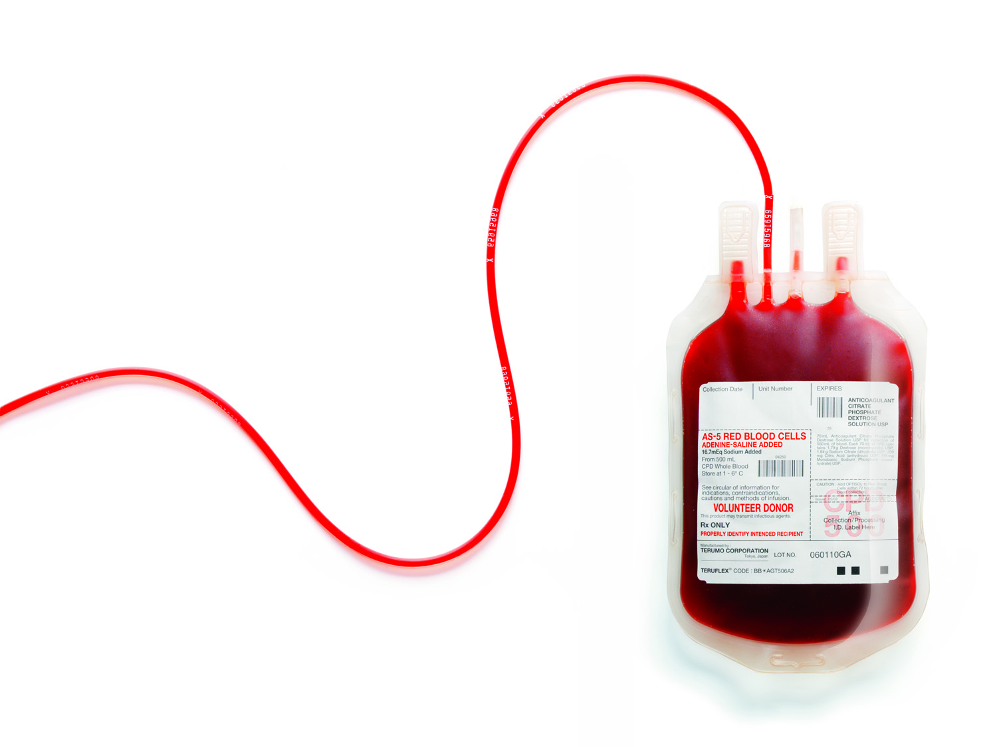
Thanks !!!
Questions ? Suggestions?

