Slide 1


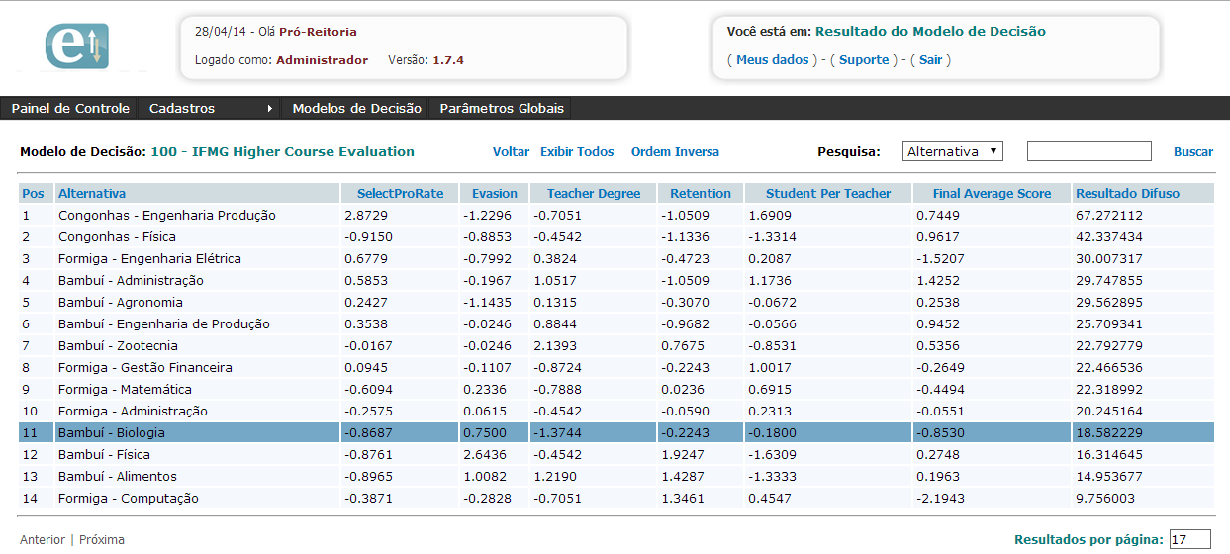
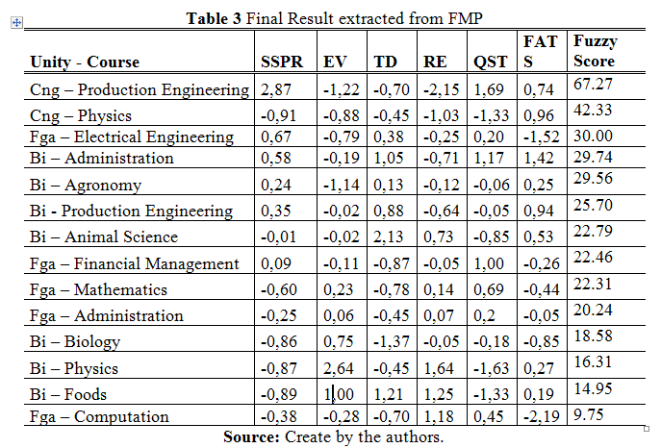
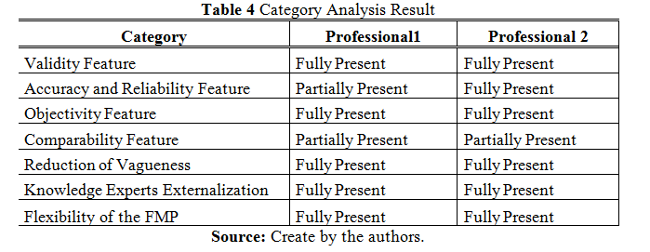
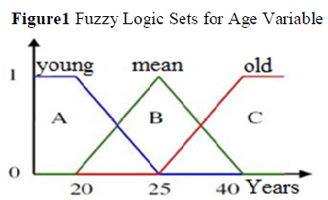
Reducing uncertainty in decision making through fuzzy logic: A model and prototype for monitoring and evaluation of IFMG higher courses
Amarildo Magalhães Renata Maria Abrantes Baracho Porto
amarildo@ufmg.br renatabaracho@eci.ufmg.br
Escola de Ciência da Informação - Universidade Federal de Minas Gerais - Belo Horizonte – Brazil
ABSTRACT
RESULTS
The existence of uncertainty in decision making processes generates a substantial demand for techniques to handle uncertainty and promote a favorable environment for decision making. The decision support systems allow the exploration and conversion of experts knowledge to govern decision-making processes. In the educational environment, the uncertainty that surrounding the assessment indicators courses, the resistance to the processes of performance evaluation generate an environment with the presence of uncertain and vague aspects and high degree of complexity in decision making. There is a need for methods of education assessment that consider vague in order to govern decision-making aspects as part of enterprise governance. This paper, through a qualitative applied research, develops a decision support system called Fuzzy Model and Prototype (FMP) in two phases: the first phase, the FMP is developed abstractly using the classic cycle of software development and in the second phase, the FMP is validated through the case study of the Federal Institute of Minas Gerais (IFMG), in the problem of educational programs evaluation with Process indicators. The business process align with Enterprise Resource Planning using information and knowledge management provides the enterprise engineering environment ideal for decision making and knowledge conversion. The Enterprise Governance`s concept of control and assessment possibility organizational measures on a continuous basis. FMP was created to help companies establish a way to systematically measure performance and make decisions. In this work, to obtain the results, the technique of content analysis by the method of categorical analysis was used. The results show that the fuzzy logic, through the concept of approximate reasoning, improves decision making by allowing a more aligned with vague analysis aspects inherent to the problem.
The images below shows the Fuzzy Result in IFMG Higher Courses Evaluation:
http://develop.coipe.com.br/smartfuzzy/
The table at the right shows the
Category Analysis Result:
The professional 1 replied Partially Present for Validity Feature category, since in his opinion, it is important the use of outcome indicators to reflect a better evaluation of the course. The professional replied 1 Partially Present for Accuracy and reliability Feature category, since in his opinion it is necessary to perform more accurate analyzes over more years to assure this category is Fully Present. The Comparability Feature category was answered by both professionals as partially present, mainly because the courses are evaluated by adding different areas of learning such as (Humanities, Biological Sciences, and Science) and in their opinion were best if the courses should be evaluation separately.
OBJECTIVES AND DEVELOPMENT
CONCLUSION
Develop a Decision Support System called Fuzzy Model and Prototype (FMP) to deal better with imprecision and reduce uncertainty in decision-making processes through Fuzzy Logic – Approximate Reasoning - Partially truth;
Validate the FMP in IFMG Higher Courses Evaluation Problem using Education Indicators like Evasion, Retention and Teacher Degree;
Contribute to Enterprise Governance - In the private sector, Enterprise Governance aims to create an environment to guarantee to stakeholders that organization is achieving its goals and objectives. In the public sector, governance aims to bring more efficiency and transparency to the actions taken, mainly ensuring that public resources are being applied correctly;
Development:
Rational Decision Model proposed by Choo 2006, which is goal-oriented, guided by rules, routines and performance programs;
IFMG’s Dean of Education - Experts Knowledge Externalization;
Fuzzy Architecture – Fuzzification: Triangular and Trapezoidal, Rule Inference: Mamdani, Defuzzification: Centroid;
Education Process Indicators and Outcome Indicators- In this work, it was used just Process Indicators: Student Select Process Rate, Evasion, Quantity Student per Teacher, Teacher Degree, Retention, and Final Average Test Score.
Extract the results with decision making by analyzing data from FMP using the method of Content Analysis through Categorical Analysis technique which consists of assessing qualitatively the result based on the theoretical framework.
PHP, MySQL and Apache. API for external database Integration – Retrieving Information for Decision Making Automatically;
BPM – Business Process Management in IFMG through ERP Implantation – First Federal Education Institute in Brazil using a consolidated a Educational ERP System;
The externalization of experts knowledge on business areas in tools that can support decision making, contributes significantly to the creation of an environment less dependent on the individual in enterprise governance.
Due to its abstract design, FMP prototype can be used by any institution or individual that aims to implement a information system in order to contribute to its enterprise governance process.
The IFMG higher Courses analysis through the FMP is a constant evaluation based on performance rules and monitoring programs, by reducing possible points of imprecision inherent in educational assessments arising from subjectivity and lack of consensus in this area.
In Brazil, Institutions from Federal Network of Technological Education, in order to be more efficient, must have set goals, defined objectives and execute programs to constant evaluation of performance using the concepts of Enterprise Governance.
REFERENCES
1. BARDIN, L. Análise de Conteúdo. Lisboa: Edições 70, 1977.
2. BUCKLAND, M. Information as Thing. School of Library and Information Studies, Journal of the American society for information science. University of
California, Berkley, 1989.
3. CAMPOS, Filho. Método para apoio à decisão na verificação da sustentabilidade de uma unidade de conservação, usando lógica fuzzy. Universidade Federal de Santa Catarina, Florianópolis, 2004.
4. CHOO, C.W.; ROCHA, E. A organização do conhecimento: como as organizações usam a informação para criar conhecimento, construir conhecimento e tomar decisões. São Paulo: SENAC, 2006, Cap.1.
5. DAVENPORT, T. H.; PRUSAK, L. Conhecimento Empresarial: Como as organizações gerenciam o seu capital intelectual. São Paulo: Elsevier, 1998. Cap. 7.
6. ELGHARBAWY, Magdy., KADER, Abdel. Enterprise Governance and valuebased management: a theoretical contingency framework. London: Springer, p. 102, 110, 2012. 15
7. FOURALI, Chahid. Using Fuzzy Logic in Education Measurement: The case of portfolio assessment. Evaluation and Research in Education. London, 1997.
8. GAETANI, Francisco; SCHWARTZMAN, Jacques. Avaliação de cursos de Graduação – Um modelo de análise. NUPES, Universidade de Minas Gerais, 1993.
9. HARVEY, Lee; GREEN, Diane. Defining quality. Assessment and evaluation in higher education, London, v.18, n.1, p. 9-34, 1993.
10. LIMEIRA, José L. S.. Utilização de Ajax no desenvolvimento de sistemas Web, 2006, p. 12.
11. JACOB, Rita C. G. Avaliação Institucional e Indicadores de Qualidade nos Cursos Superiores. Programa de Pós-Graduação em Engenharia da Produção, Florianópolis, 2003.
12. LAKATOS, E. M.; MARCONI, M. A. Fundamentos de metodologia científica. 3ed. São Paulo: Atlas, 1991.
13. MAMDANI, E.H. Application of Fuzzy Algorithms for Control of Simple Dynamic Plant. IEEE (Controland Science), v.121 (12), p.1585-1588, 1974.
14. MENEGON, Letícia F.. Contratos psicológicos como fatores influenciadores dos índices de rotatividade voluntária em empresas de consultoria. São Paulo. Usp, 2009, p.68.
15. MIRANDA, Pedro; VILELA-JUNIOR, Mauro B; KRONBAUER, Diego. Sistema de Controle Difuso de Mamdani. Aplicações: Pêndulo Invertido e outras. Universidade Federal de Mato Grosso do sul, 2003.
16. NEGNEVITSKY, M. Artificial Intelligence: A Guide To Intelligent Systems. Pearson Education Limited. Edinburgh Gate Harlow, Essex CM20 2JE England, 2005.
17. PRESSMAN, Roger S.."Software Engineering a practioner's aproach". First Edition. Singapore: McGraw-Hill, 1987. p.652.
18. TANSCHEIT, R. SISTEMAS FUZZY. Rio de Janeiro: PUC, 2008.
19. Toledo, Olga M.,Consenza Carlos A. N.. Metodologia de avaliação de desempenho baseada em lógica fuzzy.Congresso Brasileiro de Ensino de Engenharia. Brasília, 2004.
20. RATNATUNGA, Janek., ALAM, Manzurul. Strategic Governance and Management Accounting: Evidence From a Case Study. Sydney: Abacus – A Journal of Accounting, Finance and Business Studies, p. 347, 2011.
21. SEMERCI, Çetin.The influence of fuzzy logic theory on student's achievement. The turkish online journal of educationtechonology. Firat University, Elazıg- Turkey, 2004.
22. ZADEH, Lofti A. The role of fuzzy logic in modeling, identification and control. University of California, Berkeley, 1994.

