Slide 1
DEMO contribution to projects success
An insight about DEMO in practice based on semi-structured interviews
Niek Pluijmert – pluijmert@inqa.nl, N.Pluijmert@science.ru.nl Céline Décosse – celine.decosse@tudor.lu EEWC 2013 – May 14th 2013 - Luxembourg
Notes:
C

Slide 2
Goals of the presentation
Present an insight about DEMO in practice
Based on 16 semi-structured interviews about the DEMO method
Have a feedback about DEMO
Help us understand and scope our research subjects
What is DEMO added value?
What do people say about DEMO?
Notes:
C
This is an example where research has value for the industry

Slide 3
Agenda
Who are we? Our research projects
Introduction about the DEMO method
Projects in which DEMO has been applied
Interviews of DEMO users: first insights
Notes:
C

Slide 4
Agenda
✔
Who are we? Our research projects
Introduction about the DEMO method
Projects in which DEMO has been applied
Interviews of DEMO users: first insights
Notes:
c

Slide 5
EE-team
Enterprise Engineering team
Team led by Professor Doctor Erik Proper
8 Senior Members
6 Associated researchers
17 PhD Candidates
4 R&D Engineers
6 Alumni
Cooperation between business and researchers
Notes:
C

Slide 6
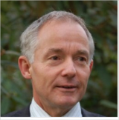
Niek Pluijmert
PhD candidate (from practice) at EE-Team
Radboud University – Nijmegen – The Netherlands
Job until now (from 1979)
Program, project, quality manager and coach
IT and IS domains
Financial Institutions, High-tech industry, Government
Owner of INQA Quality Consultants
Background
Master degree Technical Physics at TU Delft (Nl)
Living in Woerden (Nl) with Hettie
Notes:
N

Slide 7
Niek research project
Organisations encounter serious problems in keeping pace with ever faster changing markets
Enterprise Engineering (EE) probably can help solve this problem
Objective: to get a better understanding of design and quality of organisations
What use did finished projects, known as DEMO projects, made of DEMO?
Notes:
N
04:20

Slide 8
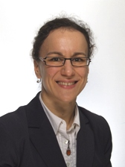
Céline Décosse
PhD candidate (1st year) in the EE team
Radboud University – Nijmegen – The Netherlands
Public Research Center Henri Tudor - Luxembourg
Job until now (1998 – 2013)
Business analyst
Requirements engineer
Background
Master: IS: Object Oriented Programming (1998)
Master: Enterprise management (2000)
Notes:
C
06:30

Slide 9
Céline research project
How to evaluate a business process modelling method?
DEMO method: seen as a case study
Exploratory interviews
Related to
Information Systems
Design Sciences
Notes:
C

Slide 10
Agenda
Who are we? Our research projects
Introduction about the DEMO method
Projects in which DEMO has been applied
Interviews of DEMO users: first insights
✔
Notes:
N

Slide 11
What is DEMO?
DEMO : Design and Engineering Methodology for Organisations
DEMO is a method to model enterprises
With a strong focus on business processes
Business process:
Set of activities performed in order to fulfil a business goal
Notes:
N
2– 06:00

Slide 12
What is DEMO?
DEMO is a special way of thinking
DEMO looks at the organisation as a social system
Where people in a certain role are working together
Coordination
To bring about products and services
Production
Notes:
N
08:08
06:30

Slide 13
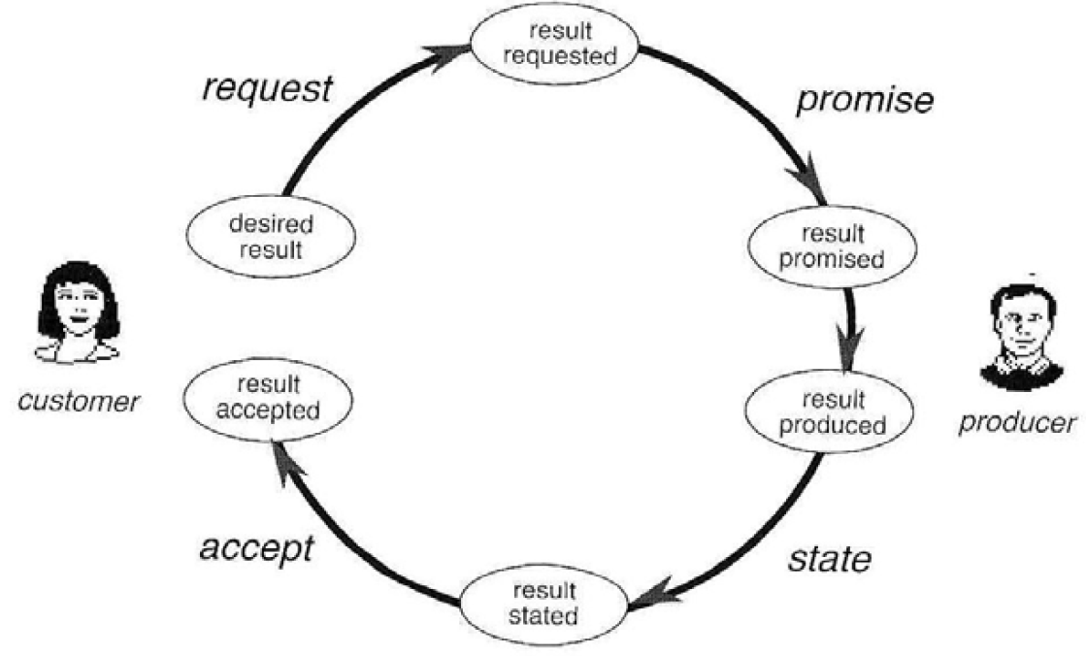


Transaction pattern
AA01
T01
A01
Notes:
N
10:00
07:30

Slide 14
DEMO models
coordination
actors
transactions
production
CM Construction model
PM Process model
AM Action model
SM State model
CM
business processes
business events
business objects
business facts
PM
SM
AM
business rules
work instructions
Notes:
N
12:00
08:00

Slide 15
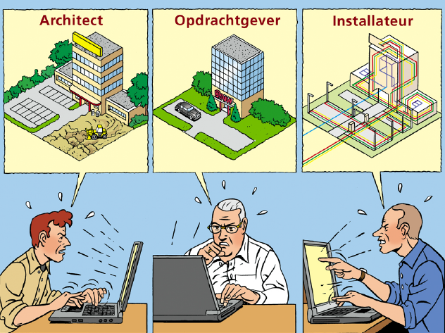
Construction project without VISI
Architect
Principal
Installer
Notes:
N

Slide 16
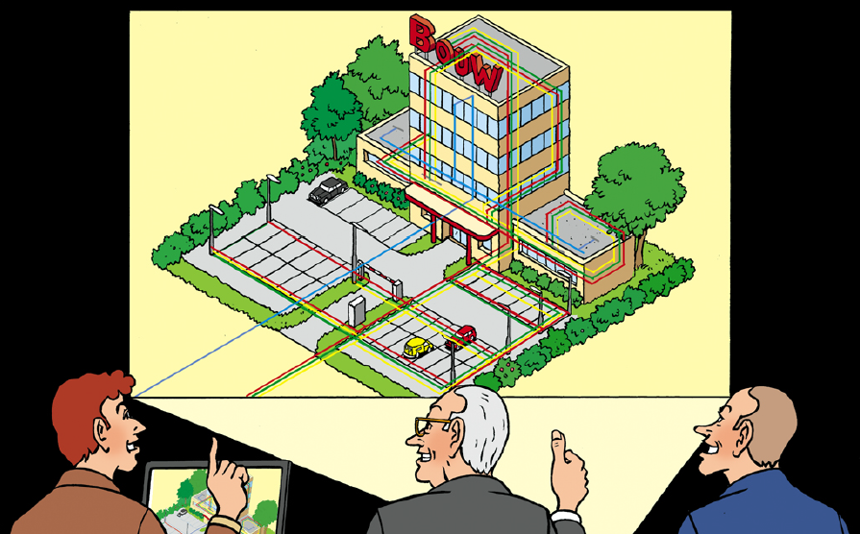
Construction project with VISI
Notes:
N

Slide 17
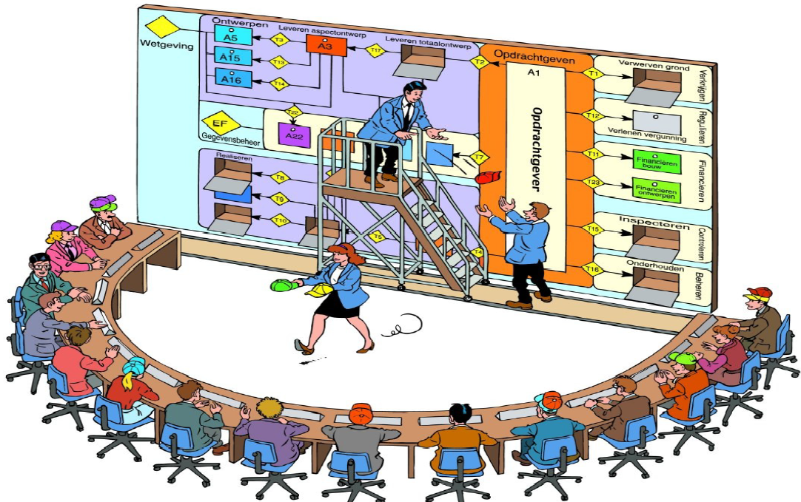
The VISI Interaction Chart
Notes:
N

Slide 18
Agenda
Who are we? Our research projects
Introduction about the DEMO method
Projects in which DEMO has been applied
Interviews of DEMO users: first insights
✔
Notes:
N

Slide 19
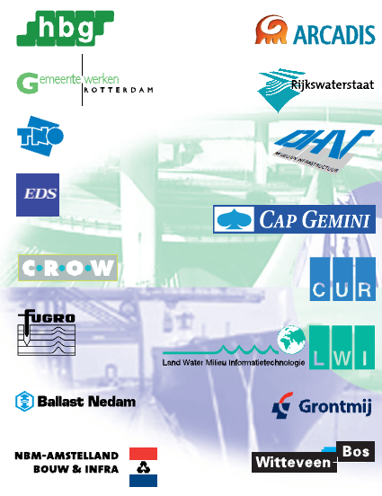





The organisations using DEMO
Notes:
N

Slide 20
ING (Financial Institution)
Project
with DEMO
Context: Implementation of Shared Service Centre for Securities business - 2002
DEMO was used for defining the business architecture
Architecture = set of principles and standards
To get economy of scale within a set of banks that had to apply locally the architecture defined with DEMO at the upper level
DEMO has been applied during a few weeks
Result: a target business architecture, that consists of
The application architecture (for IT people)
The operational model (for business people)
Notes:
N

Slide 21
Construction Sector: VISI project
Project
with DEMO
1998 - 2004
Context: Development of a standard for cooperation in large infrastructure projects
DEMO was used
To reach an agreement about what the standard construction process for an infrastructure building project was
To actually design this standard process
DEMO has been applied during the whole project
Result: VISI standard became ISO 29481 in 2012, prescribed by Dutch Government.
Notes:
N
2—10:22

Slide 22
Air-France KLM Cargo
Project
with DEMO
2006
Context: Merge of the Cargo divisions
DEMO use
Used for reaching a shared IT-system portfolio
DEMO Construction Model as objective and correct description of the cargo-business
DEMO model gave the stakeholders insights
In the different implementations in organisation and IT
In risks concerning the introduction of the new IT-system
6 weeks with 65 days of work
Before that: 4 years without having results
Involvement of the working floor leads to well-founded conclusions
Notes:
N
19:00
11:30

Slide 23
Rijkswaterstaat
Project
with DEMO
Source : Interviewees + Op ’t Land, M. (2008). Applying architecture and ontology to the splitting and allying of enterprises.
2004
Governmental agency for Public Works and Water Management
Part of Ministry for Infrastructure and Environment
Context: IT Application Portfolio Rationalisation
DEMO was used for
Mapping the business processes with the corresponding supporting IT applications
To have a clear overview (130 co-existing IT applications )
So as to tidy things up
DEMO has been applied in 175 man days, in 6 months
Results:
49% of IT applications disappeared -> cost savings
Improved use of existing application functionality
Notes:
N

Slide 24
Agenda
Who are we? Our research projects
Introduction about the DEMO method
Projects in which DEMO has been applied
Interviews of DEMO users: first insights
✔
Notes:
C

Slide 25
Survey about DEMO
Exploratory
To have an insight on how the DEMO method is looked at and used
To try out the survey technique to evaluate a method
To help us scope our research projects
Notes:
C

Slide 26
Technique: qualitative semi-structured interviews
In general: To get an insight
of what interviewees think and how they react on a specific subject
Results cannot be generalized from a sample to a whole population (at least not obviously)
In the current presentation:
First insights (qualitative analysis of the interviews still to be done)
Get insight what people think and what they do in practice, concerning DEMO
Notes:
C
In depth research vs. broad research

Slide 27
Interviewers / Interviewees
Interviewers: Décosse – Pluijmert
Interviewees
DEMO founders (creators)
Interview themes: Intentions and experience
By the time you created DEMO… and now…
DEMO modellers / consultants / sponsors / final beneficiaries
Interview themes : Expectations and experience
They either applied DEMO or worked on a project in which DEMO has been applied
Notes:
C

Slide 28
Interviewees! (potential bias)
Interviewees turned out to actually be
Dutch men aged 40 to 68
Plus one Portuguese researcher
So… only western European men, with working experience
Most of them with an engineering background (TU Delft, but not only)
Researchers, Project Managers, Line Managers, Architects
Acting as external or internal consultants
Projects were led in the early years of 2000
But interviews took place in 2012
So things can be forgotten or coloured with good/bad project context
Notes:
C

Slide 29
What, when?
Spring + summer 2012
Semi-structured interviews
Questionnaire with open questions
Used as a guideline during the interviews
Co-designed within the EE-team
Erik, Bertrand, Sybren, Wolfgang, Niek, Céline, etc.
Themes taken from Design Science literature + other ideas
Notes:
C

Slide 30
Questionnaire
Organised by themes
A- INTERVIEW SITUATION - Location, date, duration, language of the interview
B- INTERVIEW CONTEXT + allows to determine how much the person remembers about the project + Actual context of use of DEMO in a particular project
C: Typical context of use of DEMO
D: Assess the practical use of DEMO
E: Assess the organisation fit and its meeting its intended use for stakeholders
F: Chunks identification
G: Method construction
Notes:
C

Slide 31
The questionnaire
Themes > sub-themes > standard questions > sub-questions
Standard questions
Always asked
Sub-questions
Selected to be asked or not during the interview accordingly to what has been said before by the interviewee
Notes:
c

Slide 32
Preliminary results
In a few words
Issues and concerns appear
Methodical qualitative analysis not done yet
Notes:
C
26:00

Slide 33

Notes:
C

Slide 34
What is DEMO?
It is a way of thinking
It comes with a way of modelling
It is a tool
A set of concepts helping Enterprise Engineer analysts
Notes:
C
27:00
18:00

Slide 35
DEMO added value
Great for change management projects, amongst others
DEMO has the right concepts when it is about responsibility, authority, role, transaction
Most suited for complex problems
It gives total transparency
When people want to really know what is going on
Even if it is politically incorrect or if it does not reflect internal procedures
“First time I have oversight over the total process”
Models are implementation independent
Excellent if you want to model one business that has several implementations
Air-France KLM Cargo example
Notes:
C

Slide 36
Various statements about DEMO
Complies with management way of thinking
Concepts like “responsibility”...
Models are very stable
For the VISI project after 2 versions no more changes (15 years after the start)
Notes:
C

Slide 37
DEMO learning curve
Abstract thinking is required
To become an expert, at least:
(= making correct models by oneself)
At least a 5-day training + 5 days of homework
Plus some practice in at least 2 projects with expert coaching
But a group, to work with DEMO, requires only one DEMO expert
To understand the models: few hours
Easier to learn to model with if you have an engineering background
Notes:
C

Slide 38
DEMO Return on Modelling Effort (RoME)
Excellent
Provided it is used by trained people
Notes:
C

Slide 39
The “essence” of a process is unique: myth or reality?
DEMO has a very precise definition of what a process is
That makes it easy to communicate about processes
We asked the interviewees “Would two modellers obtain the same process model?”
Is there “one” essence per process?
Interviewees answers were: no
The essence for me is not the essence for you
And DEMO allows to model it
Notes:
C
32:00

Slide 40
DEMO chunks
Modellers say
Construction model is always used
Other models are sometimes used in complement
DEMO final beneficiaries (e. g. Line Managers) say
I suppose it is better to apply all models
Though it has not been done on our project
Construction model is loved by all interviewees
Notes:
C
00:26:30

Slide 41
If so powerful, why not widespread?
Hard to learn
Badly sold
Language a bit unpleasant
Better marketing necessary?
Supporting tool
No satisfying ones in 2000
3 ones exist now
Interviewees variously aware or satisfied about them
Lack of interfaces with other methods
DEMO evolution sometimes tempered by DEMO community
Notes:
N
34:10
28:10

Slide 42
DEMO context
DEMO can be applied
In conjunction with (a priori) any project management method
In any business domain
Has been successfully applied
Western northern culture
Japan
Russia
Notes:
N
35:00
29:00

Slide 43
Outstanding points
Potential bias
DEMO was successfully applied ...... in projects that anyway had “success factors” by themselves
Urgent business need for the project result
Commitment of all involved management
Involvement of the working floor
People were enthusiastic about DEMO
And would reuse it without hesitation
Notes:
N
2—30:00

Slide 44
Next steps
Analyse the interviews with qualitative analysis methods
Prepare in-depth questions for a second round of interviews
Further research on the use of the different models
Consider choosing at least one more method to be evaluated
Reflect upon the interview technique to evaluate a method
Notes:
N
31:16

Slide 45
Thank you
Questions are welcome

Slide 46
References
Projects with DEMO
Op ’t Land, M. (2008). Applying architecture and ontology to the splitting and allying of enterprises
Interviews taken into account for the current presentation
José TRIBOLET
Henk SCHAAP
Anton DE VROOMEN
Hans JONGEDIJK
Jos HAMILTON
Hans MULDER
Cees BUIJS
Victor VAN REIJSWOUD
Michael KIMMAN
Hans ZWITZER
Martin OP 'T LAND
Jan DIETZ
Paul ENSINK

