Slide 1

DEMO as core of Informed Governance at Rijkswaterstaat
All materials of these cases are provided courtesy of Dutch Ministry of Infrastructure and Environment, Rijkswaterstaat, Central Information Services, where the approaches and models shown are actively applied.
Martin Op 't Land
Capgemini: Certified Enterprise Architect, Innovation Alliance Developer
University of Antwerp Management School: Professor Enterprise Engineering
Industry Track EEWC-2013
3rd Enterprise Engineering Working Conference
May 13th – 15th, 2013

Slide 2
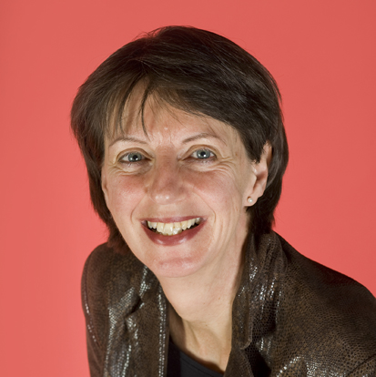


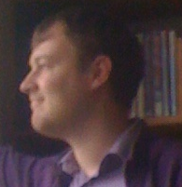















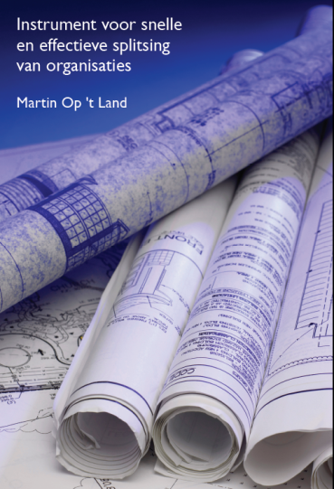
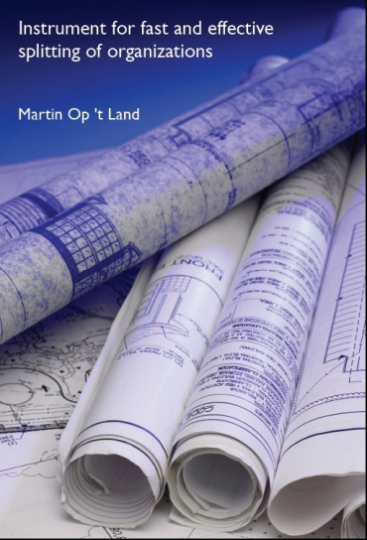
Let's introduce myself: Martin Op 't Land
married Cobi Wattez; father (in law) of Norbert (23), Sifra x Thijs-Willem (25), Sjoerd (27)
Principal Consultant and Certified Enterprise Architect at Capgemini
>25 years active in mainly Banking and Public, e.g.
several educational affiliations
Professor Enterprise Engineering, Antwerp Management School (BE)
lecturing at University Antwerp, TU Delft
lecturing DEMO Professional
finished PhD-research@TUDelft 2008
PhD thesis Applying Architecture and Ontology to the Splitting and Allying of Enterprises
Summarized for managers in Instrument for fast and effective splitting of organizations (NL)
first book @ Springer EE Series (2009)
Enterprise Architecture: Creating Value by Informed Governance
Notes:
create coherence business <> ICT, concepts <> implementation

Slide 3
DEMO as core of Informed Governance at Rijkswaterstaat Abstract
This presentation will discuss recent experiences in shared conceptualization and decision making during a (1) large transformation project at Rijkswaterstaat (RWS) Shipping Traffic Management. Using (2) stepwise Domain Architecture Explorations – with the Design & Engineering Methodology for Organizations (DEMO) as its core –, gradually (3) primary processes became explicit for all stakeholders. This (4) enabled coherent planning of change, ranging from organization and competence development to the steering of IT development. Especially (3) the nautic responsibilities for all chain parties became clear, and the content of the professionalization needed to carry these responsibilities.
Informed Governance ≈ clarity on ToBe/AsIs (essential & implementation) & transformation. Now following: examples how DEMO supports this at RWS.

Slide 4
Starter: 3 concrete examples DEMO@RWS
Uniform process and data responsibility / ownership
From information need to underlying data – with quality
Organizing: actor roles and functionary types
… all enabling well-underpinned decision making: Informed Governance

Slide 5
1. Uniform process and data responsibility / ownership
example: Notice to Skipper (NtS)
is now collected (according to a Uniformized process) by the Waterdienst and put on FIS & Teletext
content can only be determined by Nautic Control (NC)
content after the formulation by Waterdienst is strongly deformed & not always compliant with the intentions of Nautic Control anymore
NC also publishes independently ⇒ 2 versions are sent into the world
in UPP (documentation of Uniformized Primary Processes)
the direct publication by NC has not been discerned
NC has not been recognized as the real source
DEMO clarifies (data)responsibility for UPP – Distinction Axiom, Organization Theorem
Notes:
want WD had al toegang tot FIS & Teletekst voor die hadden die toegang al voor de waterstanden
The Waterdienst is a new national service of the Directorate General of Public Works and Water Management (Rijkswaterstaat). The Waterdienst oversees the state and the use of the main water system in the Netherlands: the interrelated network of major rivers, canals, lakes, coastal waters and sea. From that perspective the Waterdienst is practising an efficient and effective integrated water management, for the users, now and in the future. Knowledge and expertise provide and must safeguard a reliable, clean and safe main water system.

Slide 6
2. From information need to underlying data – with quality
skipper wants to choose: amount of cargo + transport route
⇒ information need skipper = maximum actual vessel height, maximum actual vessel draught
RWS supplies part of the data on the underlying facts:
clearance (height, width)
watermark
source of data element “clearance”?
CIS (“look it up in VIN!”)?
Asset Management?
no, Nautic Control!
source of the data element “watermark”: Waterdienst
data responsibility follows business responsibility
⇒ follow the chain until the one who determines the fact in reality, using DEMO CM

Slide 7
3. Organizing: actor roles and functionary types
example: responsibilities in Shipping Traffic Management are rearranged in the Shipping Traffic Control Center of Tomorrow (VerkeersCentrale van Morgen (VCM))
from the DEMO Construction Model already the actor roles are known, including their information needs
e.g. observer position, provider traffic instruction, realizer opening bridge
VCM defines new functionary types
e.g. object operator, traffic controller
actor roles x functionary types ⇒ information needs per functionary type are known now
functionary type | actor role
Object operator | observer position
Object operator | provider traffic instruction
Object operator | realizer opening bridge
Traffic leader | observer position
Traffic leader | provider traffic instruction
functionary type | actor role
Object operator | observer position
Object operator | provider traffic instruction
Object operator | realizer opening bridge
Traffic leader | observer position
Traffic leader | provider traffic instruction
DEMO provides durable knowledge-basis for organization & information supply
Notes:
want WD had al toegang tot FIS & Teletekst voor die hadden die toegang al voor de waterstanden

Slide 8
DEMO as core of Informed Governance at Rijkswaterstaat Content
✓
Starter: 3 concrete examples DEMO@RWS
Transformation
Domain Architecture Shipping Traffic Management (DAS)
Clarifying primary processes
Enabling coherent steering
Conclusions

Slide 9
1. Transformation RWS Shipping Traffic Management in context
In NL, Rijkswaterstaat is responsible for
sufficient clean water
smooth and safe flows of transport on the nation’s roads and waterways
dry feet
reliable and useful related information
RWS manages 3 networks
by nature, these networks cohere
infrastructure needs to be in place & OK
infrastructure provides network functionality
focus is shifting: BUILD → USE
feasible
cost-effective
information intensive
RWS-networks
highways
waterways
water system
management
management
management
road traffic
management
shipping
traffic
management
water-
management
maintenance
maintenance
maintenance
construction
construction
construction
policy
advise
policy
advise
policy
advise
Notes:
BUILDing is expensive, and on many places not possible
USE-measures are very cost-effective AND information intensive

Slide 10
1. Transformation Shipping Traffic Management: main drivers
shipping traffic is intensifying
container traffic is growing explosively
arrival Maasvlakte 2 → 45% of containers should be transported over water
in that, RWS as waterway manager has to cooperate
internally: 10 waterway regions, Asset Management (DNZ)
externally: 200 other NL + international waterway managers
STM should be based on excellent data = basis for good information
also taking into account other uniforming drivers:
European standards (River Information Services - RIS)
Remote Control (sluices, bridges)
ONE RWS! (OP-2015)
cost savings
… and excellent data flourish where responsibilities are clear
Shared understanding of the domain Shipping Traffic Management needed!
Notes:
Maasvlakte 2 is the biggest civil engineering project in the Netherlands since the Delta Works.

Slide 11
1. Transformation Areas of STM should coherently change
RWS-network
waterways
Shipping Traffic Management
Nautic Control
Vessel Traffic Services
Monitoring
Object Control
Information provision
Incidentmanagement
Enforcement
For transformation, coherent and shared insight is needed: apply Architecture!
Notes:
Let’s take a closer look at Shipping Traffic Management; because, when it has to change, it has to change coherently.

Slide 12
DEMO as core of Informed Governance at Rijkswaterstaat Content
✓
Starter: 3 concrete examples DEMO@RWS
Transformation
Domain Architecture Shipping Traffic Management (DAS)
Clarifying primary processes
Enabling coherent steering
Conclusions
✓

Slide 13
2. Domain Architecture Shipping Traffic Management (DAS) Our Way of Working: how it all started …
1st assignment: “do an architecture”, “create the architecture of STM”
new approach: let order (NOT structure!) be determined by problems
using Architecture Explorations
architecture
implemented
Nautic
Control
Fairway-
marking
VMS2015 (VOS)
Berthing
places
Architecture Explorations
⇒ solve real problems + at the same time stepwise build Architecture repository
Notes:
I now want to tell you how our approach gradually took shape. What were main characteristics of our Way of Working?
1st assignment:
result = lots of insights, analyses; tables, coherences, white spots
repairing these white spots would take lots of time, with results outdated when finished
⇒ no stakeholder support for this top-down approach
transfered to problem steered approach
not “little problem – little system”, probleempje – systeempje
only the order of working became problem steered
results are described every time in the same structured way to ensure coherence
⇒ problems are solved, while building an Architecture repository at the same time

Slide 14
2. Domain Architecture Shipping Traffic Management (DAS) Our DAShboard: from supply to questions
source: Lines in the Water: The Line of Reasoning in an Enterprise Engineering Case Study from the Public Sector (PRET-2010)
What are the goals of BpM? Who are the internal and external stakeholders for BpM and what are their interests and requirements? What types of Berthing places can be discerned, and how are they used?
Which laws and regulations are applicable for, or influencing, BpM? What are the main changes in the environment of BpM? What policies exist concerning the Business/Information, Applications and Infrastructure in the area of BpM?
Which principles and standards are applicable to BpM?
Which running programmes / projects are influencing BpM?
Context
Business
Information
Applications
T. Infrastructure
What business services does BpM supply and use? What is the required quality of these business services? What business actors deliver these services, and which business actors and need these services?
Information supply
Data management
What application services support the business, information and data actors? What is the required quality of these application services? What application component deliver these application services?
What infrastructural services do support the business, information and data actors and the application components? What is the required quality of these infrastructural services? What infrastructu-ral component deliver these infrastructural services?
What information is used by the business actors? What is the required quality of the information services? What information actors deliver these services?
What data are used by the information actors? What business actors do create the original facts? What is the required qua- lity of the data services? What data actors deliver these data services?
Conceptueel
Which business objects are observed or changed when delivering the business services? How do the processes of the business actors operate?
How are the information products composed by data objects? How do the processes of the information actors operate?
How are the data objects composed, and which states of the business objects do they concern? In which way do the processes of the data actors operate?
How are the application interfaces structured? In which way do the applica-tion components operate, what are their mutual interactions, and what is the interaction with human actors?
How are the infrastructural interfaces structured? In which way do the infrastructural components operate, what are their mutual interactions, and what are the interaction with human actors?
Logical
Physical
With what people and means are the business actors implemented, and on what locations? What are the operational costs of this implementation?
With what people and means are the information actors implemented, and on what locations? What are the operational costs of this implementation?
With what people and means are the data actors implemented, and on what locations? What are the operational costs of this implementation?
With what software products have the application compo-nents been implemented, and on what locations? What are the operational costs of this implementation?
With what infrastructural products have the infra-structural components been implemented, and on what locations? What are the operational costs of this implementation?
Transfor-mational
What are the differences between AS IS and TO BE for the business?
What are the differences between AS IS and TO BE for information supply?
What are the differences between AS IS and TO BE data management?
What are the differences between AS IS and TO BE for the applications?
What are the differences between AS IS and TO BE for the infrastructure?
What is the change plan for the transformation of Business, Information Supply, Data Management, Applications and Infrastructure?

Slide 15
2. Domain Architecture Shipping Traffic Management (DAS) Our DAShboard: from supply to questions
source: Lines in the Water: The Line of Reasoning in an Enterprise Engineering Case Study from the Public Sector (PRET-2010)
public oriented
laws & regulations
product / service
accountable & responsible inside and outside RWS (sharing & sourcing)
FTEs & budget
business case & transformation plan

Slide 16
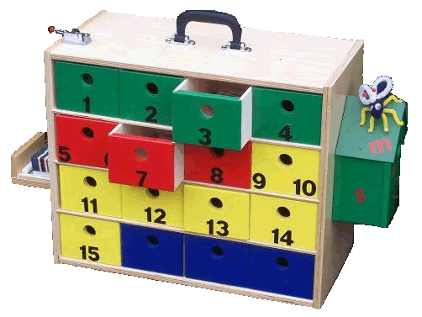

2. Domain Architecture Shipping Traffic Management (DAS) Our DAShboard: the drawers …
+ the ropes
Notes:
We were looking for coherences, e.g.
when a law changes, which process would be affected, which new data should then be created, etc.
Bij het gebruik van het raamwerk gaat het niet alleen om de losse producten, maar juist om de verbanden ertussen.
Niet alleen de laden, maar juist ook de touwtjes.
Dus:
welke objecten ontstaan bij welke transacties; bijvoorbeeld object VAARWEG bij “T050 Vaststellen (aangepaste) verkeersordening”
welke actorrollen worden vervuld door welke functionaristypen, en in welke afdelingen zitten ze?
in welke huidige bestanden / databases zijn welke objecten en beweringen daarover te vinden? b.v. “SLUIS heeft bedientijden …” in VIN

Slide 17
DEMO as core of Informed Governance at Rijkswaterstaat Content
✓
Starter: 3 concrete examples DEMO@RWS
Transformation
Domain Architecture Shipping Traffic Management (DAS)
Clarifying primary processes
Enabling coherent steering
Conclusions
✓
✓

Slide 18
3. Clarifying primary processes The challenge of Nautic Control
change
change
Shipping Traffic
Shipping Traffic
Shipping Traffic
Nautic Control
Nautic Control
Nautic Control
Fairway
Infrastructure
Fairway
Infrastructure
Fairway
Infrastructure
change
NC choices → ENC, Notices to Skipper, ...
Notes:
Nautic Control determines & makes known the rules of the game for the smooth and safe (“vlot en veilig”) use of Fairway Infrastructure
Shipping Traffic can change: intensity, type of vessels
Fairway Infrastructure can change: new locks, AIS
Then Nautic Control should change as well

Slide 19
3. Clarifying primary processes Nautic Control in action
Safety
Legal
frames
Degeneration &
wear and tear
Economic interests
Environ-ment
Crossing
infrastructures
..
Shipping-
policy
Maintenance
activities
Nautic Control
Nautic Control
Fairway contours (Navigating & mooring space) and traffic regulations
Traffic measures taken
Traffic rules
Service schedules
Fairway furniture
Permanent constraints (Fairway objects)
Consequences of temporal constraints (maintenance & events)
Licensed special transports
Determine
Publish
Advise
Inspect & Monitor
Availability
Nautic network (routes)
Accidents
Trafic
intensity
Available
means
Weather
Events

Slide 20
3. Clarifying primary processes DEMO Construction Model Nautic Control - overall
NC publish
NC determine
NC advise
NC monitor
What core concepts play a role here?

Slide 21
3. Clarifying primary processes Business Object Model: example FAIRWAYOBJECT
FAIRWAYOBJECT
LOCKAREA
BRIDGEAREA
DAMCON
AQUEDUCT
CABLE AREA
LOCKBASIN
BRIDGE
GATE-CONSTRUCTION
CLEARANCE

Slide 22
3. Clarifying primary processes Semantic Model: small example
BRIDGE allows-vesselpassage-of CLEARANCE (bxhxd)
BRIDGE allows-vessels-upto VESSELSIZE (lxbxhxd)
LOCKBASIN allows-vesselpassage-of CLEARANCE (lxbxhxd)
LOCKBASIN allows-vessels-upto VESSELSIZE (lxbxhxd)
BRIDGE is-part-of FAIRWAYOBJECT
LOCKBASIN is-part-of FAIRWAYOBJECT
What is the CLEARANCE of a PASSAGE-CHAIN (= subsequent CLEARANCES)?

Slide 23
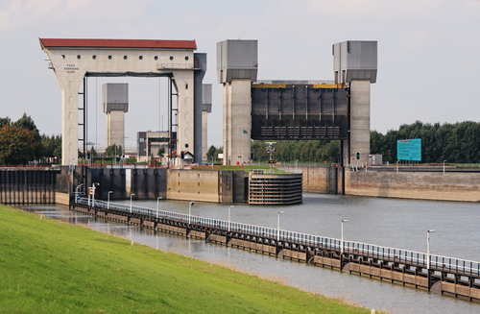
3. Clarifying primary processes Prins Bernhardsluizen at Tiel Amsterdam-Rijnkanaal
Validation by instantiation!

Slide 24
3. Clarifying primary processes Prins Bernhardsluizen at Tiel Amsterdam-Rijnkanaal
Clearance passage-chain is in
max. vessellength limited by the lockbasins
max.vesselwidth limited by the channels
max.draught limited by the channels
max. vesselheight limited by the lowest vertical clearance in the passage-chain
Z➔N: 1 lockbasin, 5 bridges
N➔Z: 4 bridges, 1 lockbasin
Who is deciding on these statements?

Slide 25
3. Clarifying primary processes Fact Model (ORM): example
CLEARANCE
PASSAGE-CHAIN
FWO | PC
fairwayobject FWO is-part-of passagechain PC
FWO | CL
fairwayobject FWO offers clearance CL
FWO
FAIRWAYOBJECT
R50-FWO
fairwayobject FWO has been determined
passage-chain clearance = minimum (clearance-size/clearance) for the subsequent clearances belonging to a passage-chain
So now the business responsibility is clear!
How about information and data responsibility?

Slide 26
3. Clarifying primary processes Defining Information Products – Mockup screen
Notes:
about the planning of LOCKS

Slide 27
3. Clarifying primary processes Defining Information Products – Information Construction - Source data need (Objects & Fact types ∊ DEMO Fact Model)
Notes:
about the planning of LOCKS

Slide 28
3. Clarifying primary processes Defining Information Products – Information Construction – Derivation rules
Notes:
about the planning of LOCKS

Slide 29
3. Clarifying primary processes Service-diagram: clarifying information & data responsibilities
Notes:
about the planning of LOCKS

Slide 30
3. Clarifying primary processes This helped professionalize Nautic Control …
Politics &
Policies
Planned Infra-
management
& Maintenance
Vessel Traffic
Services &
Object Control
Nautic
Management
Legal
Control
& Support
Monitoring
&
Enforcement
Notes:
… making Nautic Control visible as a primary process in the business of Rijkswaterstaat

Slide 31
3. Clarifying primary processes … making it visible as a primary business process
P & P
P & P
P & P
P & P
PIM
VTS/OC
PIM
VTS/OC
PIM
VTS/OC
PIM
VTS/
OC
NC
NC
LC&S
NC
M&E
LC&S
M&E
LC&S
M&E
LC&S
M&E
NC
OR
OR
OR

Slide 32
DEMO as core of Informed Governance at Rijkswaterstaat Content
✓
Starter: 3 concrete examples DEMO@RWS
Transformation
Domain Architecture Shipping Traffic Management (DAS)
Clarifying primary processes
Enabling coherent steering
Conclusions
✓
✓
✓

Slide 33
4. Enabling coherent steering Architecture: integrated steering instrument
transformation
↕
benefits
↕
costs /
investment
operation
process ⟷ IP ⟷ ICT
… leading to the implementation of integrated change:
“from operating to operating!”
Notes:
Bij transformaties gaat het om “van werkend naar werkend”.
Vandaag werkt Rijkswaterstaat met haar ketenpartners zo. Na de transformatie is opnieuw een werkende situatie van RWS met haar ketenpartners van kracht.
De transformatie moet dus alles omvatten om dat mogelijk te maken:
inrichting met mensen: werkprocessen, competenties, organisatie (centraal, decentraal, shared met ketenpartners, etc.)
inrichting met middelen: COPAFIJTH-breed, o.a. ICT-middelen; algemeen:
Commercie & Communicatie
Organisatie
Personeel
Administratieve organisatie
Financiën
Informatievoorziening
Juridisch
Technologie
Huisvesting
De kosten/baten van de ToBe-situatie in exploitatie moet mogelijk gemaakt worden door te investeren in transformatie.

Slide 34
4. Enabling coherent steering Integrated steering, stepwise building
Decide
Explore
Change initiative
Decide
Explore
Solution
Decide
Scope
Change project
Decide
Prepare
Change project
Architecture Exploration
Descred or Required
Changes
1
Phase 1 Explore
Change
initiative
2
Phase 2
Explore
Solution
3
Phase 3 Explore
Change project
Integral
Business
Case
Change
Project
4
Prepare
Integral Change
project
Assess
Current
Services, Implementation & Cost/Benefits
Business Serv
change track
Information Serv
change track
Data Serv
changetrack
New/Changed Policies
alternatives & ambition levels
Sporenplan & Business case
Change project
Working process
change track
External Developments
possible solutions
Application
change track
Infrastructure change track
Context
change track
Notes:
Architectuur als besturingsinstrument wordt stapsgewijs opgebouwd.
Basis hierbij zijn de MIRT-stappen in de besluitvorming.
We zoomen in op de eerste 3 stappen, die door een ArchitectuurVerkenning worden ondersteund, dus t/m Integraal Veranderproject voorbereiden.

Slide 35
4. Enabling coherent steering Architecture results at a glance: “trackplan”
06-04-2011
Integrale Projectdoelarchitectuur DAS v0.3
35
… assigning transformation tasks to programmes / projects

Slide 36
4. Enabling coherent steering … and who is responsible for the transformation?
DVS: Required changes business services
& information provision
DVS, DID Data: Required change data household
DVS demand, CD supply, RD implementation: change in working processes
DVS demand, DID Data supply: change in content data management
DVS demand, DID ICT supply: changes in applications & ICT
This also clarifies the need for tuning between stakeholders …
Notes:
Dit kan natuurlijk allerlei nuances hebben:
project, waarmee andere business dienstverlening met andere kwaliteit wordt geleverd
versus meer ICT-gericht project (met applicaties en OTAPE-platform)
In alle gevallen is de afstemming noodzakelijk, en hiermee in beeld gebracht.

Slide 37
4. Enabling coherent steering … both for implementing new business …
Better/New Content & Quality Services
Changed/new implementation with people & ICT means

Slide 38
4. Enabling coherent steering … and for supporting existing business with new ICT-means (e.g. applications, OTAPE)
Functional User requirements ICT-system
To realize: ICT-system (applications & OTAPE-platform)

Slide 39
4. Enabling coherent steering Active controlled steering instrument (cf. MIRT) ⇒ Reference Architecture (basis and knowledge bank)
Reference
Architecture
Reference
Architecture

Slide 40
DEMO as core of Informed Governance at Rijkswaterstaat Content
✓
Starter: 3 concrete examples DEMO@RWS
Transformation
Domain Architecture Shipping Traffic Management (DAS)
Clarifying primary processes
Enabling coherent steering
Conclusions
✓
✓
✓
✓

Slide 41
4. Enabling coherent steering Some typical applications of the methods/models
support implementation analysis (reuse, buy, build), e.g.
solution Port of Rotterdam (central concept: “visit” versus “travel”)
connectivity with several standards (or lack thereof)
clarity in consequences of assigning responsibilities
for business services, data management & information provision
as a starting point to define reusable application and data services
impact analysis
cost/benefit categories, e.g.
transformation: costs of data migration and data cleaning
AsIs exploitation: current costs of creating & maintaining copies

Slide 42
Conclusions – general
validation by instantiation, to be checked by the right stakeholders
good data flourish by the right competence, authority and responsibility
Architecture Content Framework DAShboard helps to identify the right stakeholders for operation and transformation
“just enough”, “just in time” architecture
decision making: in time, custom for the decision (durability, scope)
e.g. meaning of data early in the process, because data migration is very expensive
domain ”freedom” and inter domain ”constraints”
freedom within domain to use subject matter expert languages
e.g. nuances in BRIDGE between Nautic Control vs Asset Management
enable tuning between domains
e.g. the Infrastructure object Brienenoordbrug
limits for freedom: shared architecture approach / language
e.g. same way of thinking / notations for object definitions, actor dependencies etc.

Slide 43
Conclusions – contributions of DEMO
clarifying organization (using actor roles in defining functionary types)
clarifying data (objects / facts, ownership & governance)
clarifying information (definition and construction of information products)
starting point for data services & application services
⇒ enabling well-underpinned decision making: Informed Governance

Slide 44
DEMO as core of Informed Governance at Rijkswaterstaat Content
✓
Starter: 3 concrete examples DEMO@RWS
Transformation
Domain Architecture Shipping Traffic Management (DAS)
Clarifying primary processes
Enabling coherent steering
Conclusions
✓
✓
✓
✓
✓

Slide 45

Any other questions?
Wish you the very best in your efforts for research or its application!
That it may contribute to better and durable solutions
for you and your organizations
For any questions you might have about this case, please contact
Krystyna Robaczewska Krystyna.Robaczewska@rws.nl
Chief Domain Architect Shipping Traffic Management
Dutch Ministry of Infrastructure and Environment
Rijkswaterstaat, Central Information Services
Thanks for your attention!
Martin.OptLand@capgemini.com

Slide 46
Appendices

Slide 47
Potential next steps
read material on DEMO
what DEMO is The Deep Structure of Business Processes (ACM-2006)
how to use DEMO Benefits of Enterprise Ontology in Governing Complex Enterprise Transformations (EEWC-2012)
read material on applying DEMO
at Rijkswaterstaat, e.g.Lines in the Water: The Line of Reasoning in an Enterprise Engineering Case Study from the Public Sector (PRET-2010)
as a basis for intrinsically durable IT-systems: Using Enterprise Ontology as a basis for Requirements for Cross-Organizationally Usable Applications (MCIS-2012)
TU Delft Repository, search on “DEMO”
www.demo.nl/publications
follow the 5-day course DEMO Professional
as part of the Master in Enterprise & IT Architecture (TU Delft Toptech – NL, University Antwerp – BE) or as a separate course, e.g. at Capgemini Academy

Slide 48
Illustration bridge
width
BRIDGE
maximum actual vessel height
height
watermark
maximum actual vessel draught
BRIDGE
maximum actual vessel height
maximum actual vessel draught

