Slide 1
Multi-Agent Systems for Organizational Diagnosis
Tatiana POLETAEVA
Habib ABDULRAB
Edward BABKIN
Notes:
Good afternoon ladies and gentlemen. Before starting the presentation I would like to say thank you to conference committee for inviting me and also to all of you for your patience to follow the last presentation.
So, the topic of our research is…
National Institute of Application Science in Rouen, France
National research University Higher school of Economics, in Russia

Slide 2
Agenda
Research problem
Traceability in supply network
Organizational Diagnosis
Theoretical background
DEMO methodology for Enterprise Engineering
Object Paradigm for data modeling
Multi-agent systems
Proposed solution for organizational diagnosis
Research methodology
Problem instantiation
Future directions of the research
Notes:
Today I will go through all the main parts of my future PhD thesis.

Slide 3


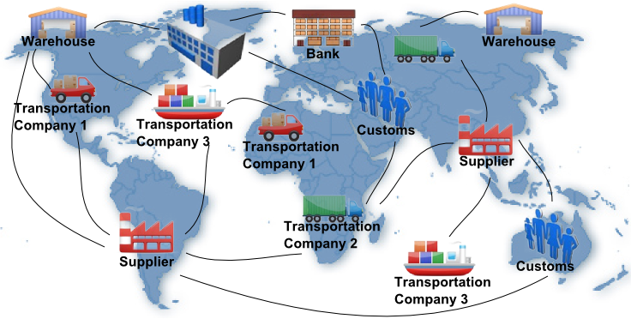
Research problem: Traceability in supply network
There is a necessity to trace objects in any time:
physical state / owner / past , current and future locations, etc.
Notes:
I will start from the description of the problem which tempted us to make a research. Imagine a supply network, where business processes are carried out by different types of social organizations. The links here are interactions between the organizations. Most of the links can be doubled by physical flows of distributed products.
There is a necessity to trace the state of these products in any time. Where the state means physical state, owner, past, current and future locations, as well as other characteristics valuable for interested parties.
…processes are carried out at facility nodes and over distribution links

Slide 4
Research problem: Traceability in supply network Key problems of traceability
?
Disjoint parties of large scale supply networks
Multiple stakeholders
Complex business processes
Continuously changing business processes
Heterogeneous tracing data
Agreed on
Functions
Data&Processes
Software
Information technologies for traceability problems resolution
Traceability applications are aimed to trace the state of objects, discover information regarding its past states, correctly predict future states and estimate different kinds of risks
Notes:
There are some obstacles of tracing objects in a supply network…
Imagine that all the nodes of the ideal multi-organizational network agreed on their functions, standardized description of data and processes, and established flawless software interaction. Even so the consolidated efforts of involved companies still would not guarantee their ability to react operatively to all the changes in the business world.

Slide 5
Research problem: Traceability in supply network Key problems of traceability applications
real-time analysis of deviations in the dynamic flow of business activities
automated adaptation of inter- and intra- organizational business processes to erratic business conditions
WHY?
dissimilarities between models of information systems and business models of supported organizations
discrepancies between the information patterns and the concepts used in the real world to talk and think about business objects
Notes:
What are the problems with traceability applications? Although the newest information systems are capable of fulfilling many human analytical and social functions, they still lack the ability ….
Degradation of existent business information systems in functional support of corporate enterprises arises due to several reasons.
At first, implemented programming objects often have no links with the objects in the business world that they are meant to refer to. The fallacy in this approach is that resulted socio-technical systems contain dissimilarities between models of information systems and business models of supported organizations.
Secondly, for the majority of information systems, embedded information patterns do not properly correspond to the concepts used in the real world to talk and think about business objects. As a result, socio-technical systems are suffering from the isolation of data analysis from actual business activities.

Slide 6
Research problem: Organizational Diagnosis
Organizational diagnosis is
the widely shared understanding of a system, and determination of desirable changes
(psychological approach, 1980)
automated discovering and optimization of changes based on desired ontological view of the enterprise
(engineering approach)
Notes:
Traceability is only a particular case of the Organizational Diagnosis. Based on the former psychological approach, we gave an engineering definitions of the Organizational Diagnosis. So, organizational diagnosis is a process of discovering changes in a dynamically changing enterprise and adjustment of future changes to the desired ontological view of the enterprise.
Also we added “automated” in the definition, because we would like to diagnose large scale and complex systems.

Slide 7
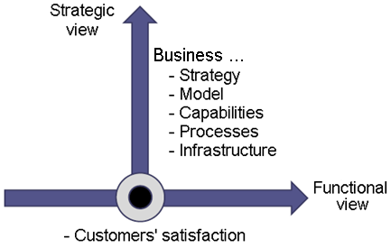
Research problem: Organizational Diagnosis Organizational Diagnosis for dynamic organizations
Notes:
Harvard school (M. Porter et all.): generalization concepts of strategic management

Slide 8
Theoretical basis: DEMO methodology
Evident perspectives:
Clarified organization (presented through actor roles in defining functionary types)
Unified description of business processes in networking organizations
Clarified B- data (objects / facts, ownership & governance)
Starting point for data services & application services
Hidden perspectives:
- Using the interpretive perspective (considering an enterprise as a social entity)
- Representation of business processes in the format suitable for automatic processing (through the Aspect Models )
- Using of natural language sentences to operate with B- data
Notes:
In our research we apply DEMO methodology for the description of business processes of organizations at the conceptual level.
…
Moreover, since the Aspect Models are expressible in natural language sentences, they are free from poor semantics of Entity Paradigm. Actually, the last point lead us, as software architects, to think about aligned data model on the Information level. From design point of view, data used at the Business level and at the Information level must be put into the same data model. So, the challenge is to find the proper paradigm for data modeling.

Slide 9
Theoretical basis: Object Paradigm for data modeling
Considering four-dimensional objects (spatial and temporal)
Identity
Relationships
Classification
Data standardization for networking organizations on both conceptual and domain-specific levels:
ISO 15926 “Integration of lifecycle data for process plants including oil and gas production facilities”
ISO 15926 unites B- and I- levels of data flows
Notes:
In Organizational Diagnosis we accept the reality through data. Thus, proper data model is required to operate with.
For the engineering of conceptual data modeling patterns, we strictly adhere to the Object Paradigm. The Object Paradigm assumes that all objects have four dimensions (spatial and temporal). The consideration of temporality unambiguously explains objects’ identity through changes, their relationships and classification principles.
The idea about data standardization based on object paradigm was substantiated in 2007 by a group of large-scale energy companies . They encouraged the development of a unified ontology for data aggregation and support of manufacturing lifecycle management. As a result, ISO 15926 was issued

Slide 10
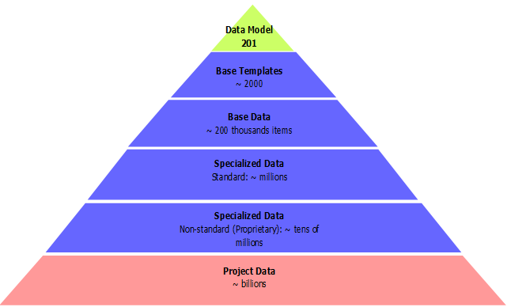

Theoretical basis: Object Paradigm for data modeling
Reference data provided with ISO 15926 as well as built on top of it is not enough to build the data model for organizational diagnosis

Slide 11
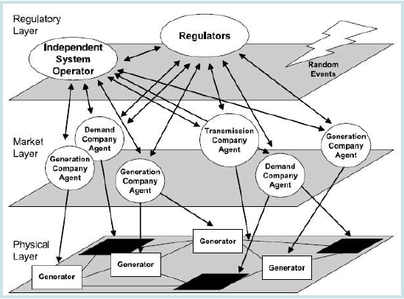
Theoretical basis: Multi-Agent Systems (MAS) paradigm
Multi-Agent System (MAS) is a dynamic, multi-level system where complex social interactions are modeled by formal A2A communication protocol.
Wooldridge & Jennings (1995):
Agent is software or hardware system with the following characteristics:
Autonomy
Social ability
Responsiveness
Proactiveness
Notes:
we may see federated enterprises as social entities with collaborative human actors. From such a viewpoint, a supportive information system for organizational diagnosis naturally becomes a part of a ‘collaboration’ design domain. The distributed manner of such systems and the large amount of autonomy among their components tempt us to use multi-agent approach .

Slide 12
Solution proposal for Organizational Diagnosis
Design of information systems for planning, discovering, monitoring deviations, and optimizing business processes
Matching construction and behavior of the IS with the ontological model of supported enterprise
consistent abstractions for the description of states and processes of federated enterprises
Notes:
Our research introduces a new approach to the design of information systems meant for planning, discovering, monitoring deviations, and optimizing business processes. Expected qualitative breakthrough in the system’s capacity is based on

Slide 13
Solution proposal: Research methodology
Design science research methodology is expected to be resulted in:
The set of concepts for alignment of the meta-models of enterprise ontology, data, and multi-agent system
Ontology of supportive information system aligned with social organization ontology
Method of MAS creation for Organizational Diagnosis
Framework for creation of a MAS for Organizational Diagnosis
Notes:
By using ontological approach, we aim at getting tight links between diverse models of social organization, data and supportive information system.
The design process is a sequence of expert activities that produces an innovative product. The artifact enables the researcher to get a better grasp of the problem; the re-evaluation of the problem improves the quality of the design process and so on. This build-and-evaluate loop is typically iterated a number of times before the final design artifact is generated.

Slide 14
Solution proposal: Steps of implementation
Developing the meta-model of MAS
Business level:
alignment with DEMO meta-model -->
agents’ interactions and perception of the word can be specified by DEMO Aspect Models
Information level:
consolidation of B- and I- data in one data model based on the Object Paradigm, by means of ISO 15926 and related tools.
Bridging the gap between business strategy, model, capabilities and processes and the functions of multi-agent framework
Implementation of the algorithms for run-time monitoring and control of processes by intellectual agents
Iterative adjustment of MAS functions to the supported environment
Notes:
It makes sense to consider functioning of MAS framework at two levels: business and information. Business level of the framework is formed by analytical and communicative abilities of intellectual agents implemented by the algorithms for data and events processing. The rules for agents’ interactions and their perception of the world can be specified by DEMO Aspect Models of supported enterprise for a particular case.
In view of the fact that all individual facts and relations between them can be unambiguously classified based on the reference data of ISO 15926, we will integrate extracted concepts with ISO 15926 reference data. The resulted conceptual schema will specify the information structure of multi-agent system.

Slide 15
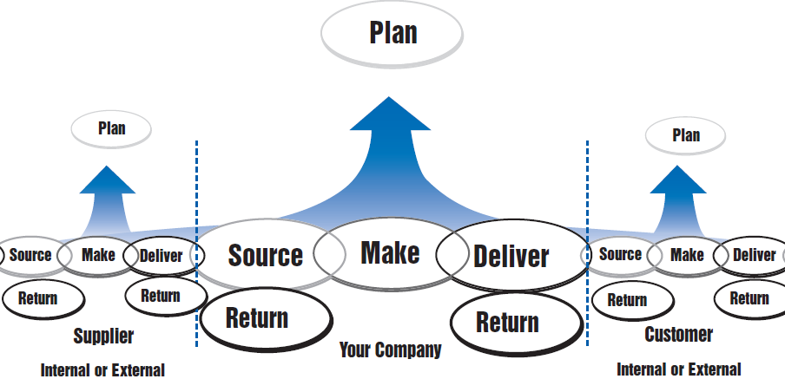
Problem instantiation: Traceability in supply network
All processes, activities, metrics, and assigned people roles related to tracing objects constitute the full set of traceability artifacts.
Tracing data in a computer system must be as close as possible to the business understanding of tracing info
Notes:
Expected responsiveness of proposed multi-agent system for tracing data processing is based on the implementation of tracing data in a computer system (i.e. in the shape of concepts) as closer as possible to the business understanding of tracing information. That is why the first step in developing of abstraction framework for traceability applications is the accurate specification of the artifacts to work with. Based on the definition of traceability given in the Introduction, we deem that all processes, activities, information inputs and outputs, metrics, and assigned people roles related to tracing objects constitute the full set of traceability artifacts. Where relevant subset of the artifacts can be found in the specifications and practices of supply activities. Consequently, generalization of supply chain practices can be considered as the most reliable method of specification of traceability artifacts.
In our work the description of common patterns for supply chain activities and metrics is founded on the Supply-Chain Operations Reference-model (SCOR-model) [25]. This model summarizes the best practices and technologies and put them into a unified structure in order to improve supply chain management

Slide 16
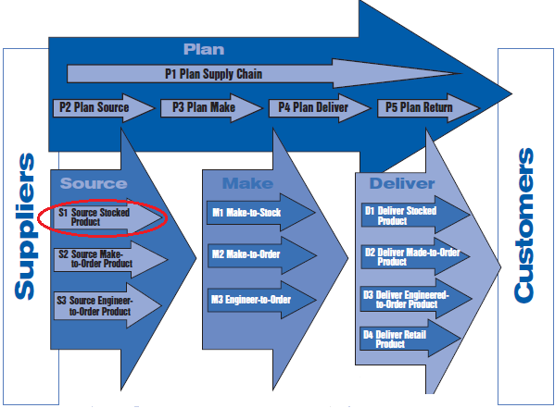
Problem instantiation: Traceability in supply network

Slide 17
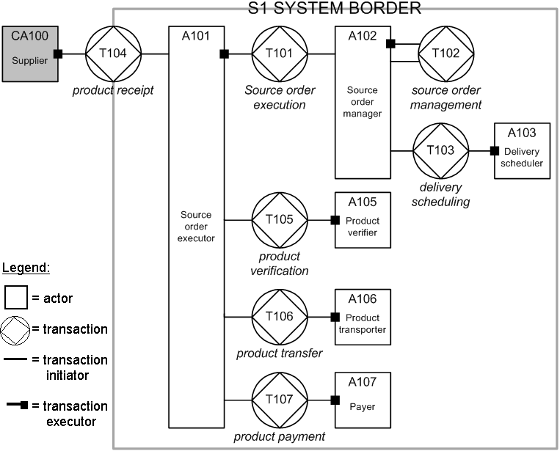
Problem instantiation: Meta-description of business processes

Slide 18
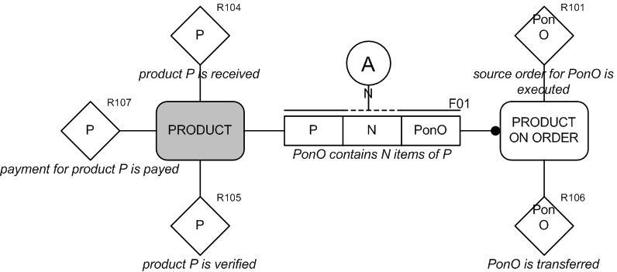
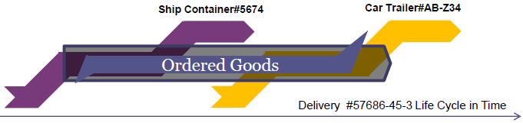
Problem instantiation: Meta-description of business processes

Slide 19
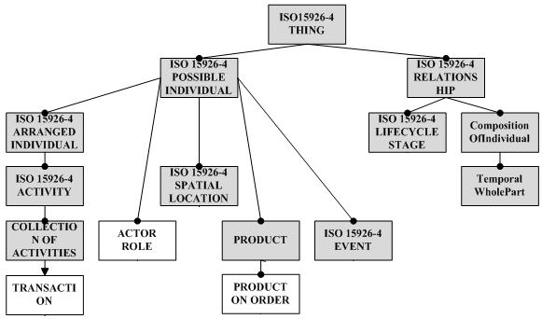
Problem instantiation: Meta-description of data

Slide 20
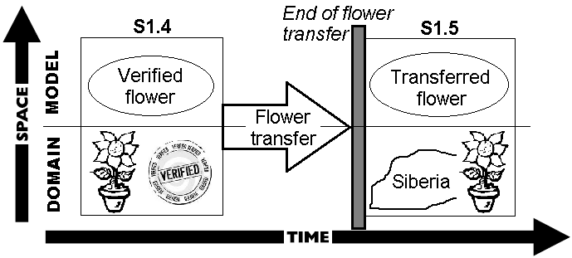
Problem instantiation: Meta-description of data

Slide 21
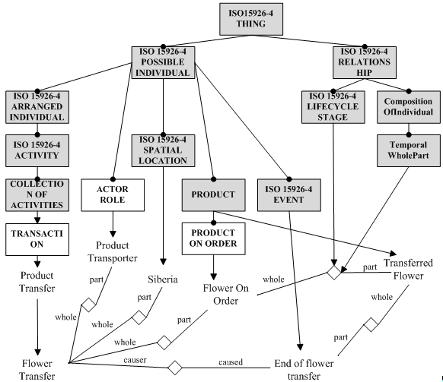
Problem instantiation: Meta-description of data

Slide 22

Problem instantiation: High level design of Multi-Agent Framework
Programming agents are based on CRISP and SMART meta-models (J.Dietz)
Design fits industrial MAS standard (FIPA – www.fipa.org)
Software Implementation uses FIPA –ACL compliant libraries (JADE – jade.tilab.com)

Slide 23
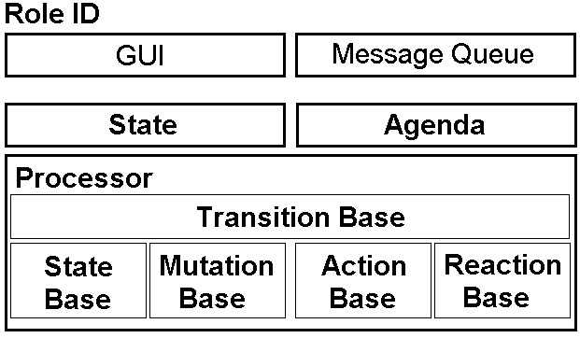
Problem instantiation: High level design of Multi-Agent Framework

Slide 24
Nearest future directions of the research
MAS developing
careful design and implementation of IA as actors.
consolidation of B- and I- data in one data model based on the Object Paradigm and DEMO meta-model.
Bridging the gap between business strategy, model, capabilities and processes and the functions of multi-agent framework
Implementation of the algorithms for run-time monitoring and control of processes by intellectual agents. Using of Process Mining tools locally, by each agent.
- Using of a meta-model for operational support
- Semantic business process mining and monitoring
- Data ontology for process mining and monitoring

Slide 25
Thank you for your attention.
Questions?
Tatiana POLETAEVA
ta.poletaeva@gmail.com

Slide 26


