Slide 1

Service Oriented Enterprise Engineering
applying viable system approach (vSa) in Enterprise Engineering
for corporate strategy decision making
13th CIAO! Doctoral Consortium Workshop, 2013

Slide 2
PhD Promoter: Prof. Geert Poels
PhD Researcher: Laleh Rafati

Slide 3
Content
Research Context
Research Goal
Research Problem
Research Solution
Research Approach

Slide 4

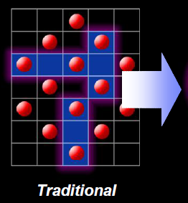
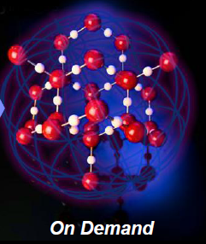
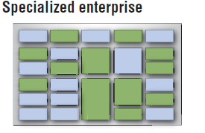
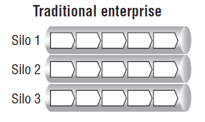
On Demand Model
Imperatives of economy
An on demand business is a business whose processes—integrated end-to-end across the company with key partners —can respond with speed to any customer demand, market opportunity or external threat .
.
.
Source: IBM Institute for Business Value, 2003-05.
“Specialized Enterprise”
A company organized into components that delivers best-in-class performance through internal excellence and external partnerships.
Notes:
the business environment is undergoing rapidly changes in competitive environment, transforming the traditional enterprise models is one of the best solutions for an organization to simultaneously attain all three imperatives of today’s economy;
Differentiation (focusing on key differentiators and relying on a network of expert partners for non-differentiating operations),
responsiveness (responding rapidly to customer needs, marketplace changes and external threats), and
efficiency (maintaining productivity and reducing risk by adapting cost structures and business processes in a flexible manner).

Slide 5
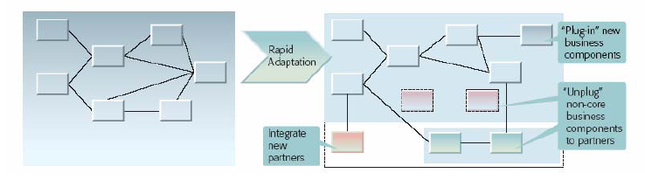
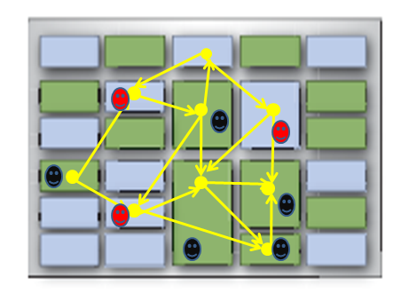
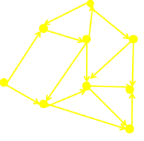
Componentization & Service-orientation
Business Component
Key Enablers
Global Connectivity Platform
Source: IBM Institute for Business Value, 2003-05.
Best-in-class Specialists
Notes:
Componentization and service orientation are two key firm’s behavioral orientations to transform the traditional (rigid) enterprise model into a flexible (dynamic) one to address all three attributes.
*Componentization: a way to deconstruct an enterprise and then reconstruct into value nets, in which partnerships with customers and suppliers operate in a value network. The process of deconstruction/reconstruction is realized through business components (i.e. distinct business functions). A business component is a part of an enterprise that has the potential to operate independently. Business components represent a logical grouping of the work done within the enterprise and contain people, activities and supporting technology.
*Service Orientation: a way to seamless integration between business components. Each business component has business services which form the interfaces to other business components.
The need for flexibility across the value net requires that the component network be flexible; that is, the enterprise can ‘‘in-source’’ an outsourced component and vice versa; replace, on demand, a current partner with a different partner; change the terms of the contract between the two components, and so on.

Slide 6
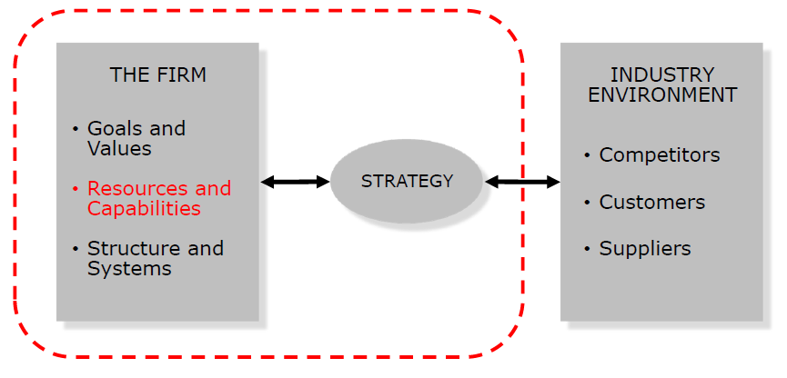
Corporate Strategy
“Corporate Strategy is the direction and scope of an organization over the long term, which achieves competitive advantage for the organization through its configuration of resources within a changing environment and to fulfill stakeholders expectations”. Johnson & Scholes, “Exploring Corporate Strategy”, 2002
The organization’s positioning in terms of responsiveness, differentiation and efficiency requirements to achieve strategic competitiveness on resources and organizational capabilities.
R. Grant, Contemporary Strategy Analysis, 2002
Notes:
In the globalized business, companies require strategic thinking and only by evolving good corporate strategies can they become strategically competitive.
“Strategy is the direction and scope of an organization over the long term, which achieves competitive advantage for the organization through its configuration of resources within a changing environment and to fulfill stakeholders expectations”.
Johnson & Scholes, “Exploring Corporate Strategy”, 2002
Corporate Strategy is the organization’s positioning in terms of responsiveness, differentiation and efficiency requirements, i.e., the sought competitive advantages.
The resources of the firm are seen as the main factors driving the firm’s strategy and performance. When the external environment is subject to rapid change, internal resources and capabilities offer a more secure basis for strategy than market focus.
Resources are productive assets owned by the firm and capabilities are what the firm can do. Individual resources do not confer competitive advantage. They must work together to create organizational capabilities which are the firm’s capacity to deploy resources for a desired end result.

Slide 7
Research Goal
Our goal: To facilitate corporate strategy decision making.
Main factors: Resource and organizational capabilities.
Tools: Sourcing models
Shared services models, out-insourced models, centralized-decentralized models and strategic alliance-joint venture models
Sourcing Model Enablers: Componentization and Service orientation.
Dynamic configuration of resource or dynamic capabilities
(Internally and externally)Interaction between components
Service exchange and Value creation

Slide 8
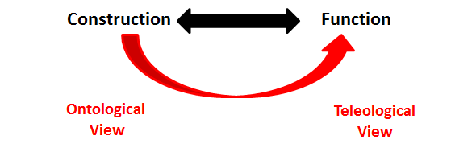
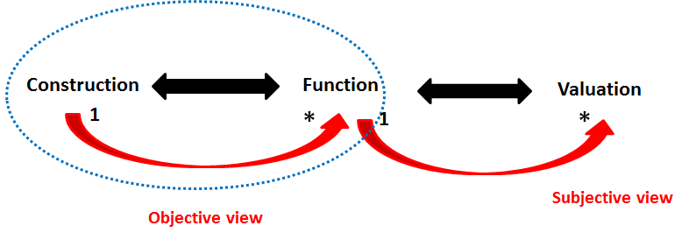
Current Perspectives in EE
EEM
João Pombinho and Martin Op 't Land
Notes:
EEM views enterprise as system and also defines it as a goal-oriented cooperative of people and means.
There are two distinct perspectives on enterprises (as on all systems): function and construction. All other perspectives are a subdivision of one of these. Accordingly, there are two distinct kinds of models: black-box models and white-box models.
White-box models are objective; they regard the construction of a system. Black-box models are subjective; they regard a function of a system. Function is not a system property but a relationship between the system and some stakeholder(s).
Both perspectives are needed for developing enterprises
Construction-Function-Valuation
a valuation of a system is defined as the contribution of a function of a system for a certain stakeholder;
one system may, and generally will, have more functions;
a function of a system is an inherent property of the system itself.
one-on-many relationships between construction and function.
one function can, and generally will, have more contributions.
Both construction and function can be objectively asserted.
Three perspectives are needed for developing enterprises

Slide 9
Research Questions
How complex emerging phenomena of componentization and service orientation can be modeled in the discipline of Enterprise Engineering?
How (corporate level) strategy decisions can be managed and governed based on the complex emerging phenomena of componentization and service orientation in the discipline of Enterprise Engineering?
Subjective and Dynamic View

Slide 10
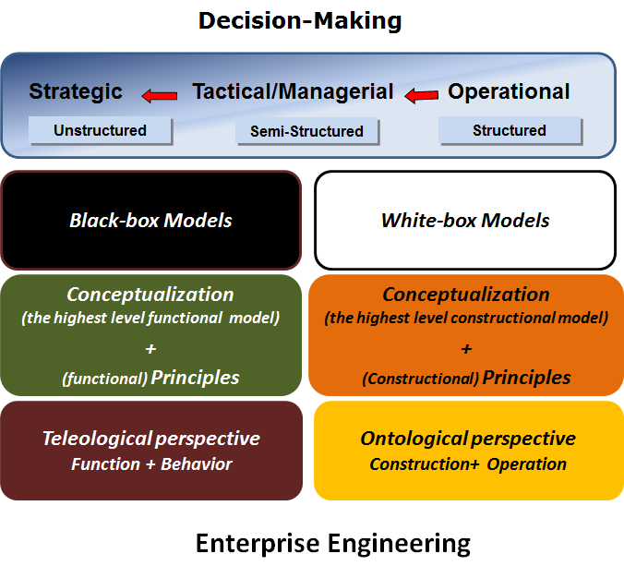
Research Focus and Requirement
EO/DEMO
?
Splitting
&
Allying
Notes:
Intention :
To govern and manage (corporate) strategy decisions
(Black box) modeling of business sourcing based on complex emerging phenomena of componentization and service orientation
Requirement :
a well-defined conceptualization of sourcing : a high level conceptualization adequate to strategy level of enterprise, not to operational level, for strategy decisions , not operational decisions.
Functional principles for sourcing of business.

Slide 11
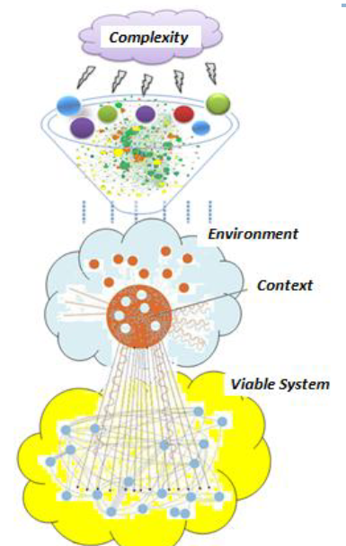
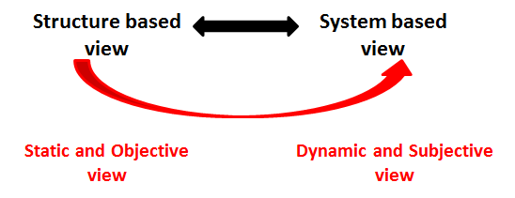
Our position statement
Viewing an enterprise as a viable system. Stafford Beer 1991
Applying viable systemic paradigm for investigating emerging phenomena. Barile and Saviano, 2008
Notes:
A viable system is a system that survives, is both internally and externally balanced, and has mechanisms and opportunities to grow and learn, to develop and adapt, and hence to become more and more efficient within its environment. Stafford Beer 1991
The firm as viable system is an organization based on interconnections and interdependence among its internal components (sub-systems) and the components of other systems (supra-systems) to evolve, develop and improve over time its conditions of survival.
viable systemic paradigm is the conceptual distinction between ‘structure’ and ‘system’. (Barile and Saviano, 2008) The advantages of the “Structure-System” view of viable systems include a more effective ability to show the evolutionary dynamics of a firm.
Static view: elements and/or relations- static components (parts) and relations (structure).
dynamic view: interaction- internal/external interactions-
Structure-based view is a static and objective view.
system-based view is a dynamic and subjective view
One-on-many relationships between structure and system - several systems can emerge from the same structure
StBV as a static and objective perspective is useful for describing and measuring a phenomenon.
SyBV as a dynamic and subjective perspective that is useful for interpreting the system dynamics.

Slide 12
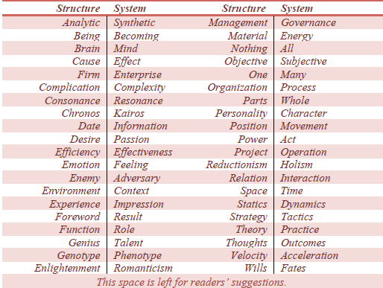
Terminological distinctions
www.asvsa.com
Notes:
in some cases, might seem synonyms

Slide 13
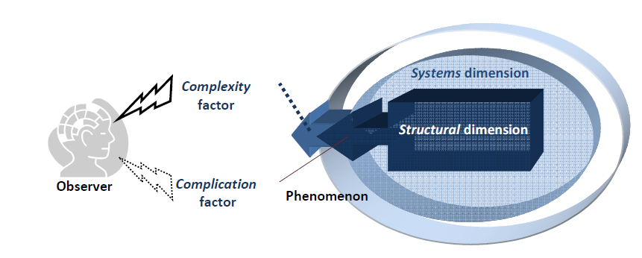
Research solution (first)
Applying viable system approach (vSa) as an interpretative approach to qualify the concepts of the complex emerging phenomena in the discipline of Enterprise Engineering.
Complexity refers to a particular combination of multiplicities and autonomies in a given context
A system is a phenomenon that can generate chaos, complexity or simply complication, depending on the interpretative capacity of the observer (decision maker), not on the characteristics of the phenomenon.
Complication and complexity factors in perceiving phenomena, Saviano, Berardi, 2009.
Notes:
The first solution is: Applying viable system approach (vSa) as an interpretative approach to qualify the concepts of the complex emerging phenomena of componentization and service orientation such as resource integration and dynamic capabilities, interactions between components, service exchange and value creation in the discipline of Enterprise Engineering.
complexity refers to a particular combination of multiplicities and autonomies in a given context
A system is a phenomenon that can generate chaos, complexity or simply complication, depending on the interpretative capacity of the observer (decision maker), not on the characteristics of the phenomenon
A system cannot be examined and understood as a single phenomenon, but it should be contextualized within the framework of interconnections and interdependences with the external environment, from which the same system derives the degree of complication or complexity of its representation
The interpretation of complex emerging phenomena requires interdisciplinary approaches, both a reductionist view (analyzing elements and their relations) and a holistic view (capable of observing the whole).
Increasing attention in service research due to its contribution to understanding complex emerging phenomena such as value co-creation, service exchange and service systems

Slide 14
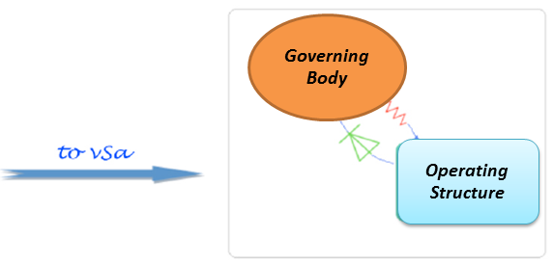
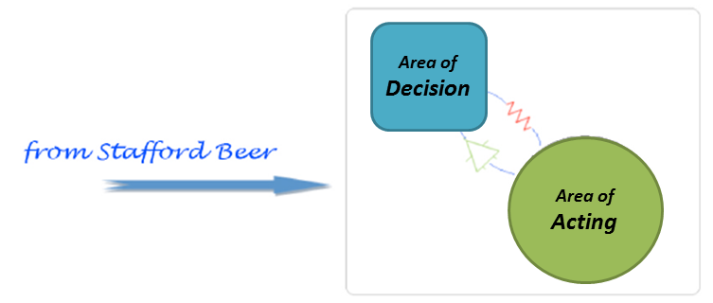
Research solution (second)
2. Applying vSa as a governance approach for investigating the implications of complex emerging phenomena for (corporate-level) strategy decision making in the discipline of Enterprise Engineering.
vSa redefines the initial distinction between decision and action
Governing Body: Strategic decision making;
Operating Structure: Operational decision making and operations executive.
Notes:
the second solution is: Applying vSa as a governance approach for investigating the implications of complex emerging phenomena for (corporate-level) strategy decision making in the discipline of Enterprise Engineering.
vSa redefines the initial distinction between decision and action
specifying that in organizations it is always possible to identify two decisional areas: the governing body, deputed to the strategic decisions (decision making) and the operational structure, deputed not only to executive operations, but also to operational decision making related to problem-solving

Slide 15
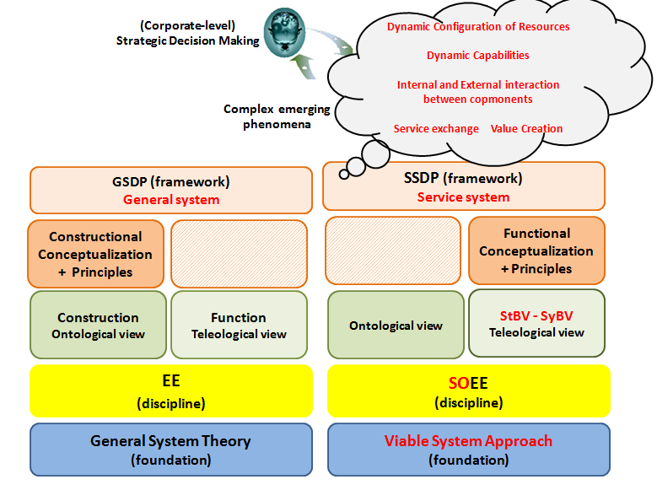
Research approach

Slide 16
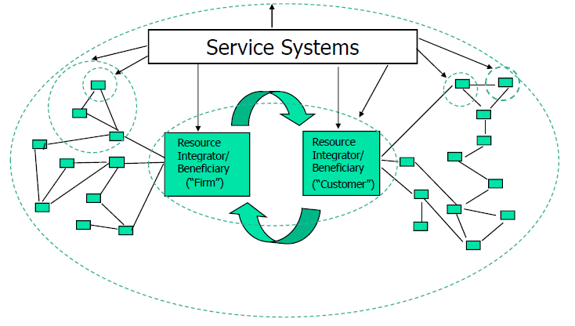
Why Service System?
Resources are the building blocks of service systems, Jorge Sanz 2008
Dynamic Configuration
of Resources
Actors = Resource Integrators
Service exchange
Value Co-Creation
Notes:
The service system abstraction introduces a meaningful way to understanding key new sourcing model enablers like componentization (dynamic configuration of resources and internal or external interaction between components), service orientation (service exchange and value creation).

Slide 17
Methodology & Research Plan
Methodology: Design Science
Research Plan:
Formulating problem and defining solution (the first year)
Design and development framework (the second year)
Evaluation (the third year)

Slide 18
Foundamental Theories
System thinking
vSa
SS
RBV
DCs
Viable system approach
Resource based view
Organizational management thinking
Service thinking
Service System
Dynamic capabilities

Slide 19
Thanks for your attention

Slide 20
Back up slides

Slide 21
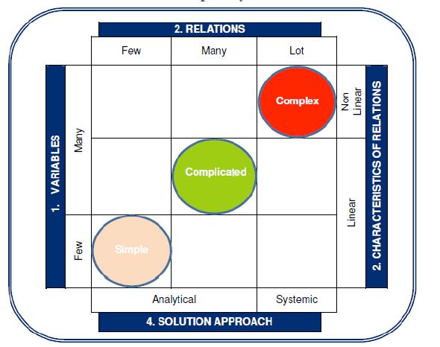
The dimensions of complexity
the dimensions of complexity

