Slide 1
CIAO DC 2013
Interactive Roadmap Generation in Enterprise Architecture Planning
Philipp Diefenthaler, 15. May 2013
Supervisor Prof. Dr. Bernhard Bauer, University of Augsburg

Slide 2
Agenda
Motivation & Problem Identification
Proposed Solution
State of the thesis & Achievements
Future Plans
Q & A

Slide 3
Motivation
Change is an essential part
Internally and externally events trigger change of enterprises
Enterprises need to change in order to stay competitive
Enterprise Architecture Planning supports the definition of the target and the creation of the plan how to get from the current to the target state
Enterprise models, i.e. of the current and target state, can support the communication and analysis
Complexity of problems that are addressed and modeling can be supported by appropriate tools -> Interaction
A Roadmap
is an “abstracted plan for business or technology change, typically operating across multiple disciplines over multiple years” (TOGAF 9.1, chapter 3)
describes the transformation path, in a qualitative and quantitative way, from the current to a target state (Engels et al.: Quasar Enterprise, p. 291)
Notes:
All your base are belong to us!

Slide 4
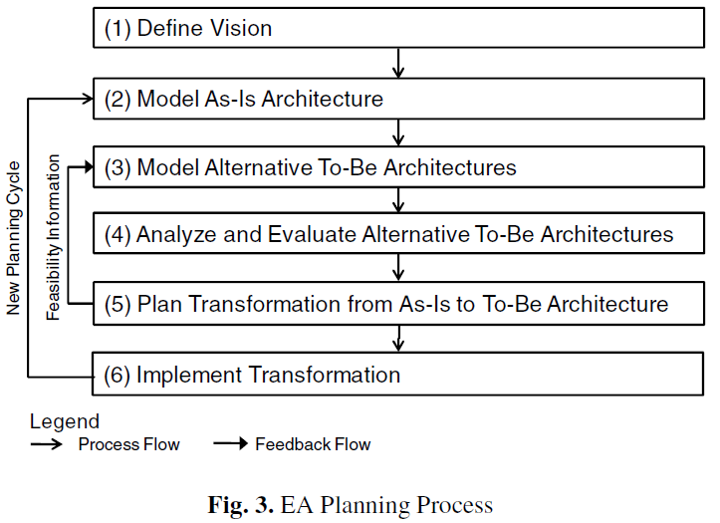
EA Planning Process - Aier at al. 2009
Complexity Levels of Representing Dynamics in EA Planning in Albani, Barjis et al. (Ed.) 2009 – Advances in Enterprise Engineering III
p. 64

Slide 5
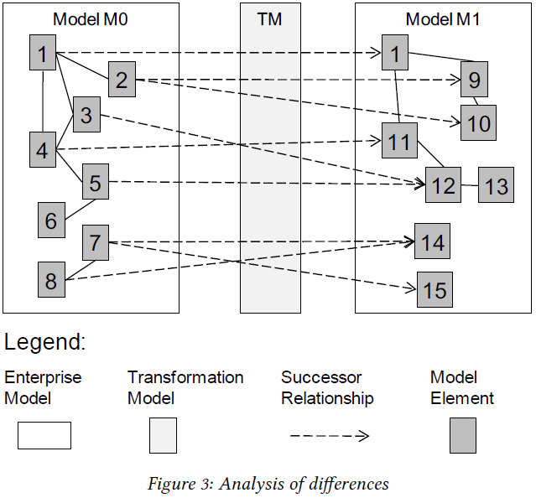


Transformation Model (TM)
What is it and why is it important?
TM contains information which element is successor of which element
Each Model contains elements and relationships
E.g. model of current and target state
Transformation model is necessary for roadmapping as it constrains the possible sequencing of changes
Aier, Stephan and Gleichauf, Bettina: Application of Enterprise Models for Engineering Enterprise Transformation
in Enterprise Modelling and Information Systems Architectures 5(1) 2010 p. 64
Research Question (RQ) 1: Which preliminaries and extensions to transformation models are necessary to allow an interactive roadmap generation?
RQ 2: How can resources and time be considered to allow the scheduling of a roadmap?

Slide 6
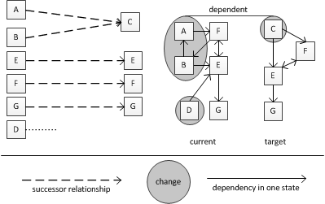
Dependent Changes
Projects are the implementers of change and create and delete certain artifacts (Sousa et al., An Approach for Creating and Managing Enterprise Blueprints: A Case for IT Blueprints in Albani, Barjis et al. (Ed.) 2009 – Advances in Enterprise Engineering III)
Every project has a deadList and aliveList for artifacts
Dependent elements in one state if they have a relationship to each other (Aier, Stephan and Gleichauf, Bettina: Application of Enterprise Models for Engineering Enterprise Transformation in Enterprise Modelling and Information Systems Architectures 5(1) 2010 p. 64)
Dependent changes are changes that influence each other and cannot be planned separately
Changes have an influence on each other if they have elements in the current or target state in common.
Notes:
Dependent changes are changes that influence each other and cannot be planned separately. Changes have an influence on each other if they have elements in the current or target state in common. Additionally, Aier and Gleichauf ([6], p.64) define dependent elements in one state if they have a relationship to each other. To detect dependent changes between two states of an EA it is necessary to know the successor relationships between elements of the current and target state. Figure 1 shows the successor relationships between elements and the dependencies between elements in one state. For example, element A and B both have the successor C in the target state. Furthermore, A and B do not have any further successors and C does not have any further predecessors, then A, B and C are part of a dependent change. A and B depend on other elements but these dependencies are adopted by the successor C.

Slide 7
Changes between States in EA models
(New types of elements are not considered as changes in my work)
In general every successor model differs from the predecessor model in created and deleted elements, relationships and attributes
Change (Update) of an element can be seen as a create (S-new) and delete (S-old)
Relationships pose a special challenge for planning as they may indicate dependencies
RQ 3: How can the differences of relationships between elements in the current and target state be derived to support the roadmap generation?
Interaction is only possible if the changes can be anticipated by a tool
RQ4: How can the changes (actions) in enterprise architecture be formalized?
Transition States (Plateaus) as the planned stops on the way to the target
Best Practices for changes
Reference Scenarios (Engels et al.: Quasar Enterprise, p. 291)
Certain type of components should be migrated first
Certain services should be realized first
RQ5: Can reference scenarios be formalized to allow the suggestion of intermediate steps and states?

Slide 8
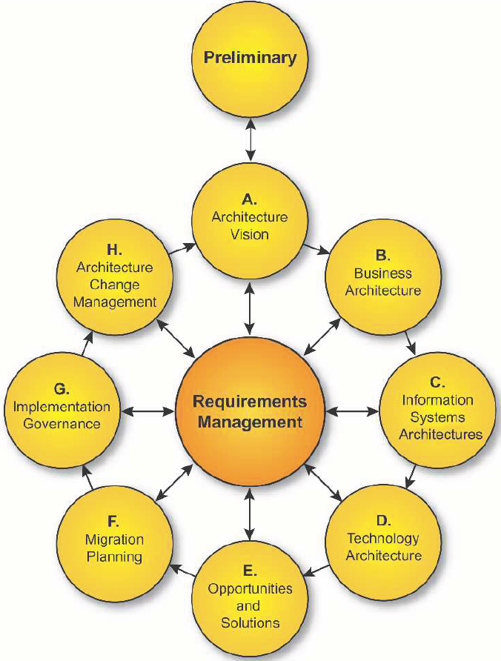
Last but not least
Connect the artifacts that are to be developed with existing solutions
RQ6: How can the stakeholders interactively develop a roadmap with a planning component?
The Open Group Architecture Framework (TOGAF) Architecture Development Method (ADM)
© The Open Group

Slide 9
Interaction of the Proposed Solution
Detailing the Target State and Setting Successor Relationships
Creating detailed Plans
Creating the Roadmap

Slide 10
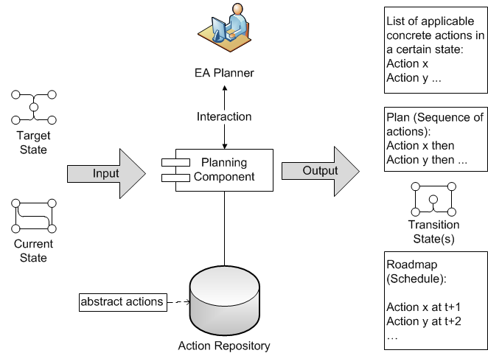
Planning Component in Context
Models of current and target state based on Web Ontology Language (OWL 2) from World Wide Web Consortium
Actions:
Detailling
Sequencing
Debugging

Slide 11
Detailing the Target
Input: Coarse model of the target state, e.g. a Business Support Map of the Application Landscape with target processes and target organization units
Abstract actions for detailing the target:
Create new application component
Retain one application component
Retain several application components
Create new application service
Retain application service
Retain several application services
….
Result: Transformation Model with successor relationships between elements of the current and target state
Notes:
The planning component guides the EA Planner through the detailing process of the target state. At first the planning component creates from the abstract actions create new application component, retain one application component or retain several application components, applied on the current state, concrete actions. The EA Planner may need additional information to decide which of the suggestions is the most beneficial. Additionally, the planning component sets the successor relationships, within the transformation model, in the background as the EA Planner makes the decisions which application components have to be built or retained. If a new application component is selected to be built the planning component will suggest to implement and use the services implemented and
used by the predecessor. The EA Planner may follow these suggestions or adjust them to his needs. At this point the EA Planner does not specify the temporal sequence of changes. He is detailing the information to allow a sound sequencing and scheduling later on. All parts that are not specied in interaction between the EA Planner and the planning component remain the same as in the detailed cur-
rent state, as no changes are specied. As a result a detailed target state and the successor relationships between elements of the current and target state are available. The transformation model contains the successor relationships at the end of this phase.

Slide 12
Excerpts of dependent changes
Excerpt 1
Develop Application Component
Develop
Service
Change Dependencies
Shutdown
Service
Shutdown
Application Component
detailed Target State
Excerpt 1
Excerpt 2
Each excerpt is planned in detail
An Excerpt consists of at least one dependent change
Excerpt 3
Excerpt n
detailed Current State

Slide 13
Creating Detailed Plans
From an initial to a goal state
The initial state is a combination of the current and target state connected through the transformation model and all relationships from the current state
The goal state is a combination of the current and target state connected through the transformation model and all relationships from the current state
Current
Target
Excerpt 1
Initial
Action x
Excerpt 2
Initial
Sequencing action
Goal
Goal
Interaction: EA Planner may decide to automatically create a plan or select applicable actions in interaction until goal state is reached.
Results: Refined TM and plans for each excerpt showing the sequence of actions
Action repository

Slide 14
Creating the Roadmap
If all constraints posed by the EA Planner can be satisfied the planning component can schedule a roadmap with the information gathered from the creation of the detailed plans.
If the constraints allow a solution can be computed automatically
Support for conflict resolution
The planning component has to take the durations of the activities and the resources into account. Furthermore, if any additional temporal constraints have been posed by the EA Planner during the Creating Detailed Plans phase the planning component has to take them also into account.
An optimization of the roadmap taking further needs of the EA Planner into account is favourable.
For example, the planning component can schedule the shortest roadmap, regarding the timespan and considering resource constraints, or taking urgency and importance of changes into account.
Result: Roadmap

Slide 15
State of the thesis
Conducted Literature Review in EA Planning and knowledge-based planning
Identififed problems and motivated the topic
Defined the objectives of my solution
Designed artifacts for RQ 3 & RQ 4
Future plans
My Ph D Roadmap
Q1 2012
Q2 2013
Q4 2014
Notes:
We nished the literature research on the state of the art in enterprise architecture planning and knowledge-based planning in articial intelligence relevant for the thesis' topic. Furthermore, we identied the problems and dened the objectives of the proposed solution.

Slide 16
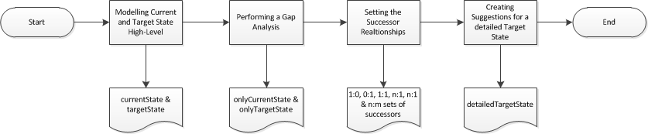
Research Question 3
Gap Analysis in EA using Semantic Web Technologies
Modelling with Protégé (Ontology Editor of the University of Standford)
OWLDiff performs the Gap Analysis on the models (OWLDiff: A Practical Tool for Comparison and Merge of OWL Ontologies at 22nd International Workshop on Database 2011)
onlyCurrentState: all elements, relationships and attributes that only exist in the current state
onlyTargetState: all elements, relationships and attributes that only exist in the target state
Successor relationships between applications can be set automatically according to Business Support Map
Suggestions for detailed target state are to reuse existing services which provide the same information object
Notes:
The first result that has been achieved is tackling the third research questions.
It shows how all dierences between two states modelled in OWL can be derived automatically. We modelled at rst a coarse current state and target state of an application architecture based upon examples provided from Hanschke [26]. Hanschke uses business support maps to plan the changes in information systems. We adopted the procedure for a proof of concept to derive successor relationships automatically. For each cell within the business support map, consisting of business processes (x-axis) and customer groups (y-axis), the applications localized in a cell of the current target state were made successors of each other's.
Based on the successor relationships and information detailing the current state with application services and information (data) objects it is possible to create suggestions for a detailed target state [27]. We modelled the states in OWL using the Protege ontology editor. The derivation of dierences between the current and target state was conducted using the Protege Plugin OWLDi [28], which can trace dierences of any kind between two OWL ontologies.

Slide 17
Research Question 4
Using GROOVE to create detailed plans
GROOVE is a graph transformation tool from the University of Twente developed under the lead of Prof. Dr. Arend Rensink
GROOVE can be used for AI planning purposes
Several sequencing actions have been modelled in Groove:
Develop Application Component
Develop Service
Change Dependencies
Shutdown Application Component
Shutdown Service
GROOVE can tell if there exsits a plan to get from the initial to a target state
From an EA Viewpoint what sequence of changes my current state to the target state
GROOVE allows user interaction
User can interactively select concrete actions and gets the actions that are applicable in the new state
Initial
Goal

Slide 18
Future Plans 1/2
Design and Development Activities
Near term:
Finish the method and model for the action repository for sequencing actions (RQ 4)
Finish the method and model for the action repository for debugging actions (RQ4)
Mid term:
Create the method and model for the action repository for detailing actions (RQ4)
Identify the possibilities to integrate reference scenarios into the action repository (RQ 5)
Extension of the transformation model to consider further temporal constraints (RQ 1)
Extension of the transformation model to consider resources and time in roadmaps (RQ 2)
Long term:
Method artifact to extend an existing EA process to allow the usage of the developed artifacts in combination with TOGAF ADM (RQ 6)
Notes:
As a next step the method how to develop an action repository and the actions it contains are elaborated in further detail, especially focusing on the formalization of reference scenarios.
The identication of further temporal constraints that have to be considered in a transformation model, which allow a sequencing of changes will be designed afterwards. Resource and time aspects that have to be considered are addressed subsequently.
Moreover, a method artifact, as an additional fragment for an existing method for roadmap generation, is crucial to show that the approach is capable to be connected with an existing architecture process. This artifact addresses research question 6: How can the
stakeholders interactively develop a roadmap with a planning component? We favour the extension of the Architecture Development Method of TOGAF, as it has a broad acceptance in dierent industries and sizes of enterprises and is publicly accessible. Furthermore, an instantiation of the planning component will be built. The designed artifacts will be evaluated in case studies with industry partners with a focus on the instantiation; one automotive, one banking and one multi-industry enterprise.

Slide 19
Future Plans 2/2
Demonstration and Evaluation Activities
Case Studies with industry partners
One automotive, one banking and one multi-industry enterprise
First round of Interviews was already conducted in 2012
Highly diverse Architecture Models & Methods and different Maturities of the EA management approach (initial, consolidated and mature)
But all have a focus on the applications in context with the business and technology
Applicability of the planning component and developed models & methods will be evaluated
Effectiveness and efficiency will be observed
by providing hands-on experiences and
conducting interviews for open issues and unsatisfactory results
Furthermore: Communication of the results

Slide 20
Q & A
? ? ??

Slide 21
Thank you very much for your feedback and attention!

Slide 22
Backup

Slide 23
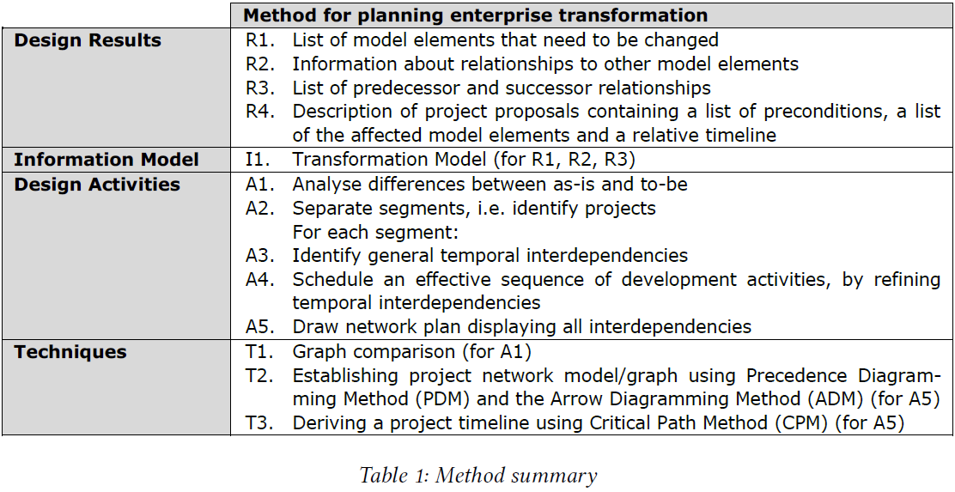
Aier and Gleichauf 2010
Application of Enterprise Models for Engineering Enterprise Transformation
P. 62 table 1
“Based on the relationships within the to-be model, general segments of model elements can be derived (A2).” p. 63-64

Slide 24
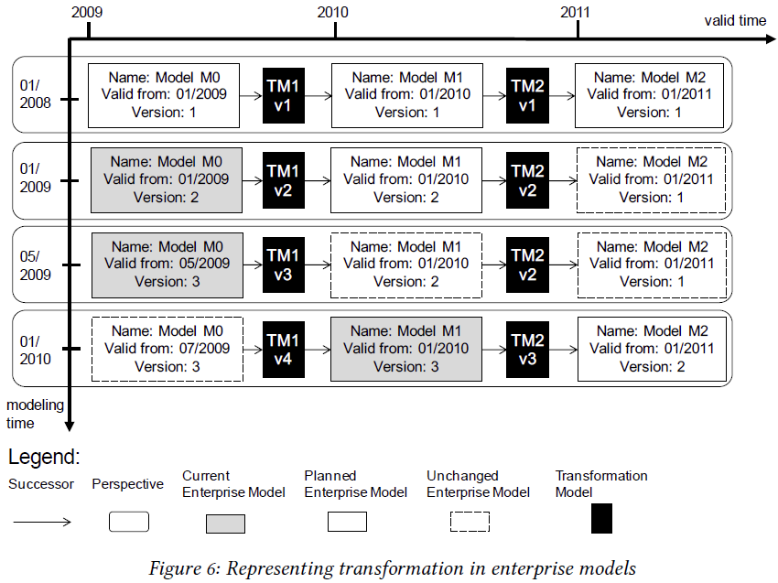
Aier and Gleichauf 2010
Application of Enterprise Models for Engineering Enterprise Transformation
Each model can be for example an application landscape
Figure 6, p. 67

Slide 25
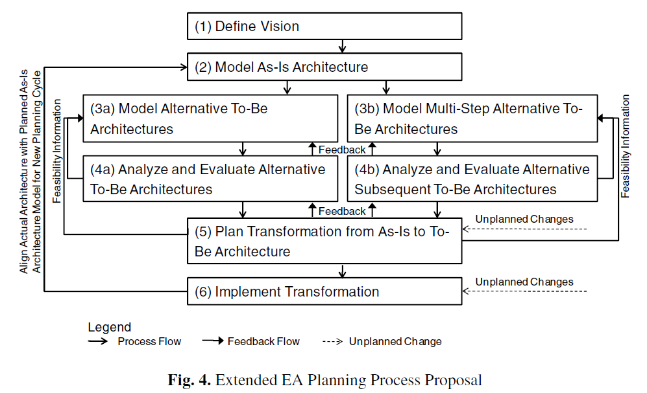
Extended EA Planning Process Proposal - Aier at al. 2009
Complexity Levels of Representing Dynamics in EA Planning in Albani, Barjis et al. (Ed.) 2009 – Advances in Enterprise Engineering III
p. 67

Slide 26
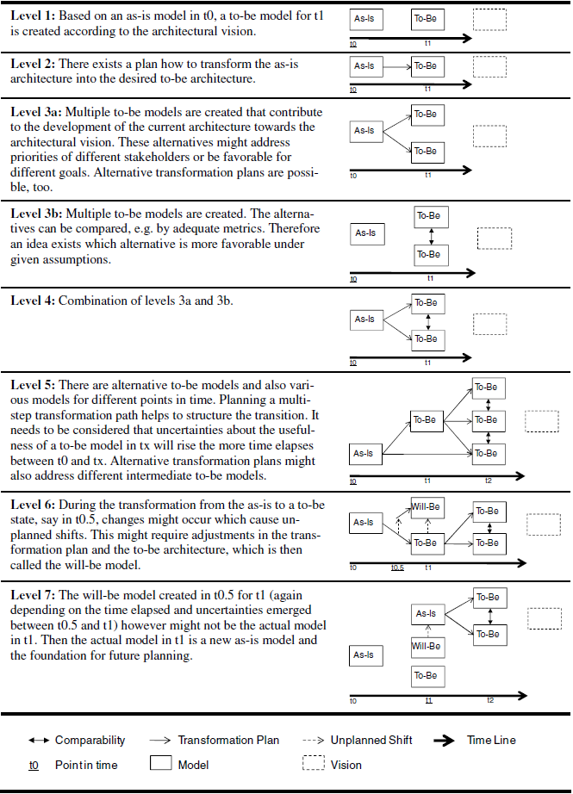
Aier at al. 2009
Complexity Levels of Representing Dynamics in EA Planning in Albani, Barjis et al. (Ed.) 2009 – Advances in Enterprise Engineering III
p. 65

Slide 27
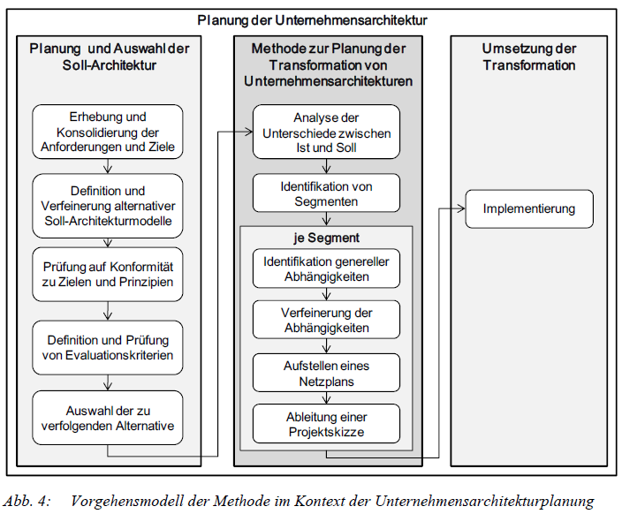
Gleichauf 2011 Ph D Thesis
Planung der Unternehmensarchitektur
p. 31

Slide 28
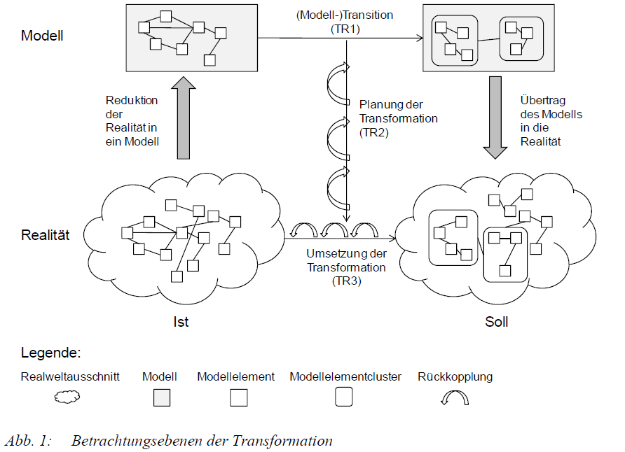
Gleichauf 2011 Ph D Thesis
Planung der Unternehmensarchitektur
p. 6

Slide 29
Gringel and Postina
I-Pattern for Gap Analysis in Engels, Luckey et al. (Hg.) 2010 – Software engineering 2010
Overview of current and ideal landscape
Action list to remove structural differences between ideal and current landscape
Selected actions result in target landscape
Metrics on the current and target landscape are provided

Slide 30
Postina 2012
Evolutionsmanagement prozess- und serviceorientierter Unternehmensarchitekturen – Ph D Thesis
Evolutions-schritt typ
Evolutionsschritt
0..*
Fragestellung
1
1
1
1..*
Entität
1..*
Viewpoint
1
Stakeholder
2
0..*
0..*
1
Referenz
Datenquelle
Visualisierung

Slide 31
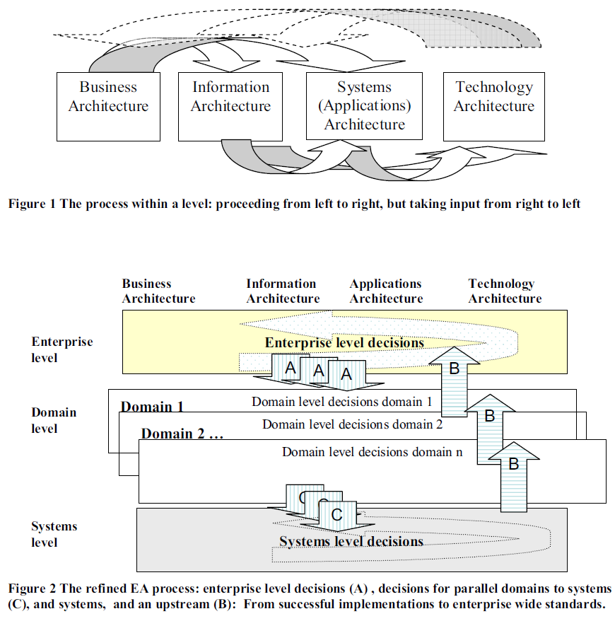
Pulkkinnen 2006
Systemic Management of Architectural Decisions in Enterprise Architecture Planning. Four Dimensions and Three Abstraction Levels in Proceedings of the 39th Annual Hawaii International Conference on System Sciences (HICSS'06)

Slide 32
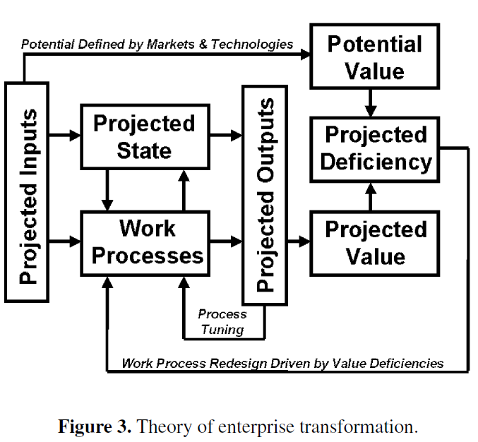
Rouse 2005
Theory of Enterprise Transformation

Slide 33
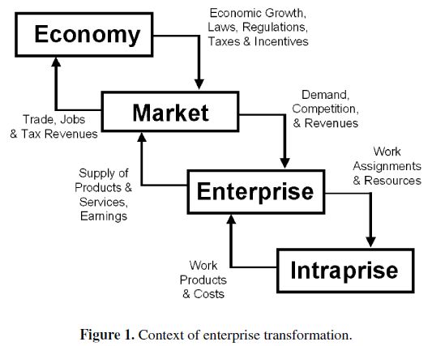
Rouse 2005 Context of enterprise transformation

Slide 34
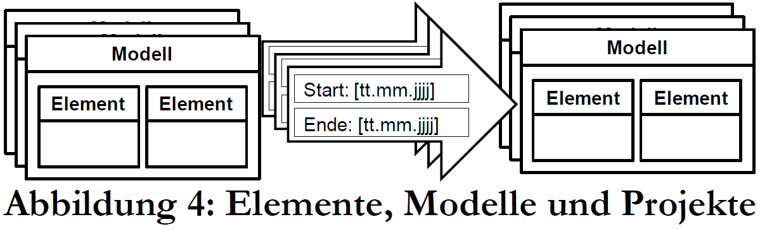
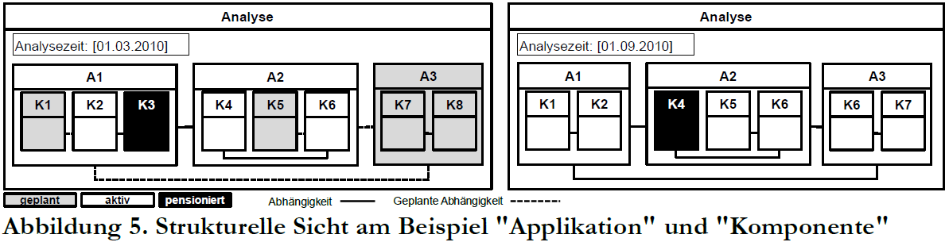
Saat 2010
Zeitbezogene Abhängigkeitsanalysen der Unternehmensarchitektur in Schumann (Hg.) 2010 – Multikonferenz Wirtschaftsinformatik 2010

Slide 35
Sousa et al. Blueprint Management System
An Approach for Creating and Managing Enterprise Blueprints: A Case for IT Blueprints in Albani, Barjis et al. (Ed.) 2009 – Advances in Enterprise Engineering III
Enterprise E modeled as a graph G of artifacts and their relationships
A set of artifacts
R set of relationships
G t(A,R) is a Graph at a certain point in time
G0 bis Gn ist die sequence of states over time (time bar)
Project.aliveList is the list of artifacts a project makes alive and Project.deadList is the list of artifacts a project turns from live to „dead“

Slide 36
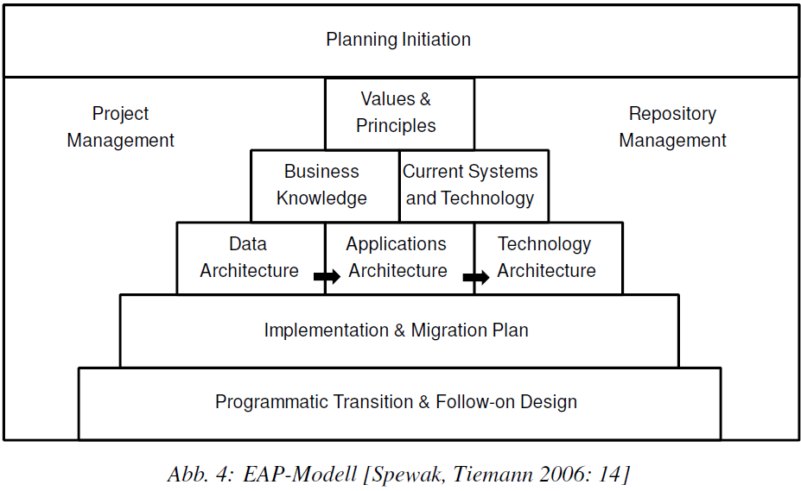
Spewak und Tiemann 2006
Enterprise Architecture Planning Modell (Wedding Cake) newer version of “Developing a blueprint for data, applications, and technology” from 1992

Slide 37
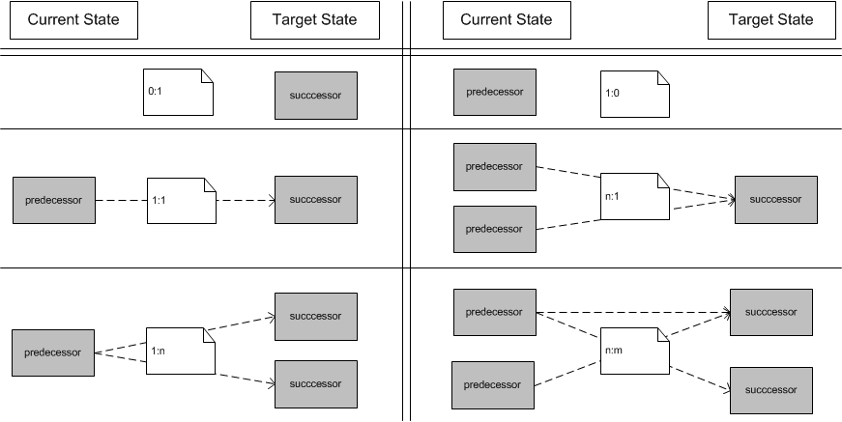
Possible Successor relationship bundles
In accordance with Aier and Gleichauf

Slide 38
Reference Scenario – in a nutshell

Slide 39
Examples from Practice
Projects have different types: Process (Re-)Engineering, Proof of Concept functional and/or IT-related, IT Consolidation, inter-organizational workflows, IT integration
Certain types of projects are likely to trigger certain types of projects
E.g. Process Engineering Process triggers IT integration

Slide 40
Cyclic Dependencies in successor relationships
Successor (ManyToOne)
G
If only the successor relationships on the applications were considered (blocks) F could be built before G
A -> G AND S1 -> S3 AND E -> F form an cyclic dependency
A
B
Successor (ManyToOne)
S3
C
S1
uses
uses
S2
D
provides
F
E
provides
noSuccessor
Successor (OneToOne)

