Slide 1



Value-oriented Enterprise Engineering
Uncovering the rationale behind organization components
João Pombinho
Doctoral Consortium – EEWC 2013
Luxembourg, May 2013

Slide 2
Agenda
Introduction and Motivation
  IT Demand Management @ZON Multimedia
Problem Statement – Where is the Value?
Research Approach
Related Work – Benefits Mgmt., e3value and DEMO
Proposed Solution
  Value-oriented Solution Development Process
  Solution Development Organization
Practical Application
Contributions and Conclusions

Slide 3


“Why do so many IT leaders do such a terrible job of running their departments like a business? Because they put too much emphasis on supply and not enough on demand.” ¹
Doing things right
vs
... do we really have to choose?
doing the right things
¹ Michael Gentle, “A New Model for IT Demand Management”, cio.com, october2007

Slide 4
Introduction and Motivation
The question is doing things right vs doing the right things
  Ideally both!
Let us consider two different perspectives of a system [1]
  Teleological, concerning its function and behaviour, a black-box
  Ontological, about its construction and operation, a white-box
ICT-related approaches mainly deal with the ontological perspective…
  Yet, from the customers viewpoint, the organization does not matter!©
Strategic failure is commonly attributed to Business/IT misalignment [2]
  Do systems and their supporting systems really belong to separate worlds?
How to integrate Business and supporting System development?
[1] Dietz, J.L.G., ed. Architecture - Building strategy into design. Academic Service, ed. N.A. Forum. 2008, Sdu Uitgevers.
[2] Ross and Weil, Enterprise Architecture as Strategy: Creating a Foundation for Business Execution. 2006, HBS Press
Notes:
4

Slide 5

Introduction and Motivation
ZON Multimedia
In 2008, after TV Cabo had split off from the incumbent operator, ZON Multimedia first appeared as an independent brand
The ZON Multimedia business group leads the market in pay TV and cinema in Portugal and is the second largest internet provider
1.6 million customers
ZON operates the largest New Generation Network in Portugal, reaching over three million homes.
Its 210 cinemas make up the largest network in the country and attract almost ten million cinema-goers a year.
ZON Multimedia and its affiliates have approximately 1,600 employees

Slide 6
Introduction and Motivation
ZON Multimedia – IT Demand Management
Responsible for analyzing business needs and using the available resources to provide feasible solutions
Managed platforms included those typical of a Telco, e.g. CRM, Integration, Billing, Provisioning, ERP, public and internal Portals
A standard IT DM process that mapped to a classical Software Development LifeCycle (SDLC) was in place
IT client units (business and support) jointly created over a thousand project requests per year through this process, ranging from simple changes to full-scale product launches and IT transformations with development effort that amount to hundreds of staff-days
The IS support services annual investment was 18,9 M€ in 2011 [8]

Slide 7




Introduction and Motivation
What does IT Demand Management do?
Consolidate business needs
Identify and specify solutions
Evaluate priorities and cost/benefit
Plan according to delivery capacity
Hands over to Delivery
  ... or not!

Slide 8

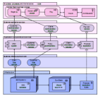


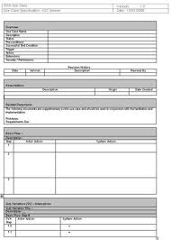
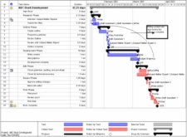

Introduction and Motivation
IT Demand Management process
Project Request
Benefits
Quickscan
Detailed Solution
Functional Units
Planning
Implementation and Delivery
Runtime
Business Case
Requirements
Priority
Dependencies
IT Estimate
Architecture
Coding
Testing
PIR
Bottom-up Costs
!
!
What is the value generated by a particular IT asset at runtime?

Slide 9
Introduction and Motivation
IT Demand Management process - Issues
Problems/opportunities were not clear and direct implementation of solutions was requested from IT
Prioritization of projects was casuistic and used criteria were opaque
A large number of projects went through detailed and time-consuming specification and only after an estimate by the development team was it possible to evaluate the merit of the project
Project backlog amounting to half the new project requests/year
The capacity issue led to ageing and dated solution specifications
Investment control and visibility: IT was mostly seen as a cost center
Solution design: ROI imbalances were found at solution component level, i.e., their contribution to the benefits was unknown or unjustifiable

Slide 10

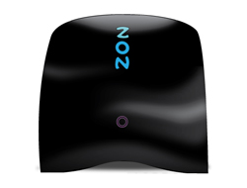
Problem Statement
Remote Internet support Example
In the case there is a perceived malfunction by the customer, she can contact the call center to identify and solve the issue. After calling the support number, her call is handled by an Interactive Voice Response (IVR) system. IVR allows customers to interact with the company via telephone keypad or by speech, so they can service their own inquiries by following the predefined process or eventually get redirected to a human operator.
The client identifies herself by dialing the national ID number. Additional identification information can be requested for cross-check later in the call if there are relevant actions to be taken.
Following, a diagnosis process is carried on. The diagnosis can be at customer side (e.g. check the modem lights) or at the provider side (e.g. check service provisioning status).
After a diagnosis is established, a solution is attempted. Again, the solution can be at the customer side (e.g. reset device) or at the provider side (e.g. force firmware update). The call ends after reaching a solution or, if it is not successful, by requesting field service.

Slide 11
Problem Statement
Remote Internet support Example – Actor Transaction Diagram (ATD)

Slide 12
Problem Statement
Remote Internet support Example – Rationale?
Does a customer want to take part on diagnosis and solution application?
  Or she accepts it as a condition to be eligible for “free” support?
Is it still justifiable if the customer pays for the service?
Does the customer want to go through this process or is willing to pay for 2h SLA service restore? SMB?
Is there a market, black-box, solution for this problem?
If any hidden assumptions change, how should the organization adjust?
How does our model support the transformation of the organization to, say, improve customer support value through internal cost reduction?

Slide 13
Problem Statement
Main issues
Traceability
  The construction of an organization obscures the system/subsystem relations and their motivation
  How is value dispersed by organizational components?
Value/Function/Construction relations are not one-way:
  If restrictions cease to be, contextualized revision should occur
  What extra value can be generated by changing the construction?
  Function and, in turn, purpose, could be improved and/or extended, by improved implementation technology, better construction or both
  How to analyze cost reduction solutions, e.g. increase IVR automation?

Slide 14
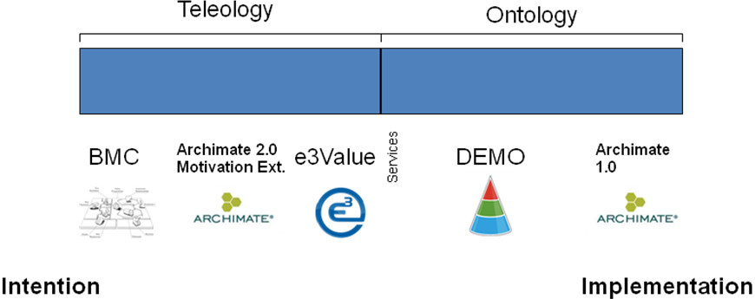

Problem Statement
System Development Continuum

Slide 15
Problem Statement
Summary
While changing an enterprise one needs to be aware of value conditions imposed by stakeholders (past, present and future)
  Sometimes it is obvious by observing organization components, sometimes not
  Value conditions show how each part of an organization contributes to the purpose of the organization itself and of other elements in the organization's environment (market)
Current research approaches do not model value in a formal way that can be related to the composition of the value providing system
How to integrate the teleological and ontological perspectives of an enterprise model to support systematic value based system development decisions?

Slide 16
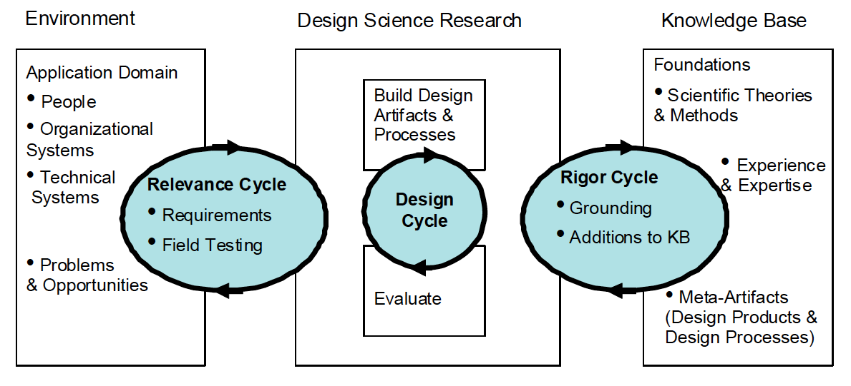
Approach
Methodolody - Design Science Research
Context: real-world industry scenario - IT Demand Management practice at a Telco [1]
ICT-enabled Enterprise Transformation
Explicitating Value-based rationale
GST
DEMO
e3Value
Service Science
GORE
BMC
Design Science Research cycles according to Hevner [2]
e3Value and DEMO integration ontology
VoSDP Organization
VoSDP Method
[1] Pombinho, Aveiro and Tribolet, The role of IT Demand Management on Business/IT Alignment: the case of ZON Multimedia, PRET 2013 (forthcoming)
[2] Hevner, A.R., A Three Cycle View of Design Science Research. Scandinavian Journal of Information Systems, 2007. 19(2): p. 87-92.
Notes:
16

Slide 17
Related Work
Benefits Management
Focus on defining the benefit of a given change
  The objective is to increase the delivery of relevant and quantifiable benefits to the organization
  Framework to identify, plan, measure and manage benefits
Main activities are aligned with IT DM
  Project costs identification
  Project priority definition
  Benefit identification
  Business Cases development
  Benefit delivery planning
  Realized benefits evaluation and revision
Notes:
Pp 81 e 83

Slide 18
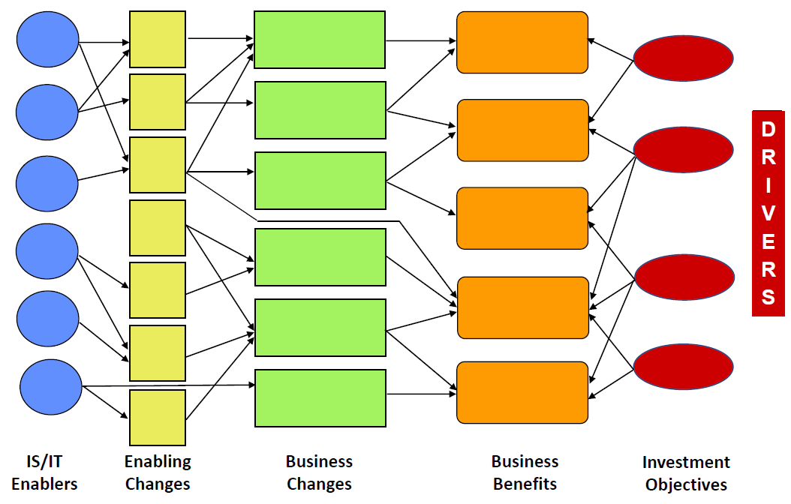
Related Work
Benefits Management - BDN
Ward, J and Daniel, E.M. (2012) “Benefits Management: How to increase the Business Value of Your IT Projects”, 2nd Edition, Wiley.
Notes:
Pp 81 e 83

Slide 19
Related Work e3Value
Ontological approach for modelling networked value constellations
  Directed towards e-commerce
  Creation, exchange and consumption of economically valuable objects
  No construction support
Introduces value model deconstruction and reconstruction [1]
  Still, no structural support for a formal, content-based rationale for decisions
Actors must be economically independent entities - constraint
[1] Gordijn, J., Value-based requirements Engineering: Exploring innovatie e-commerce ideas. 2002, Vrije Universiteit Amsterdam: Amsterdam.
Notes:
19

Slide 20
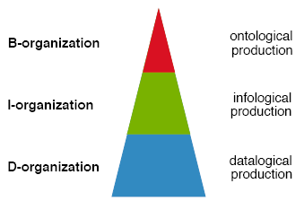
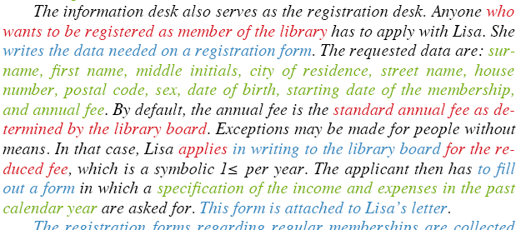
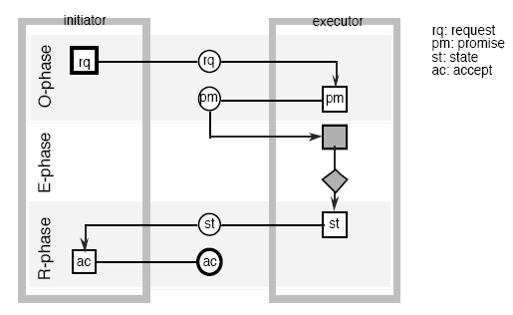
Related Work
DEMO
Why DEMO?
  Complexity reduction, retaining relevance
  Distinguishing intention, content and form
  Transactional pattern based on communication theory
  Formal definitions of competence, authority, responsibility
  Method – repeatability and consistency
How to:
Improve problem specification?
Relate it with the construction?
Notes:
20
4

Slide 21
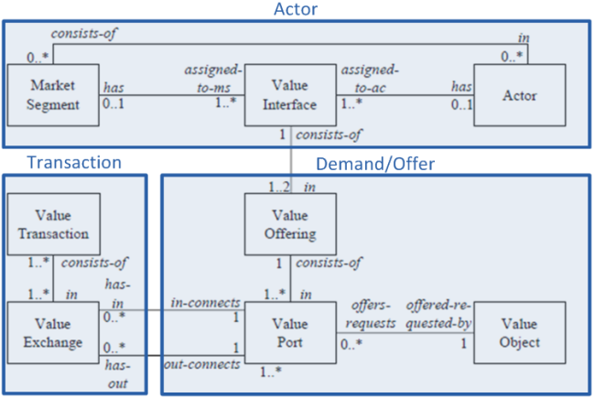
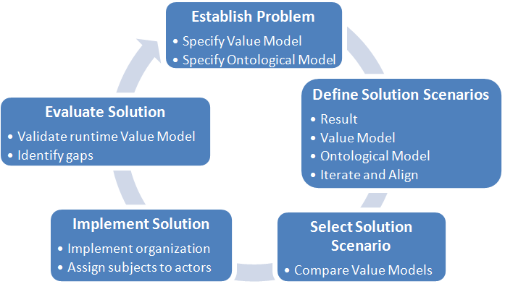
Solution Proposal
Overview and Developed Artifacts
e3Value and DEMO integration ontology
VoSDP Method
Solution Development Organization (SDO)
Notes:
21

Slide 22
Solution Proposal - Ontology e3Value and DEMO integration Ontology
e3Value:
  value coherence and completeness through assigning responsibility
  economic reciprocity
  value object enforcement on p-facts
DEMO
  complexity reduction
  transactional context
  construction support
Notes:
22

Slide 23
Solution Proposal - Ontology
Integration Ontology :: Aligning Actors + Value Transaction
Actors are active elements of social systems and value networks, i.e., belong to a system part
In DEMO, an actor is a subject fulfilling an actor role in a transaction type. The initiator and executor actor roles are related by their common interest in bringing about a production result
In e3Value, both actors (provider and requester) are bound by the willingness to share value objects with the concept of reciprocity
Artificial economical independence - actor role + subject match economic actor
Actors connect by associating Value Ports of different directions
A DEMO Transaction matches a Value Exchange, relating two value ports
A Value Transaction involves at least two, according to the principle of economic reciprocity
In the Library, Readers (US) choose to use the CSO (OS) to get a Book in exchange for Money

Slide 24
Solution Proposal - Ontology
Integration Ontology :: Demand / Offer definition
A Value Interface represents willingness to provide service to its environment
An outbound Value Port specifies the offer of a particular Value Object
To enter into transactions, actors must be competent to perform the associated acts:
  hasInValuePort x => x is competent to perform request and accept (c-act)
  hasOutValuePort x => x is competent to perform promise and state (c-act)
  hasOutValuePort x => x is competent to perform execute (p-act)
A p-fact is produced by performing a Value Activity
A value activity must be assigned to some actor; an actor has at least one value activity
In e3Value, a given value activity is performed by precisely one elementary actor
In the same way, a given transaction is executed by precisely one actor role in DEMO

Slide 25
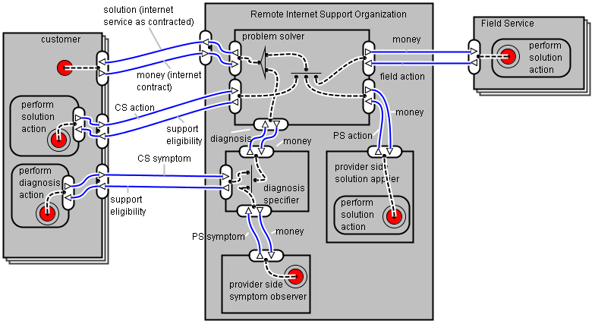
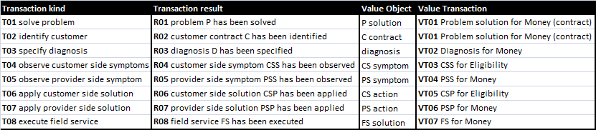
Solution Proposal - Ontology
Remote Internet support Example – Value model driven by construction

Slide 26
Solution Proposal - Method
Value-oriented Solution Development Process (VoSDP)
Notes:
Motivation for entering into transactions to obtain results they value
The value must be accepted, and, therefore, must be defined

Slide 27
Solution Proposal - SDO
Solution Development Organization ATD
Notes:
After clarifying the problem, the solution manager starts a solution development cycle that returns a list of possible solutions in a reasonable period of time. Please note that modeling the value of the solution development process itself and, therefore, obtaining a consolidated value model that takes into account return on modeling effort (ROME), can be done by using the same methodology but exceeds this paper’s scope.
One obvious solution, which is exists in most situations, is to leave everything as it is. By default, this represents the baseline scenario. The solution development manager it so identify additional scenarios and begins as a mostly creative endeavor of identifying results / value objects that make up the following nodes on the value chain for obtaining the original result. In our example, it is necessary to know the cost structure of the business actor from Figure 6. For simplicity and space economy, let us consider that Figure 2 is a complete model of the business actor. In this case, it turns out that the problem solver stands out by a large margin while analyzing the transactional costs of the actors (part of the e3Value model). The fact that the ontological model of the organization does not allow concluding this is no surprise as it abstracts implementation. On the other hand, the value model also has an invariant perspective but it is complemented with selected implementation-level constructs. In this perspective, it is possible to include parameters that are implementation-level value estimates.
Returning to the example, the transactional costs of the problem solver are mostly due to the time the human agent spends in 1) initial call handling, i.e., identifying the customer and 2) filtering away exceptions to normal diagnosis.

Slide 28
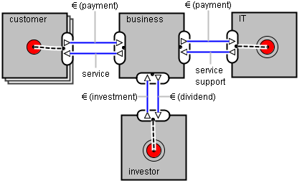
VoSDP – Instantiation
I. Establish Problem
Following up on board decision, Head of Customer Support requests cost reduction by 20%
What is the as-is value model?
What is the overall value model it must comply to?
The transactional costs are mostly due to the time human agents spend in:
initial call handling, i.e., identifying the customer
filtering away exceptions to normal diagnosis
Notes:
28
Head of Customer Support requests a solution for reducing costs, following a decision by the board that their internet support costs are to be reduced by at least 20%. The solution manager asks the requester to specify the Using System value model, which is critical to identify rational solutions. In this case, the requester produces a value model, showing that the largest costs come from the calls that get redirected to human operators. The fact that the investors are the requester means they must come into play explicitly in the value model. The result can be attained by reducing the expenditure or finding alternative ways of generating value, such as increasing revenue (relating with the customer actor) or decreasing support costs (relating with the IT actor). Somewhat surprisingly, as we are about to see, the choice was increasing investment and IT OPEX costs.

Slide 29
VoSDP – Instantiation
II. Define Solution scenarios
Two (L2) SDPs are started by the solution development manager (L1) with the request of reducing human operator time by each of the conditions mentioned previously
condition #1 can be solved by using existing CRM services to identify a customer by DMTF keyed-in data
condition #2 can be solved by using existing services that, based on the customer address and portfolio, identify scope exceptions
By splitting the initiating actor of the transaction, it is now possible to allocate different subjects that can execute more efficiently
Notes:
We are aware that these conditions are of infological nature but to implement each solution, it is necessary to add an actor to the construction. This actor has its own business with service levels and responsibilities, which is the same as saying we are dealing with a US and OS both at the B-level, so it is a matter of relativity as discussed in [4].

Slide 30
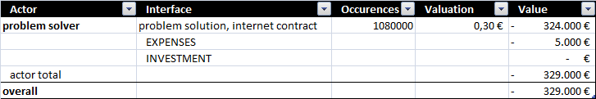
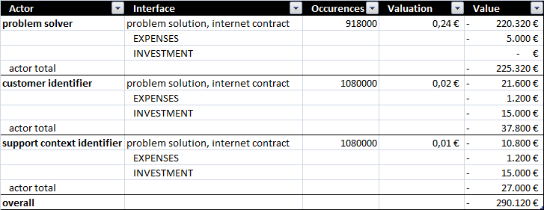
VoSDP – Instantiation
III. Select Solution Scenario
In order to rationally select solutions scenarios, objective criteria must be defined
Using e3Value it is possible to assign valuation formulas to value object transferences through value ports
e3Value also defines the concept of expenses which contribute to the economic viability analysis but are not explicitly modeled as value exchanges:
  Variable expenses (OPEX dep. on volume)
  Fixed expenses (OPEX per time period)
  Investments (CAPEX)
e3Value allows specifying value model components using specific attributes that make the profitability sheets directly derivable from the model
Profitability sheet for scenario A
Profitability sheet for scenario B
Assumptions:
Stable customer revenue
900K customers have internet services and call 1,2 times/year on average for internet support reasons
implementation of the new actors has a CAPEX of 30 K€ and OPEX of 2,4 K€
# calls handled by problem solver reduces by 15%
avg support call duration lowers from 10 to 8 minutes because of effectively reduced support scope due to early context clarification
Notes:
There are two types of value objects: 1) money objects, when the amount transferred can be objectively stated and observed; and 2) non-money objects: the value is subjective, meaning actors can disagree about the amount of economic units they assign it. While non-money objects can be important for design and impacts analysis, there should be an effort to monetize costs/benefits to allow financial analysis. The techniques and theory for doing so are out of the scope of this paper. Nevertheless, it is worth noting that seemingly the value model creation by itself is a step forward creating consensus and improving objectivity.
Besides the valuation of individual transactions on each value port, e3Value defines the concept of expenses which contribute to the economic viability analysis but are not explicitly modeled as value exchanges (e.g., employee costs).
Variable expenses – occur multiple times per value model, depending on the transaction volume and are assigned to value ports, being useful for modeling operational expenditure (OPEX);
Fixed expenses – occur only once per period, e.g. monthly wages, used for simplification, also useful for modeling OPEX;
Investments – a particular fixed expense, occurring only once per time series (scenario) and therefore useful for modeling capital expenditure (CAPEX).
e3Value allows specifying value model components using specific attributes that make the profitability sheets directly derivable from the model. Table 2 and Table 3 represent simplified annual profitability sheets for both scenarios, where value port details have been excluded.
One way of contributing to this value stream is by using the automated IVR-based solution just developed to use it as a channel for up selling/cross-selling. This repositions the customer care organization from a cost center to a value center. The opportunity of having the customer in-line can be taken advantage of by creating a discounted offer for these situations to be presented automatically (relatively inexpensive) and/or redirect the call to a sales operator (more costly; more effective?). To explore this path, a new GSDP cycle is in sight. Only after successful solving the customer problem, of course!

Slide 31
VoSDP – Instantiation
IV+V. Implement and Evaluate
Check the created value conditions for gaps
  Trigger the Solution Development Process if necessary
Use logged VoSDP information to improve
  Using the developed IVR-based solution as a channel for up selling/cross-selling?
  … repositioning the CC organization from a cost center to a value center
  The opportunity of having the customer in-line can be taken advantage of by creating a discounted offer for these situations to be presented automatically (relatively inexpensive) and/or redirect the call to a sales operator (more costly; more effective?)
Again, to explore this path, a new GSDP cycle is in sight!

Slide 32
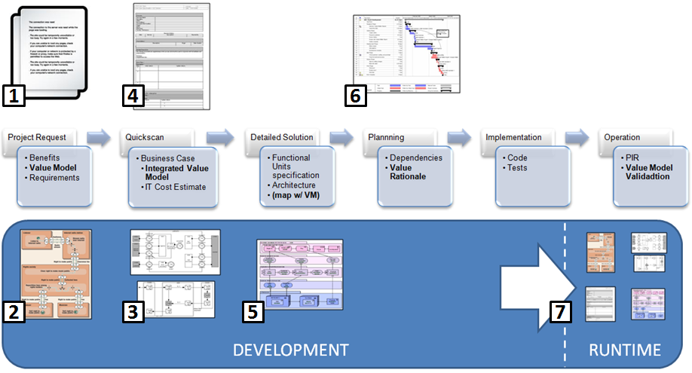
Practical Application
IT DM Process 2.0 – Value-oriented
Notes:
Leveraging the new deliverables produced we can now map the artifacts regarding value-orientation through the process, as represented in Figure 7. Particularly, each Project Request (1) entails a value model (2) that must be made explicit. This value model specifies the exchanges of value objects between stakeholders, representing expected benefits. The quickscan produces a high-level solution that honors the value model. The fact that the components of the value model are matched to ontological components, e.g. from a DEMO model (3), allows constructive estimates that complement the value model with the cost dimension. The result is a formal, integrated, problem/solution value model that provides structure to the business case (4). After investment appraisal, the detailed implementation models are produced (5). Following, implementation planning (6) can now be performed based on the project value proposals across the portfolio.
More importantly, the mentioned artifacts are aligned and represent a value proposal along the three perspectives – contribution, function and construction – and have significance during operation (7). This marks a significant difference from traditional business case approaches, which are used solely for decision making during early design stages. The value proposal can effectively be used during operation of the solution for justification of each component in the runtime environment and for change analysis.

Slide 33
Practical Application
Challenges and preliminary Results
Challenges
  The detail level attained by recursive application of the GSDP is quite high
  Forces the definition of value at design time
  No silver bullet: domain-specific design and construction principles are necessary
Input - improved problem elicitation
  Stakeholders, scoping and value proposal
Decision - Business Case clarity
  GO/NOGO and prioritization
Content - better input to Functional Analysis and following activities
  Tracing BC benefits to implementation support
Validation - Value Proposal at Post-Implementation Review
Notes:
19

Slide 34
Practical Application
Results
Evolution over 3 years
  Application of Benefits Management
Focus on Value
  Backog reduction
  Less project requests
  Increase in % project completion
  Project cancelling and termination with clear and consistent rationale
Notes:
The main quantitative improvements to the IT Demand process found over the three year period are summarized in Table 1. The IN column establishes the number of projects of whichever category that entered the process each year. The terminal states of the process, Cancelled and Implemented, come next and its sum equals the projects leaving the process, represented in the OUT column. Finally, d backlog refers to the backlog variation, or project flux through the IT DM process.
9% and 29% backlog reduction were achieved in the second and third years, respectively.

Slide 35
Practical Application
Results
Phase I
  Massive cancellation due to missing benefits specification and ageing
  Project backlog grew as there was a very large number of new projects
Phase II
  Mounted a large obstacle to project creation, which dropped by almost 50% in 2011 and kept the tendency for 2012
  The input to solution development process had a quality increase, resulting from better problem specification
  Business case clarity was increased
    Enhancing GO/NOGO decisions, prioritization criteria and scrutiny between peers
    Planning and priority volatility has been greatly reduced, leading to less suspensions
Phase III
  Not enough finished projects in the new process allow complete validation
  Interesting metrics would be, e.g., stakeholder identification gaps, the number of times the construction model is not compliant with the value model (differentiate incompleteness and violation), average number of alignment iterations, etc.
Notes:
The main quantitative improvements to the IT Demand process found over the three year period are summarized in Table 1. The IN column establishes the number of projects of whichever category that entered the process each year. The terminal states of the process, Cancelled and Implemented, come next and its sum equals the projects leaving the process, represented in the OUT column. Finally, d backlog refers to the backlog variation, or project flux through the IT DM process.
9% and 29% backlog reduction were achieved in the second and third years, respectively.

Slide 36
Practical Application
Results
Improvements in IT DM Process for Value-related concerns
  Increase of justified and mature project requests
  Improved specification of benefits and value generation mechanisms
  Project Appraisal based on IT DM inputs
  Stakeholder visibility and buy-in
  Prioritization based on known and systematic criteria
  Value models that can be checked at runtime
  Reduction of planning volatility
… without specialized tool support
  Current portfolio management tools, spreadsheets and process control mechanisms were used with minimum adjustments
Notes:
The main quantitative improvements to the IT Demand process found over the three year period are summarized in Table 1. The IN column establishes the number of projects of whichever category that entered the process each year. The terminal states of the process, Cancelled and Implemented, come next and its sum equals the projects leaving the process, represented in the OUT column. Finally, d backlog refers to the backlog variation, or project flux through the IT DM process.
9% and 29% backlog reduction were achieved in the second and third years, respectively.

Slide 37
Practical Application
Results – additional contribution
IT Value Management Maturity Model
Maturity increased from level 0 to 3 and is currently entering level 4
IT DM is now positioned to promoting B2B alignment while maintaining neutrality
Handling OPEX increases et al by making IT itself explicit as a business
Notes:
The main quantitative improvements to the IT Demand process found over the three year period are summarized in Table 1. The IN column establishes the number of projects of whichever category that entered the process each year. The terminal states of the process, Cancelled and Implemented, come next and its sum equals the projects leaving the process, represented in the OUT column. Finally, d backlog refers to the backlog variation, or project flux through the IT DM process.
9% and 29% backlog reduction were achieved in the second and third years, respectively.

Slide 38
Contributions & conclusion
Ontology for integrating e3Value and DEMO
  Differentiating Construction, Function, Value and Purpose
  Integrating the Teleological and Ontological perspectives
  VM: value coherence, economic reciprocity, value object enforcement on p-facts
  EE: transactional context, construction support
Method – explicitating internal Value Chains
  Addressing purpose recursively – use e3Value from a teleological perspective
VoSDP organization specification
  Towards formalizing solution development process & rationale
EE and Value Modeling are compatible and complementary
  → Contribute to formally increasing business and IT alignment

Slide 39
Questions?
Thank You!
jpombinho@gmail.com
linkedin/jpombinho
Notes:
39

Slide 40
- Support Slides -

Slide 41
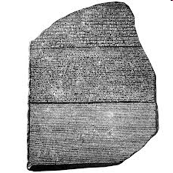


Approach
Mindset
Speaking the same language
  “Value is the most relevant negotiation common ground between business and IT”” [1]
Having a common referential
  Value orientation over the full lifecycle
Promoting Alignment
  Coherency between models
[1] Cameron, B., S. Leaver, and B. Worthington, Value-Based Communication Boosts Business' Perception Of IT. 2009, Forrester Research

Slide 42
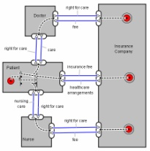
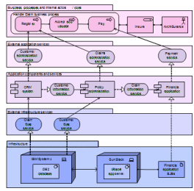

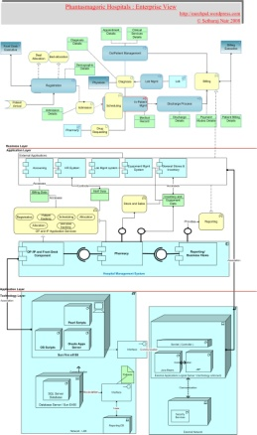
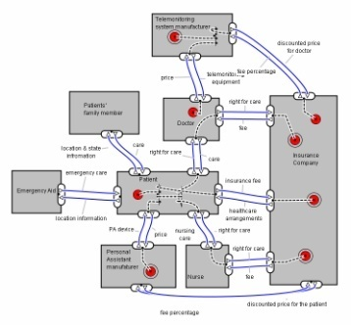
Application in Practice
Business/IT Alignment?
Value Model Project A
EA Model
Project A
Business/Business alignment
Global Value Model
Global EA Model

Slide 43
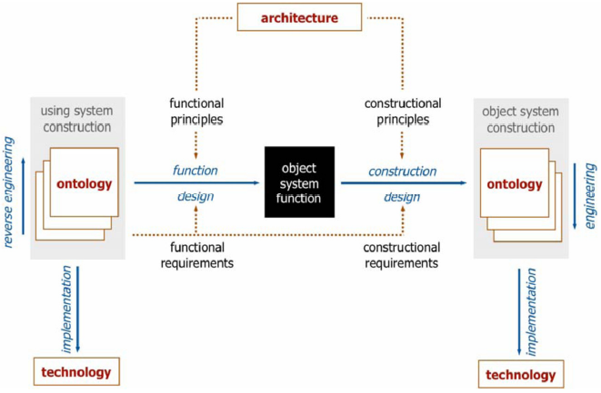
Generic System Development Process
Overview

Slide 44
Solution Proposal
Contribution Perspective
Construction
Function
Contribution
Alignment

Slide 45
Related Work Analysis
Archimate, Business Modeling and Requirements Engineering
Archimate’s business layer relates to all three B-I-D layers of DEMO, without clear distinction
  Application and technology layers are implementation-level
  Value - measure of appreciation of Business Service by Business Actor
    Value concept is subordinate to the Business Service
    Limits exploring multiplicity between Value and Business Service
    No value chain structure, i.e., relation between value nodes
Business Modeling approach (BMC)
  Uses concepts found/accepted on the business stakeholders UoD
  Semi-formal ontology that can be translated with other concepts
  Does not model constructional perspective
GORE provide structure and traceability but no model the origin of the goals, their why dimension, in a structured way
  Representing motivation ≠ Business Engineering
Notes:
45
REFs

Slide 46
Solution Proposal - Ontology
DEMO Ontology Summary
Act - An atomic activity performed by an actor, resulting in the creation of a factum. Two kinds of acts are distinguished: coordination acts and production acts
Actor - is a subject in fulfilling an Actor Role
Actor Role - Unit of authority, responsibility and competence
Competence - The ability of a subject to perform a particular type of production act and the corresponding coordination acts, i.e., the ability to be the executor of a transaction type
Fact – An elementary state of affairs in a world
Production Act - The act in a transaction by which the executor creates the production factum;
Production Fact - An elementary state of affairs in the production world
Transaction – A sequence of acts that is a path through the complete transaction pattern, minimally comprising the basic pattern;
World - The concept of World is crucial to distinguish separate sets of System. System would not be enough to provide this distinction since there can be many interacting systems is a particular World. It represents the modeling UoD.

Slide 47
Solution Proposal - Ontology e3Value Ontology Summary
Market Segment – Groups value interfaces of actors which equally value objects
Actor - An actor is perceived by his/her environment as an economically independent entity. It can be an Elementary Actor or a Composite Actor
Value Object - Actors exchange value objects. A value object is a service (SD-Logic) which is of economic value for at least one of the actors involved in a value model
Value Port - It belongs to an actor, and allows it to request value objects to the others actors. It is characterized by its direction (“in” or “out”); in the implementation
Value Exchange - A value exchange is used to connect two value ports. It represents one or more potential trades of value object instances between value ports.
Value Offering - A value offering models what an actor offers to, or requests from, his environment. An offering is a set of equally directed value ports exchanging value objects
Value Interface - It belongs to an actor, and usually groups one “ingoing” value port, and one “outgoing” value port
Value Transaction – A group of Value Exchanges that should occur simultaneously. It is interesting in modeling alternative scenarios, since different Value Transactions can happen as variations of a single Value Interface from one Actor’s perspective and towards different Actors.

Slide 48
Introduction and Motivation
Practical Background
IT Demand Management @ ZON Multimedia
  Portugal’s largest Cable Operator (TV, NET, Voice and Mobile)
  30 business areas - Heterogeneous problem/opportunity descriptions
1200+ new project requests / year + 400 backlog; >1/day/person
No tool support, “no time” to model… decisions must be made!
The platforms (BSS) include:
Customer Relationship Mgmt(CRM)
Enterprise Application Integration (EAI)
Billing
Enterprise Resource Planning (ERP)
Field-Force
Portals
Comissioning
Mediation
Provisioning
Notes:
1 - Hinge between business and IT – establish problem/opportunity, evaluate and propose solutions, plan and check
Business Case

Slide 49
Introduction and Motivation
Practical Background – Main activities and Value driver
Specify Problem – clearly establishing the problem to be addressed and collecting additional information about it in order to link individual problem parts to purpose and value
Quickscan + Business Case Approval - developing solution scenarios. Can change scope or even solve problem without the need of IT project
Detailed Solution –specification of FUs and validation of QS assumptions
Prioritization and Planning - establishing a relative priority over all the active projects and planning with the Delivery area vs. capacity
Post-Implementation Review (PIR) - after the delivery of the project, assist in verifying if the proposed value is effectively transferred by using the solution
Notes:
1 - Hinge between business and IT – establish problem/opportunity, evaluate and propose solutions, plan and check
Business Case

